Slide 1
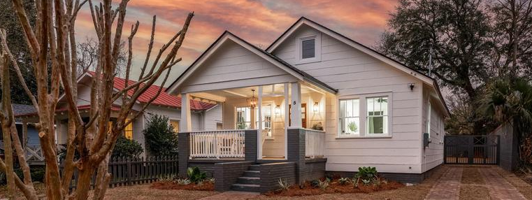
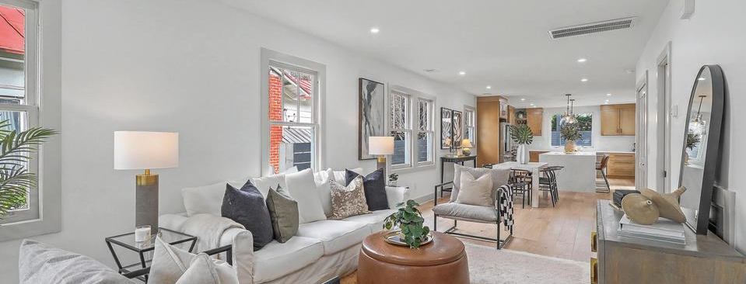
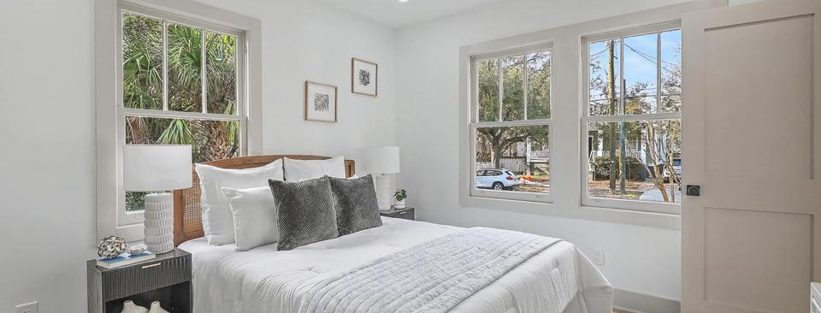

Fully Renovated in Wagener Terrace
JUS
9714 ROSEBERRY STREE
MOTIVATED SELLER!
/
7
1/
ii
Upcoming Open Houses:
Wed from 2-6 | Thur from 12-3 | Fri from 4:6:30 | Sat from 10-1
5 Saint Margaret Street
Wagener Terrace | Charleston, SC 29403 | MLS# 26005880 | $1,395,000
�
$1,395,000
3 BED
3½ BATH
1,570 SQ FT
0.11 ACRES
A rare, true ground-up reconstruction in the heart of Wagener Terrace, where timeless Charleston character meets the strength and sophistication of modern construction. Taken down to the dirt and studs and rebuilt with intention, this residence offers the confidence of essentially new construction, including a new foundation, electrical, plumbing including sewer line replaced to the street, HVAC with ductwork, roof, and more. No detail was overlooked. The original windows and siding were preserved to maintain architectural integrity and meticulously rebuilt by skilled craftsmen, blending historic authenticity with modern performance. Inside, wide-plank French oak flooring runs throughout, complemented by custom tile work in each bathroom for a refined, cohesive finish. The main level features two private ensuite bedrooms, a stylish powder room, dedicated laundry, and open living and dining spaces filled with natural light. The kitchen serves as the showpiece, anchored by a dramatic 10-foot waterfall quartz island, custom cabinetry, and a premium Z-Line stainless appliance suite including a 36" gas range, refrigerator, built-in microwave, and dishwasher. A large undermount sink overlooks the private backyard, creating seamless indoor-outdoor flow. Upstairs, a creatively designed third bedroom and full bath are paired with versatile loft space ideal for a home office, media lounge, or flex retreat.
Outdoor spaces are equally curated. A new brick driveway provides off-street parking, while the fully fenced yard offers exceptional privacy, a custom hardscape paver patio with built-in firepit, deck, ambient lighting, and a custom-built onsite storage shed with power. The lot configuration also allows space for a future pool, offering flexibility seldom found in this location. Just moments from Hampton Park, neighborhood green spaces, and celebrated local dining, this comprehensive, no-shortcuts rebuild delivers enduring quality, thoughtful craftsmanship, and modern infrastructure, all within one of Charleston's most established and sought after neighborhoods.
Scott Baskin
THE SCOTT BASKIN TEAM
843-324-4139
scott@explorecharlestonrealestate.com
SCOTT BASKIN TEAM

