Slide 1
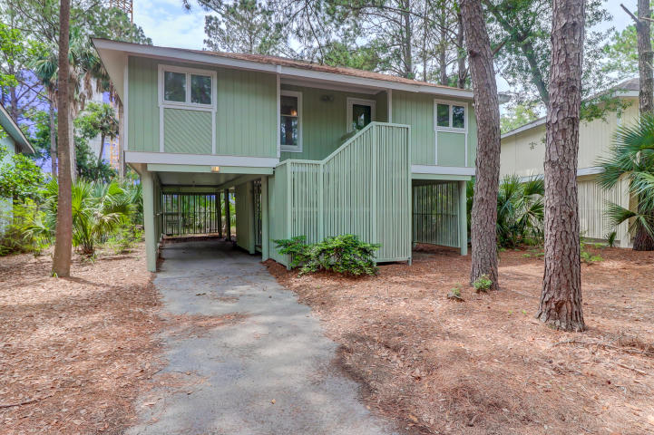
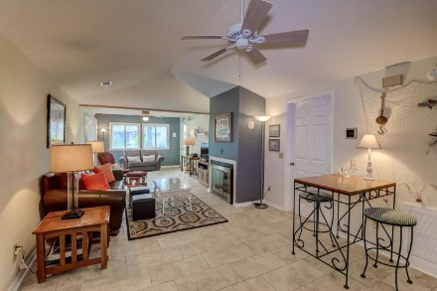
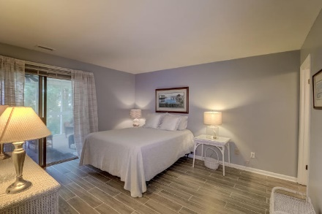
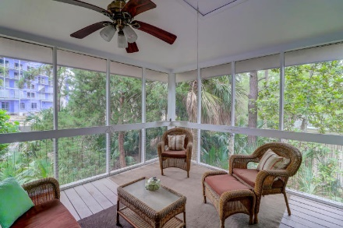
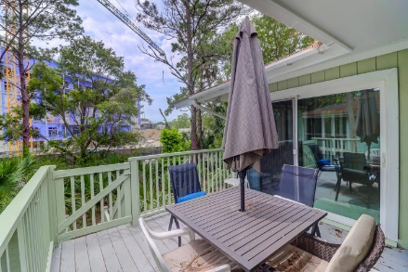


5 Twin Oaks Lane
Wild Dunes | Isle of Palms, SC 29451 | MLS# 20013997 | $629,000
3 Bed/2 Bath IOP Cottage
Great Location
MOTIVATED SELLER!! REDUCED 150K!
Wonderful Island cottage is close to the beach and convenient to many resort amenities.
This 3 bedroom 2 bath home is all on one level and has been well maintained with many recent updates such as paint, counter tops and flooring.
Enjoy the private deck and screened porch for the lazy days on the Island.
Darlene Smith
Office - (843) 886-8110
Mobile - (843) 696-7824
darlenesmith@carolinaone.com
DarleneSmithTeam.com
Carolina One Real Estate
1503 Palm Blvd Ste
Isle of Palms, SC 29451

