Slide 1
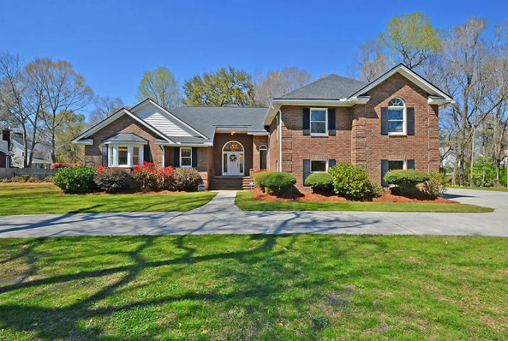
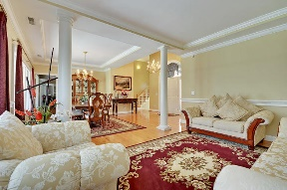
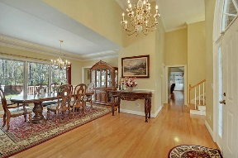
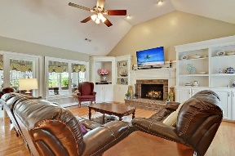
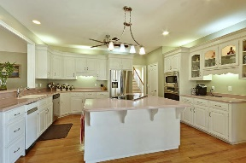
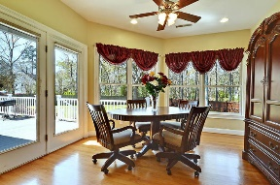
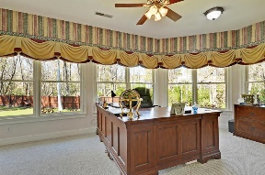
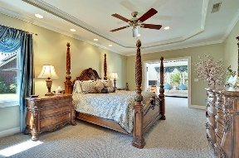
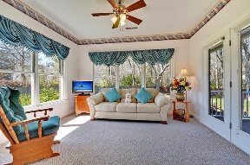
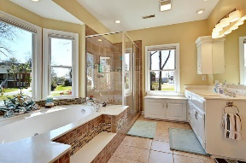
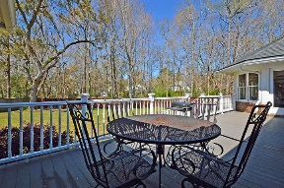
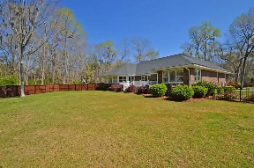
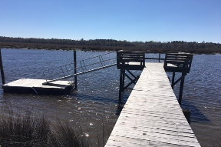


Community Dock On Ashley River
6004 Mansfield Blvd
Bakers Landing
North Charleston, SC 29418
MLS# 18007170
$499,900
4 Bedrooms | 2½ Baths | 3,460 sf
This beautiful, brick, custom built home is in IMMACULATE, move-in condition! With low HOA fees and a community dock on the Ashley River as well as convenient location to the Airport, Boeing, Bosch, Mercedes, shopping and restaurants, this home will not last long!
The first floor offers beautiful hardwood floors, a kitchen with island, stainless steel appliances and custom cabinetry which is open to the cozy family room with vaulted ceilings and fireplace. In addition to the family room, buyers will find an office / sunroom, formal dining room and living room as well as an eat-in kitchen area.
The master bedroom is on the 1st floor and offers an attached bonus room / office / sitting area as well as a spectacular master bath with jetted tub, two walk in closets, tile shower and two sinks. The home also features a 3 car garage and circular driveway as well as a large fenced-in yard and back deck. Upstairs buyers will find 3 bedrooms all with walk-in closets and a full bathroom. The roof was replaced in 2015, HVAC in 2013 and this home should be very low maintenance!
This home is a MUST SEE!
Larry & Kathy Mazalatis
Larry Cell 843-693-0529
Kathy Cell 843-693-0159
Office 843-871-9133
AGENTOWNED PREMIERE GROUP | 1800 TROLLEY RD | SUMMERVILLE, SC 29485

