Slide 1
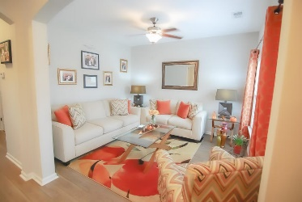
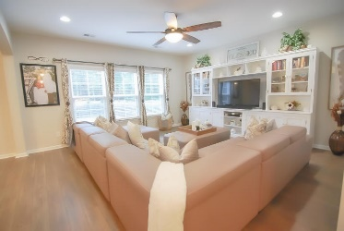
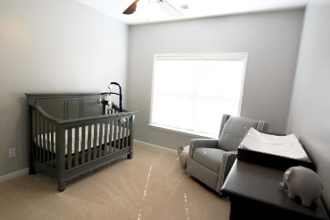
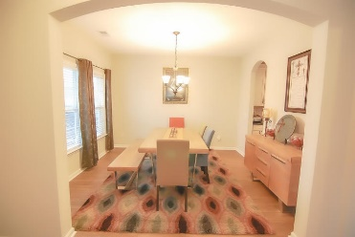
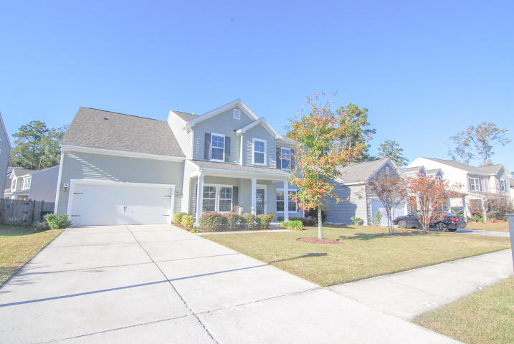
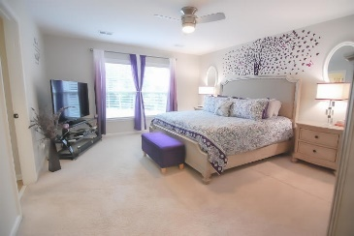
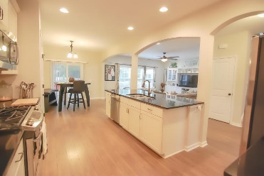
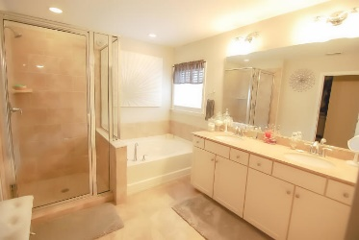
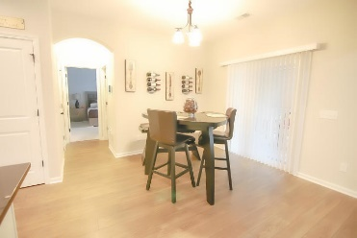
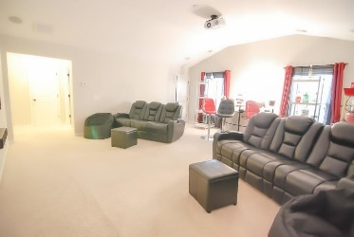
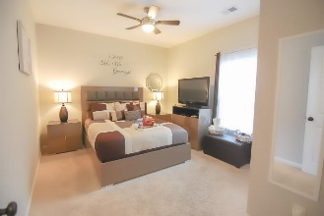
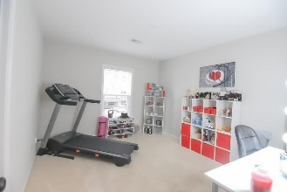
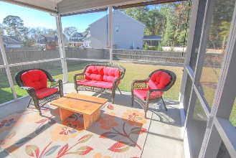
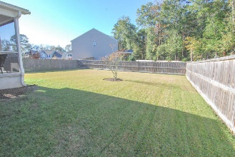
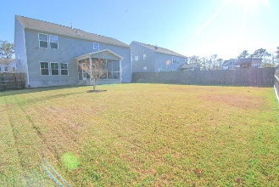



6008 Begonia Way
Tanner Plantation
Hanahan, SC 29410
MLS# 19032771 | $394,900
Tanner Plantation
Move-in Ready
Just Listed!
Under $280,000
LIKE NEW but BETTER with just under 3,000 sqft, 4 bedrooms, 3 full bathrooms, PLUS a huge bonus room with walk-in closet, first floor guest suite, living room/office, dining room, screen porch, fenced yard, two-car garage and every upgrade you could want including: *Laminate Hardwood Flooring Throughout the First Floor (Less Guest Suite) *Granite Countertops *Upgraded White Cabinets with Crown Molding and Glass Fronts *Gourmet Stainless Steel Appliance Package *Architectural Roof *Deluxe Master Bathroom with Double Sinks, Oversized Shower and Tub *Ceramic Tile in Baths and Laundry *Irrigation *Pre-Wires Throughout *Upgraded Fixtures and Lighting *Community Pool *Community Playpark *Awesome Shopping a Short Walk Away *Top Rated Schools ***ALL FURNITURE AND ACCESSORIES ARE NEGOTIABLE!!***
Beth Moore
M (843) 532-4892
bmoore@carolinaone.com
Meg H. Kandik
M (843) 814-5137 | O (843) 603-4659
Meg@HolyCityRE.com | www.holycityre.com
Bennett Construction & Realty | 792 Folly Rd | Charleston, SC 29412

