Slide 1

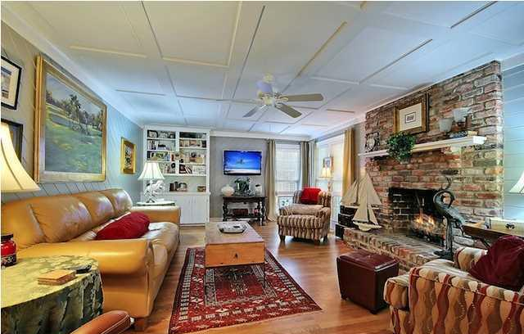
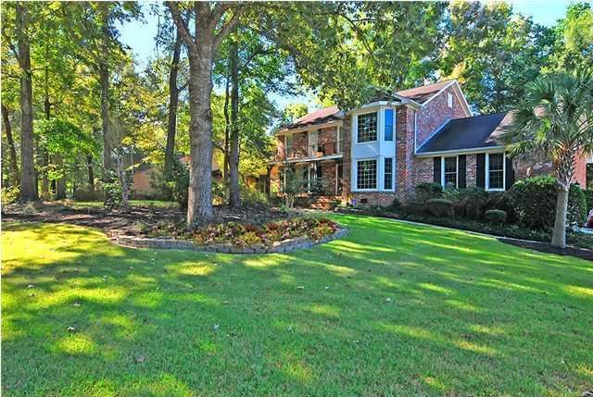
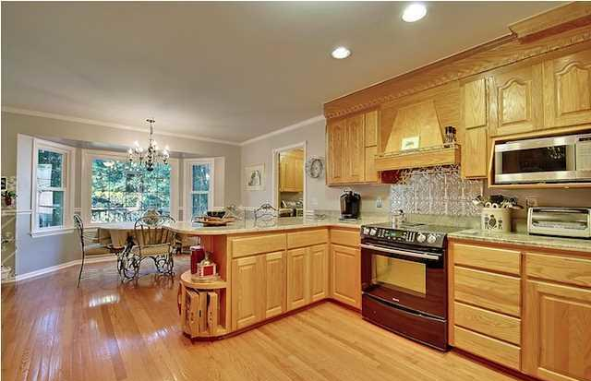
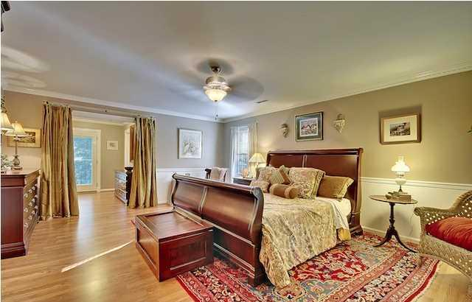
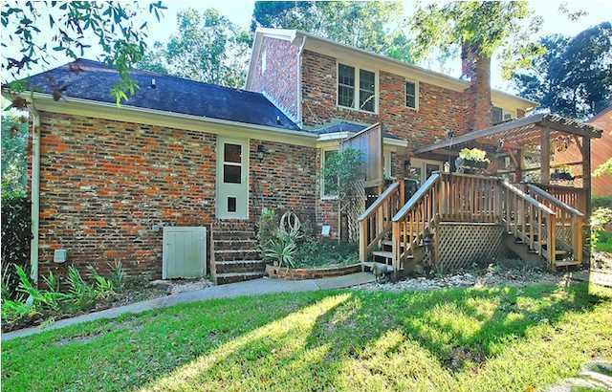
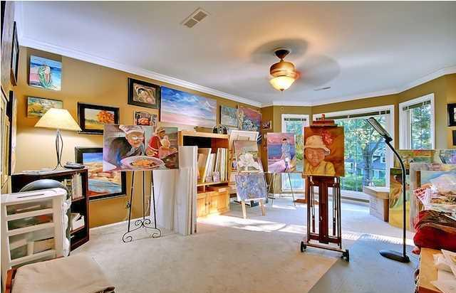
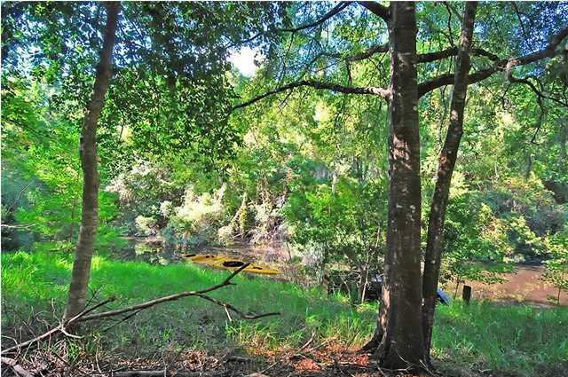
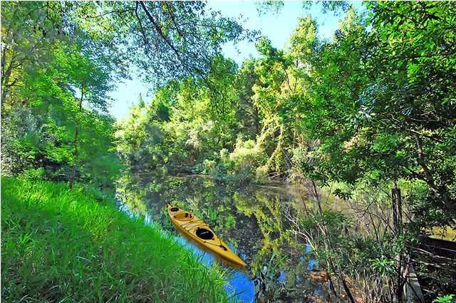

Unbelievably Low Price For An Executive Waterfront Home!
600 Mayfield Street
Ashborough ~ Summerville
MLS# 17014697 ~ $359,900
4 Bedrooms ~ 2½ Bathrooms
Turn-key, custom-built Charleston Brick home with sleek bathrooms and brand new HVAC systems on lushly landscaped private three-quarters of an acre lot with mature trees buffered by a tidal creek leading directly to the Ashley River. Make your dreams a reality by owning this one-of-a kind home. When we say "one of a kind" home what we are talking about is a home loaded with custom upgrades including: stately slate flooring in the foyer, majestic crown molding throughout the home, an exquisite coffered ceiling in the living room, Charleston brick over-sized fire place, custom oak walk-in closet in the Master Bedroom, specially-made slide-out cabinets and two "lazy Susans" for maximum culinary and storage efficiency in your chef's kitchen along with granite countertops and a Jen Aire "downdraft" smooth top range, dynamic dentil molding and picture frame molding below the chair railing in the formal dining room, raised paneling in the foyer and stairwell, new lighting and ceiling fans throughout, exquisite Travertine tile in the bathrooms, over-sized 2-car garage with two automatic garage openers, leaf-guard gutters, security system, and fully wired yard for dog electric fence. Storage space is abundant in this home. The benefits of 600 Mayfield don't stop at the house. The neighbors in this quiet subdivision exude equal warmth. The community includes amenities such as a tennis court, walk/jog nature trails, a play park, an exclusive club house and a gleaming community pool. Award-winning schools further support the value of your home and the future of your children. This new life lived at the highest level can all be YOURS for the BEST VALUE IN SUMMERVILLE! This home is priced low and firm for your pre-approved buyer who wants a great deal on the nicest house in Summerville. Hurry, it won't last long at this low, low price.
Chip Walsh
843-822-4663
chipwalsh@gmail.com
The Boulevard Company, LLC
35 Broad Street
Charleston, SC 29401
www.TeamWalshRealEstate.com

