Slide 1
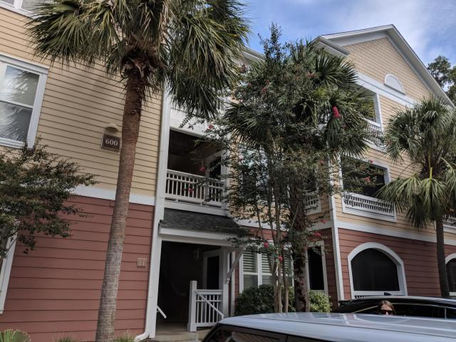
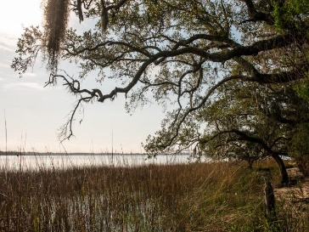
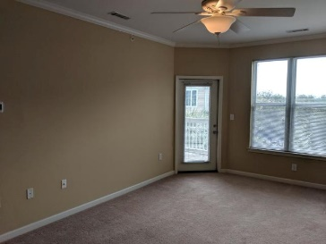
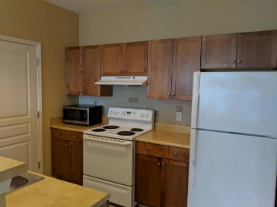
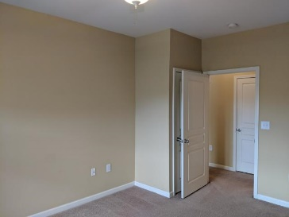
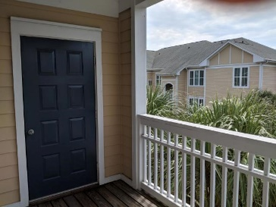
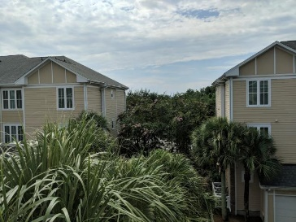


600 Bucksley Ln Lane #304
254 Seven Farms Drive | Charleston, SC 29492
MLS# 19023635 | $157,500
Top Floor Condo with GARAGE in the Heart of Daniel Island!
1Bed/1bath Top Floor Unit
Bright and Open Floor Plan
Separate Laundry Room
Washer and Dryer Convey
Generous Size Bathroom
Spacious Walk-In Master Closet
Private Balcony w/ Outside Storage
Neighborhood Pool
Walking and Jogging Trails
Heart of Daniel Island
Convenient to Schools, Shopping, Restaurants, Library
Easy Access to 526 and Charleston Airport, Boeing, Downtown Charleston
Peggy Leete
Office - (843) 884-1622
Cell - (843) 532-7923
pleete@carolinaone.com
www.peggyleetehomes.com
Carolina One Real Estate
628 Long Point Rd
Mt Pleasant, SC 29464

