Slide 1
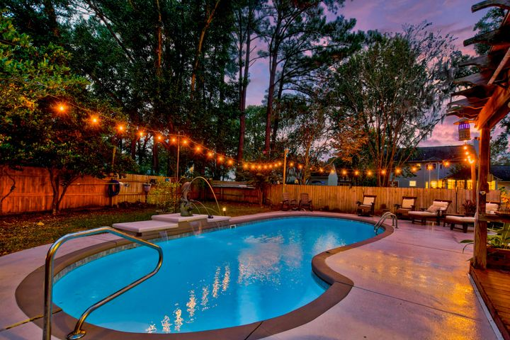
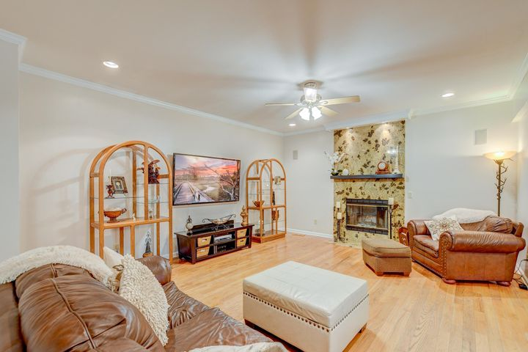
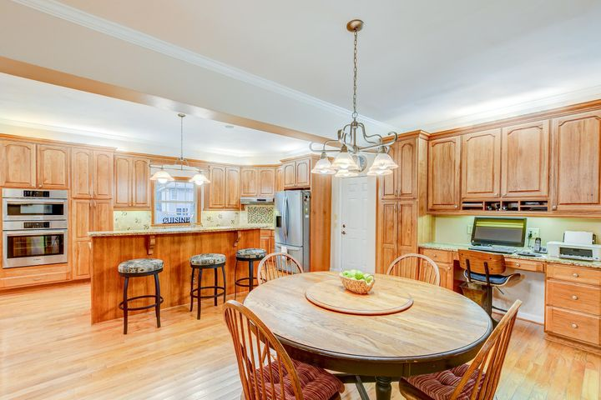


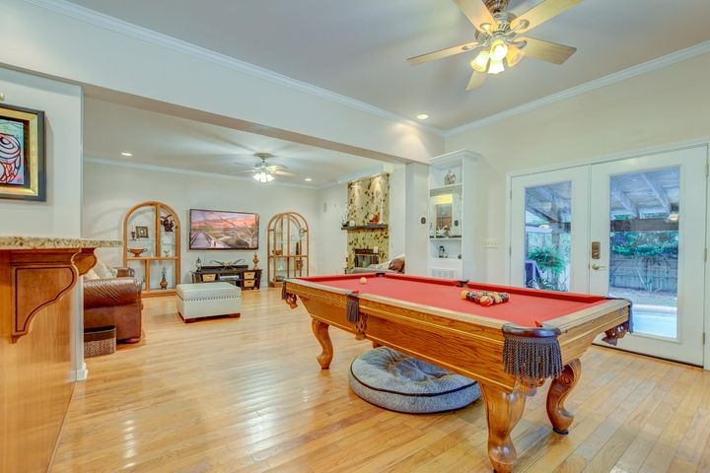

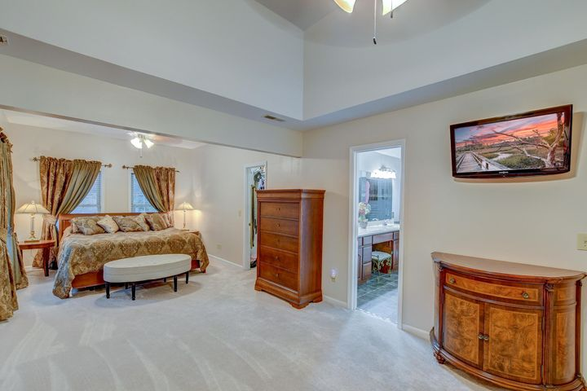
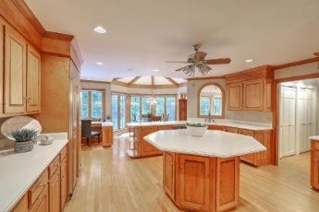

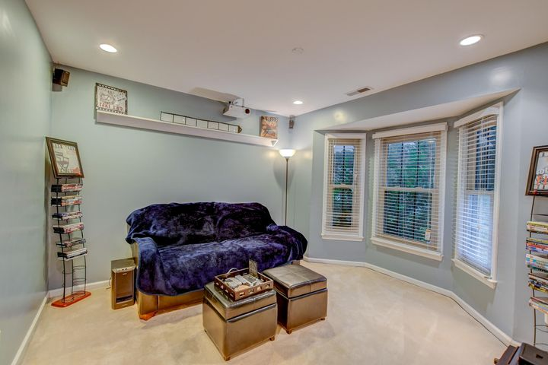


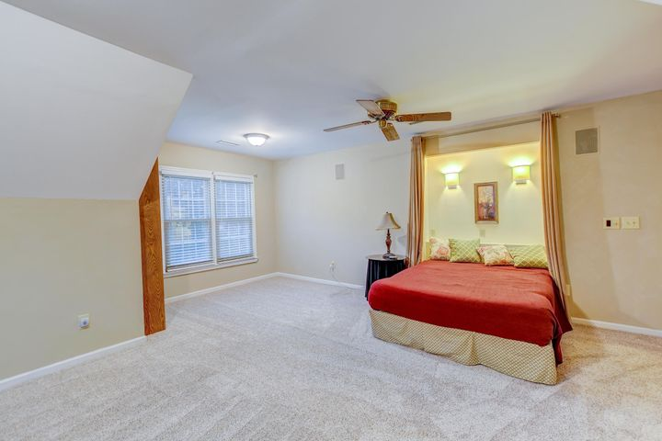

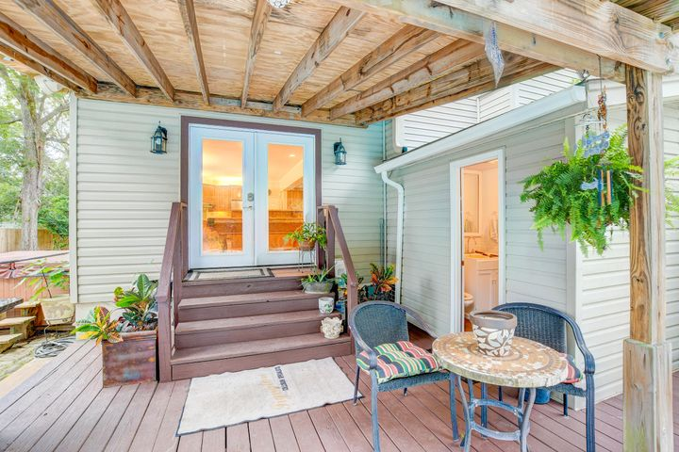
Parkshore Marshfront
Just Listed!
600 Salty Alley
Hidden Cove ~ Mount Pleasant, SC 29464 ~ MLS# 20031499 ~ $735,000
Located on a spacious lot in the convenient Hidden Cove community in Mt Pleasant, this gorgeous home boasts a stunning swimming pool and backyard oasis! A well-manicured and beautifully landscaped front yard greet you as you approach this lovely home. Step inside the two-story foyer and you'll immediately notice great details including wood flooring, crown molding, and great natural light. To the right of the foyer is a study/formal living room with glass French doors and bay windows. Pass through the hallway to the open gathering room/dining/kitchen space. The dining room has a built-in desk and shelving to make working from home a breeze, and the family room has a cozy fireplace. You will never run low on workspace in the massive kitchen! The kitchen includes granite countertops, a decorative backsplash, plenty of solid KraftMade Hickory Wood cabinets, stainless steel appliances, and an island with breakfast bar. Just off the family room and kitchen is a large sunroom with built-in shelves and French doors leading to the backyard.The incredible fenced-in backyard will take your breath away with a 16,000 gallon in-ground swimming pool with a dolphin water feature, a hot tub, and a deck with a covered pergola and grilling station with a gas connection. Head upstairs to find four generously-sized bedrooms, all with lots of storage space, and a shared bathroom with soft-close premium cabinets and elegant tile. The massive owner's suite has new carpet and includes a sitting room with a tray ceiling, a 14 foot walk-in closet with built-in shoe racks, and the en-suite has a vaulted ceiling, built-in drawers, a dual vanity with a seating area in the center, a tiled step-in shower, and a sauna with a TV. This home has lots of space, and lots of storage both inside and out. Hidden Cove has great amenities including tennis courts, a swimming pool, a dock, and a boat ramp. This location is just minutes from I-526, shopping, restaurants, area beaches, and downtown Charleston.
Additional features include:
Stereo system wiring throughout most of the house
Sauna
Complete gutter system
Encapsulated crawlspace
Termite bond
Rinnai tankless water heater
Spray foam insulation
Book your showing today!
David Clausen | 336-682-5022 | dclausen@mattoneillteam.com
Michaela Kulyk | 843-442-9506 | mkulyk@mattoneillteam.com

