Slide 1
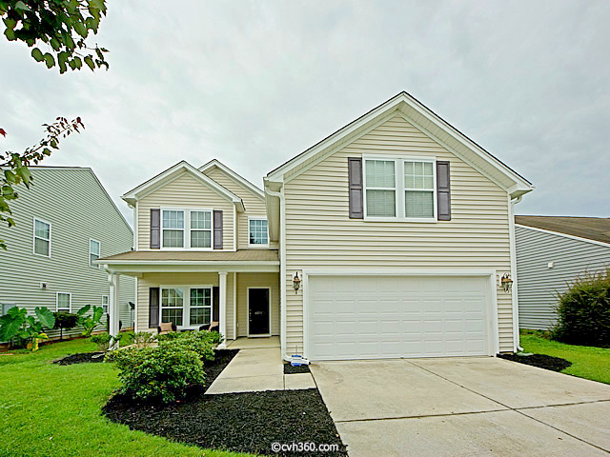
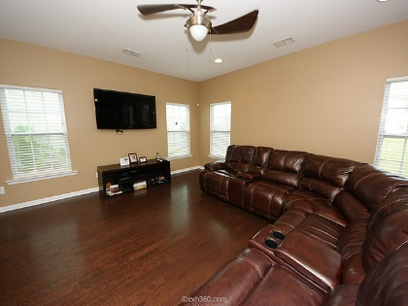
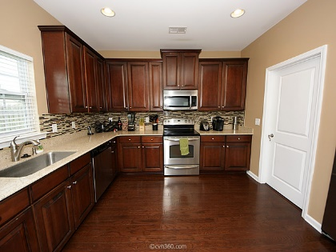
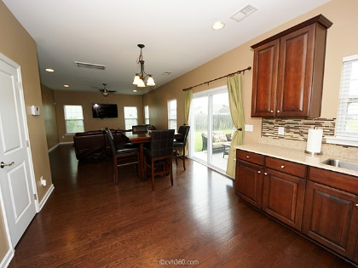
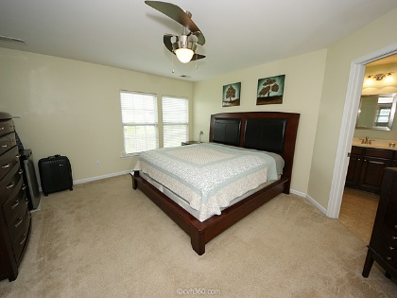
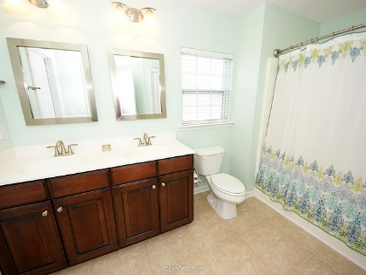
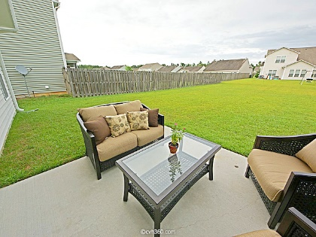
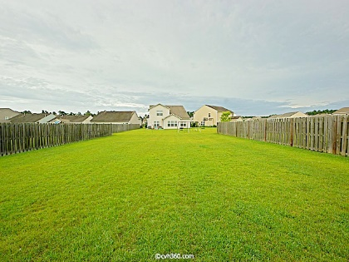


Open House Sunday, May 1st, 2-4pm
6011 Snead Lane
Myers Mill · Summerville MLS# 16003877 · $212,400
This immaculate, well cared for 1 owner home is ready for new owners! This home shows like a model and comes with over 2200 square feet of open living space. There are 4 bedrooms, 2.5 full baths, formal dining room/office, eat in kitchen, large open modern kitchen with adjoining family room. The first thing you will notice upon entering the home are the beautiful hardwood floors throughout the first floor. The formal dining room is currently being used as an office space but has an abundance of natural light with the 3 transom windows. The chef’s delight, gourmet kitchen has been upgraded to include 42” cabinets, granite counter tops, tile backsplash and stainless steel appliance to include stove, microwave, dishwasher and refrigerator. All bedrooms to include the master are located on the 2nd floor. The well-appointed master suite has been freshly painted with walk in closet and in suite master bath. The master bath has double vanity sinks, large shower/tub combo and linen closet. The 4th bedrooms is also considered a FROG, and is very spacious. Additional features that help accentuate this beautiful home include: oversized back yard, 2 car garage with electric door opener, entire home has been painted within the last year, upgraded lighting and plumbing fixtures, upgraded new vanity sink in powder room, newly added back tile backsplash in kitchen, large laundry room from garage for washer/dryer, hardwoods throughout first floor. Myers Mill is a great neighborhood located in Dorchester County School district and has a beautiful pool and play area for the kids.
Bob Chambers, ABR
Office (843) 849-3005 · Mobile (843) 296-2546
bobchambers@infinity-realty.com
www.soldoncharleston.com
Infinity Realty | 1250 Fairmont Ave | Mt. Pleasant, SC 29464

