Slide 1
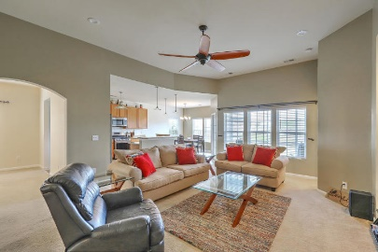
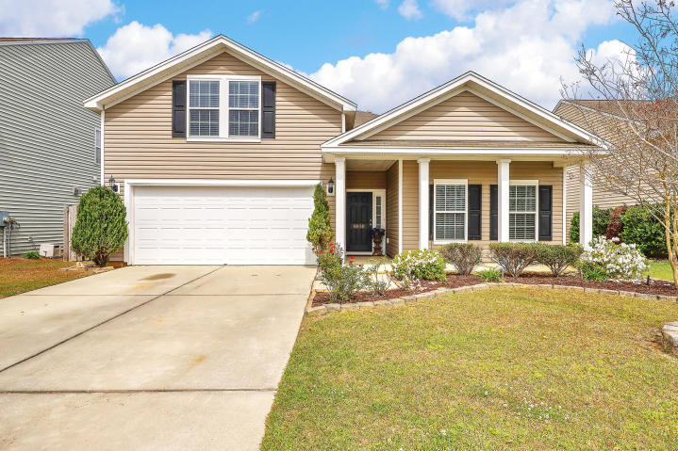
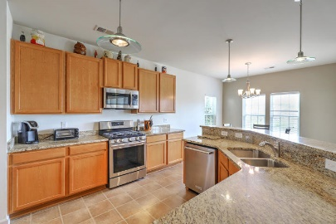
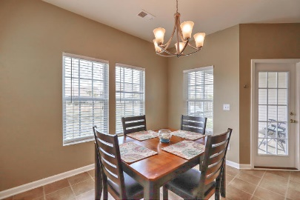
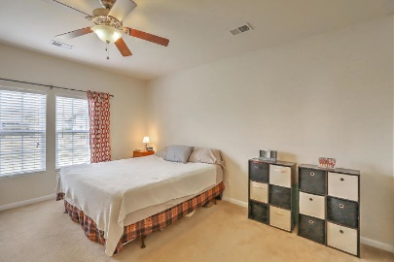
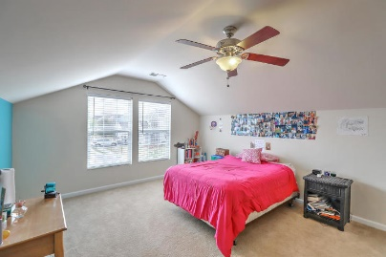
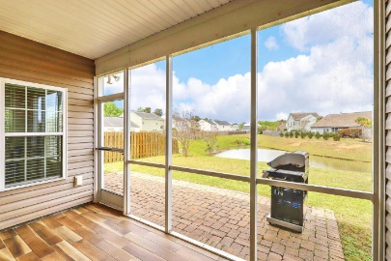
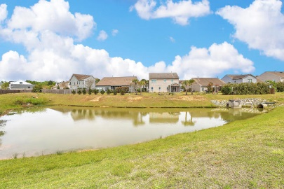


6018 Snead Lane
Myers Mill | Summerville, SC 29483 | MLS# 19009466 | $250,000
Just Listed!
Open House April 6^{th ~} 1-4pm
Welcome home to easy living in this spacious 1.5 story, open concept, ranch styled home. You will love how this floor plan flows from the moment you step inside. You are greeted by a foyer with two bedrooms and a full bathroom at the front of the home, garage access and laundry room are on the left. Proceed through the arched doorway where you will see the formal dining room to your left and the open great room in front of you that offers plenty of space for large furniture. There is even a bump out that is perfect for an entertainment center and large screen TV. The kitchen is a cook's dream offering all stainless steel appliances including a GAS RANGE, granite counters, gorgeous pendant lights, loads of cabinet space and a breakfast bar. The informal eat-in area is light and bright with a French door leading out to the nicely sized screen porch with beautiful tiled floors overlooking the pond in back. The spacious master bedroom suite, which also looks out at the pond, offers great wall space for furniture placement. Retreat to the master bathroom for some relaxation in the garden tub or separate shower. Single vanity allows for plenty of counter space along with an added glass shelf. Large walk-in closet is well designed. Head upstairs to the large bonus room which can be used as a 4th bedroom, man cave, craft room, playroom or den. The options are endless! Backyard has a paver patio off of the screened porch with additional green space and is mostly fenced but can easily be finished by connecting to the neighbor's fence on each side. There are also access gates on both sides of the home leading to the backyard. Seller's are offering a one-year home warranty and termite bond.
Beth Mandell
M 843-900-1296 | O 843-871-2121
bmandell@century21properties.com
www.bestcarolinahomedeals.com
Century 21 Properties Plus of Summerville | 118 W Richardson Ave | Summerville, SC 29483

