Slide 1

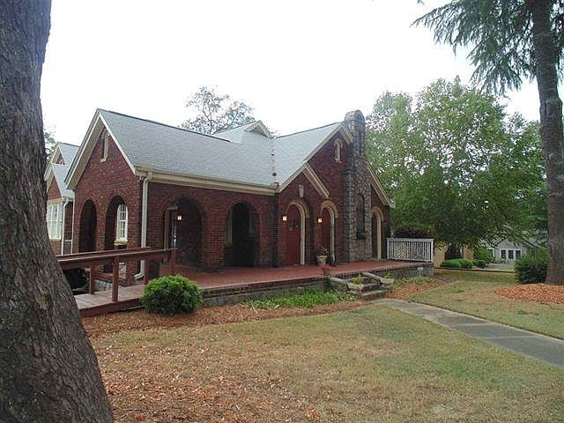
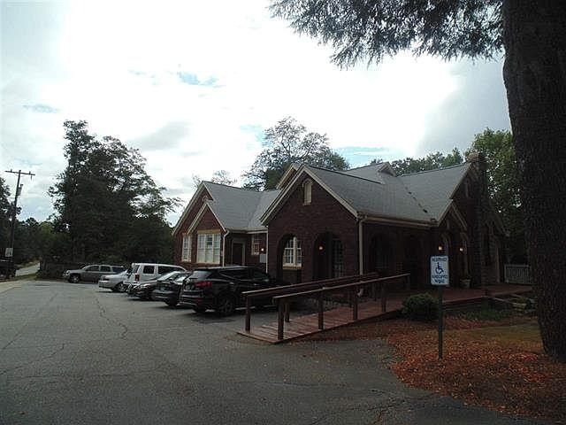
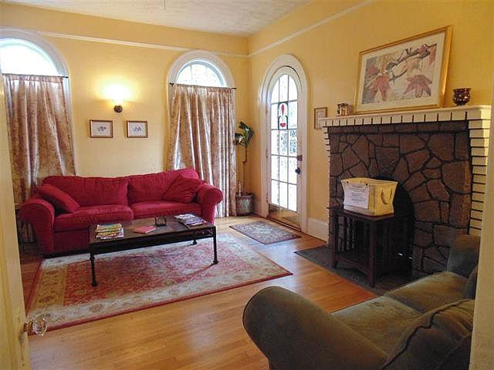
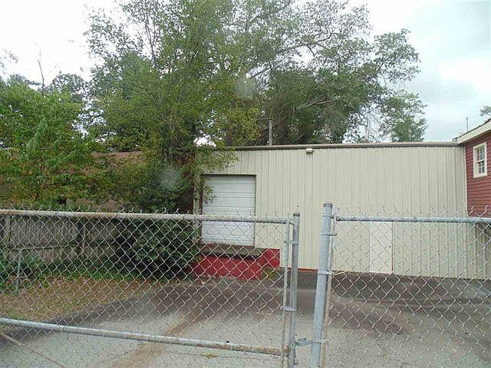
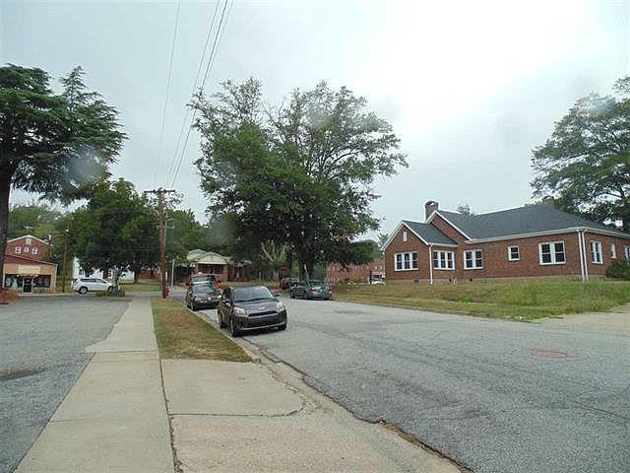
Commercial Office Building 9.9% Cap Rate
Amoroso Real Estate Group, LLC
Office: (864) 606-4968
Cell: (864) 316-5440
theamoregroup@yahoo.com
601 W Main St
Spartanburg, SC 29301
Commercial office building with 7 offices and 2 reception areas plus a 2496 square foot attached warehouse with loading dock. All 7 offices are currently rented but could make room for an owner occupant wanting office space. High daily traffic count and within minutes of downtown Spartanburg and the new hotel.
MLS ID: | #238173
Square Feet: | 3,327
Rate: | $105/sqft
Price: | $349,900
Lot Size | 0.34 acres
Built: | 1922

