Slide 1
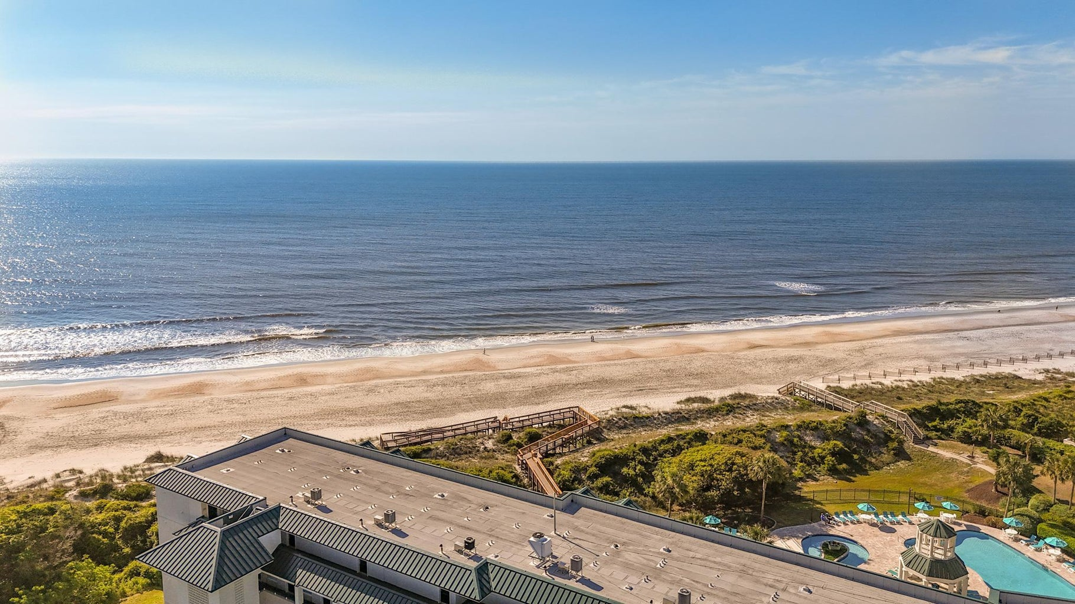

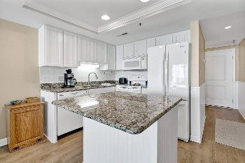
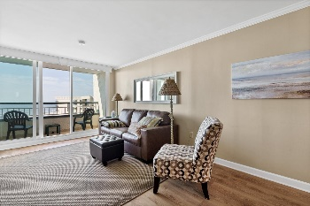
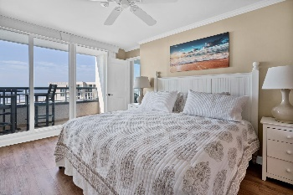
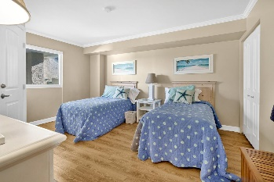
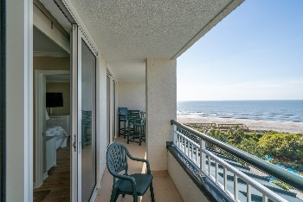

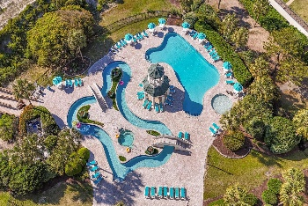
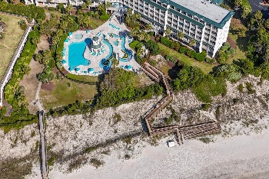
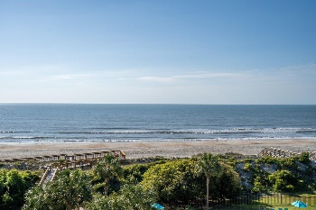
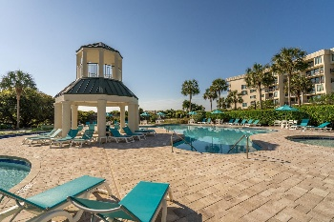
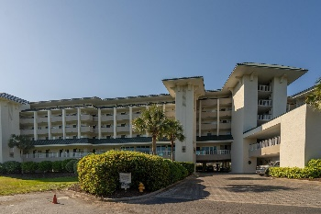
Joe Stalvey
843-460-2850
josephstalvey@gmail.com
Oceanfront
Price Reduced
601 Retreat Beach Circle 508
Pawleys Island, SC 29585 | MLS# 2409824 | $650,000
Quiet sea breezes await you in your Oceanfront top (5th) floor home.
This 2 bedroom 2 bath home is fully equipped with newer LVP throughout, Newer full kitchen, washer and dryer, spectacular ocean views and birds-eye view of the pool and lazy-river.
Home comes furnished “AS IS”. No rental history.
Current Owners did not rent. Move in ready.
The Charleston Real Estate Café | 672 Marina Dr Suite 110 | Charleston, SC 29492

