Slide 1
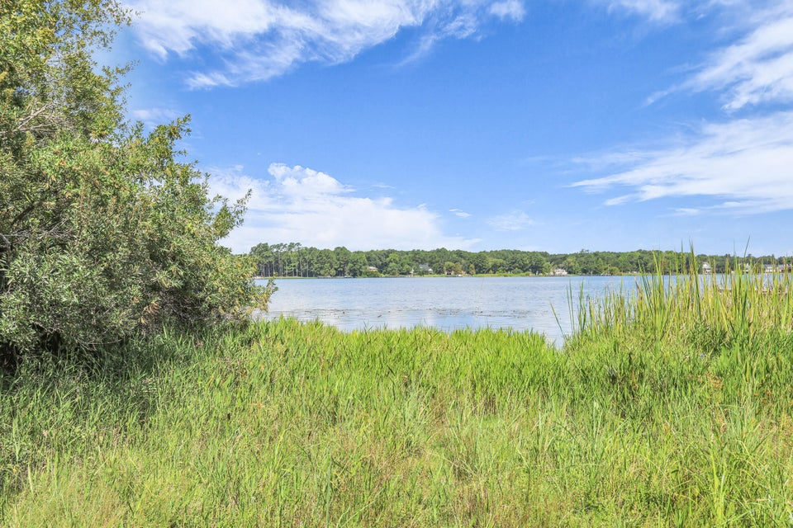
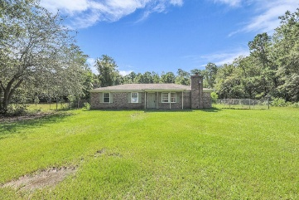
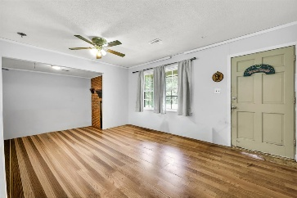
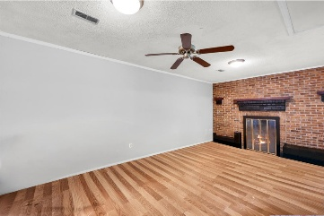
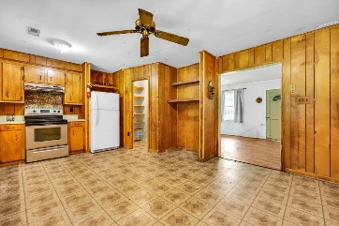
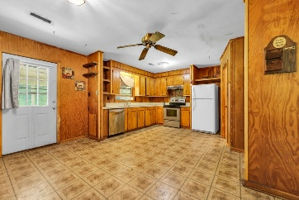
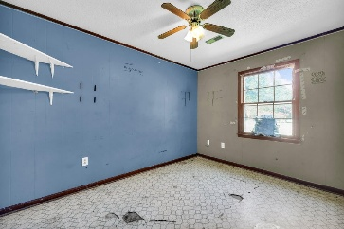
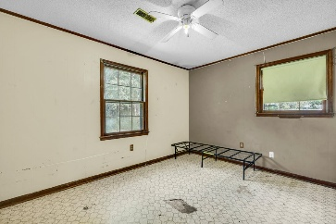
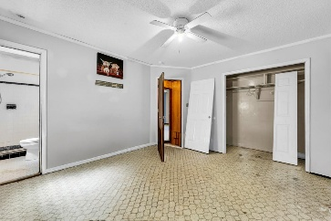
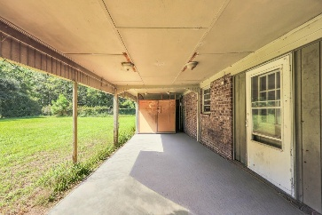
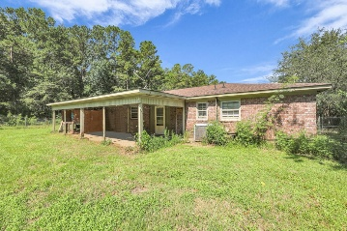



Handyman Special With Views of Lake Moultrie
601 Levee Drive
Thornley Forest I
Moncks Corner, SC 29461
MLS# 25022690
$300,000
3 Beds | 2 Baths | 1,512 SF
Welcome to 601 Levee Drive—an all-brick ranch with 3 bedrooms and 2 baths, offering solid bones and tons of potential for a handyman, investor, or flip. The layout is classic and functional, the lot sits across from Lake Moultrie, and the location puts you moments from boating, fishing, and Lowcountry outdoor living. The home needs work and is being sold as-is or owner may be willing to get work done, presenting a great opportunity to add value and make it your own.
This property is part of a lake community with a $500/year HOA that covers neighborhood security. It is also on a land lease with approximately 30 years remaining. Around Lake Moultrie, many shoreline and near-shore homes sit on land owned by the utility and leased long-term to homeowners; the structure is privately owned, while the land is held under a transferable lease. The upside is access to a lake area at a low entry price. If you're looking for a value-add project in a prime recreation spot, this is the one. Bring your vision and unlock the potential of a brick ranch across from Lake Moultrie.
Nick Mazzilli 843-640-5575
nick@themazzilliteam.com
sellmyhousecharlestonsc.com
The Mazzilli Team
3427 W Montague Ave
Suite 6
North Charleston, SC 29418

