Slide 1
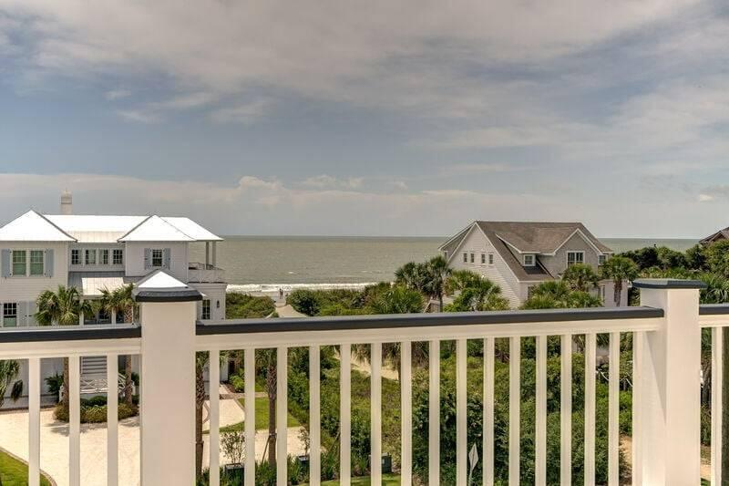
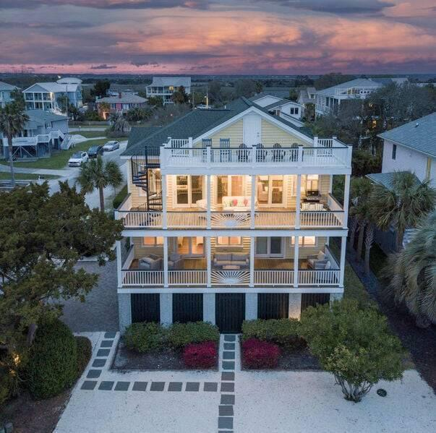
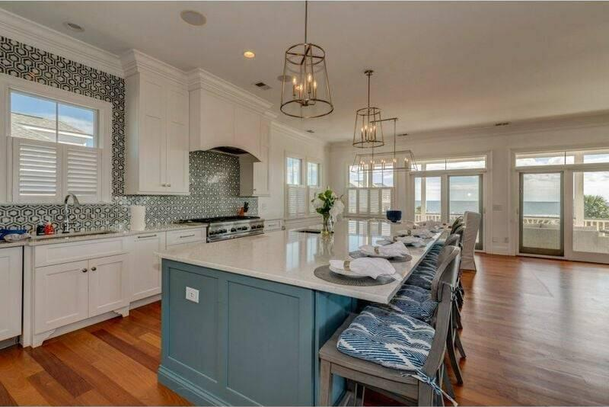
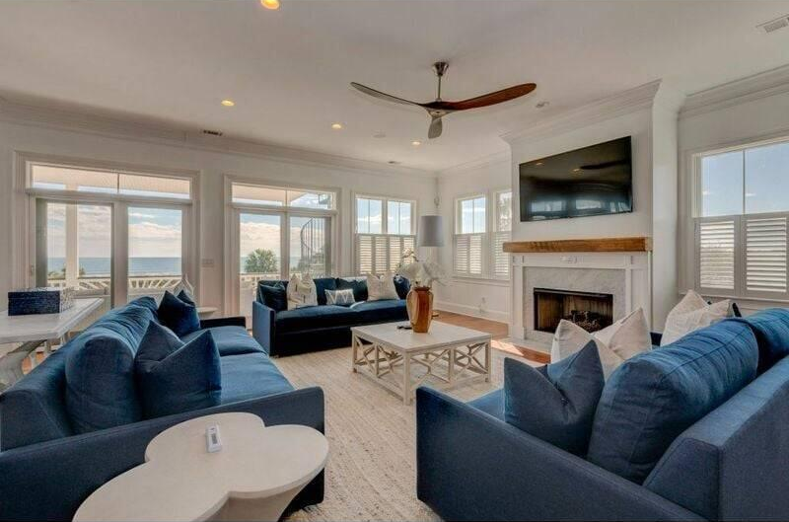
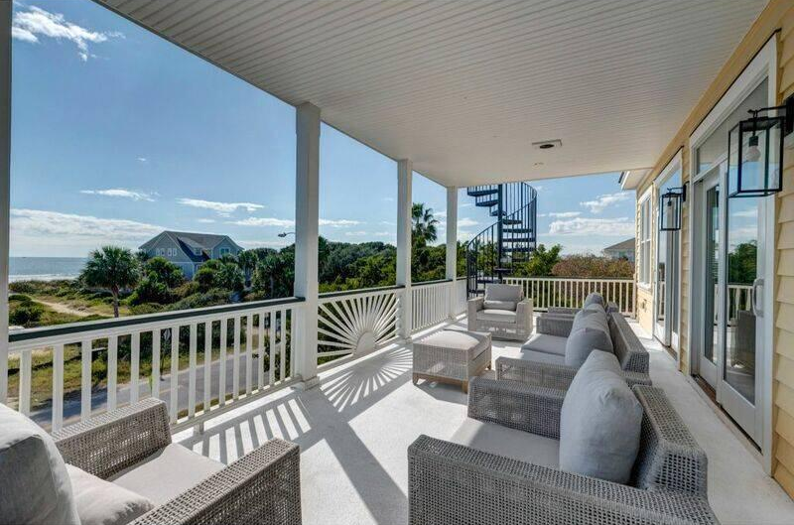
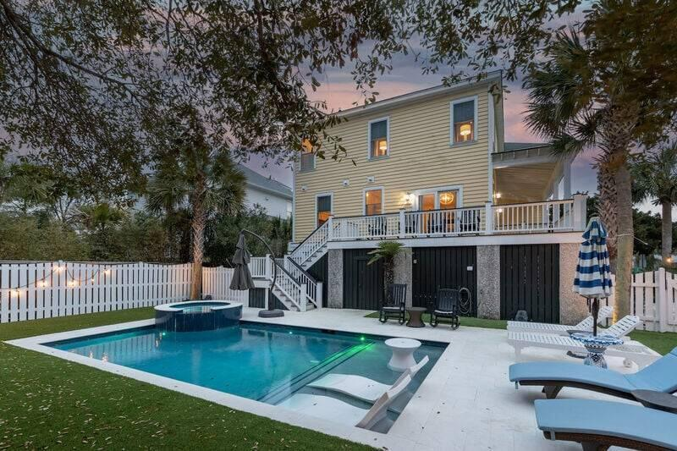
2nd Row with Ocean Views
601 Ocean Boulevard
Isle of Palms, SC 29451
MLS# 25013787 | $5,285,000
Beautiful 2nd row home located in the most desirable location on IOP (South IOP) directly across the street from the 6th Ave. beach path! The property has excellent views, an amazing, renovated pool with built in hot tub. New landscaping, including turf for very low maintenance... and don't forget the putting green! This home has been maintained to very high standards. It offers a great inverted floor plan with a large kitchen, granite counter space for cooking for large crowds, and an open floor plan with tons of living space. The front of the home features 3 multi-level decks to take advantage of the ocean views. All four guest rooms have full ensuite bathrooms, with two primary suites, one on each level. This custom home also features an elevator that services all 3 levels, a wet bar in the great room, high-end appliances, and a 3rd floor deck for even more amazing views! House is sold fully furnished except for a few personal items, and it comes heavily booked with 2025 rentals!
Jamie Hollingsworth
843-442-6492 | iopsold@aol.com
Salmonsen Realty | 864 Lowcountry Blvd Ste B | Mt Pleasant, SC 29464

