Slide 1
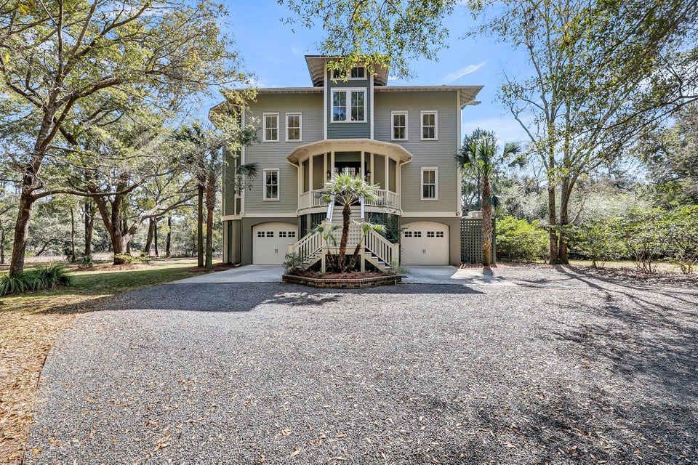
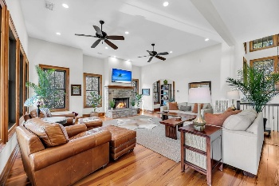
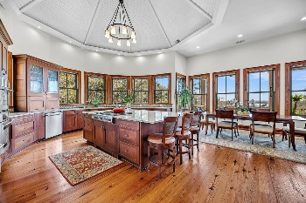
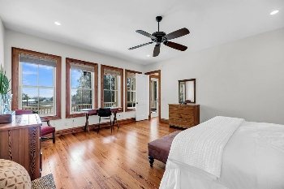
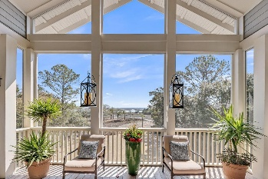
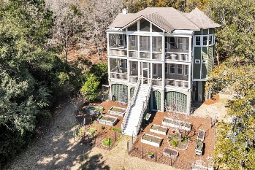

6021 Jibe Court
Romain Retreat · Awendaw, SC 29429 · MLS# 25006691 · $1,795,000
Incredible Views-Minutes to Mount Pleasant
Welcome to Your Secluded Sanctuary at 6021 Jibe Ct! Tucked away in the nature-filled Romain Retreat, a gated 300-acre community bordering the Cape Romain Wildlife Refuge, this lighthouse-inspired masterpiece offers a rare blend of luxury and Lowcountry charm. Meticulously crafted by Bennett Builders of Awendaw, with fine details and trim by the local custom boat builder/homeowner, this custom-designed residence harmonizes natural beauty, abundant light, and masterful craftsmanship in an unparalleled setting.Set on 2.4 private acres, this home showcases stunning reclaimed heart pine flooring, baseboards, and window trim repurposed from a historic Manhattan factory. The grandeur of three levels of spacious living is accentuated by soaring 12' and 10' ceilings, solid 8' wood interior doors, and the convenience of an elevator servicing all three floors. On breezy days, open the windows to welcome the refreshing ocean air, while an attic fan enhances comfort. Unwind and take in the serene surroundings from the expansive screened porches.
This one-of-a-kind home is a rare opportunity to own a private retreat where luxury meets nature...a place where every detail has been thoughtfully designed to create an unparalleled living experience.
HOA: $698/year
Luxury meets craftsmanship and nature
Direct access to the Cape Romain Wildlife Refuge
Stan Huff
843-670-2835
stan.huff@agentowned.com
Jill Marcacci
843-297-5590
jill@agentowned.com
www.agentownedrealty.com
AgentOwned Realty Co. Preferred Group, Inc. | 824 Johnnie Dodds Blvd | Mt Pleasant, SC 29464

