Slide 1
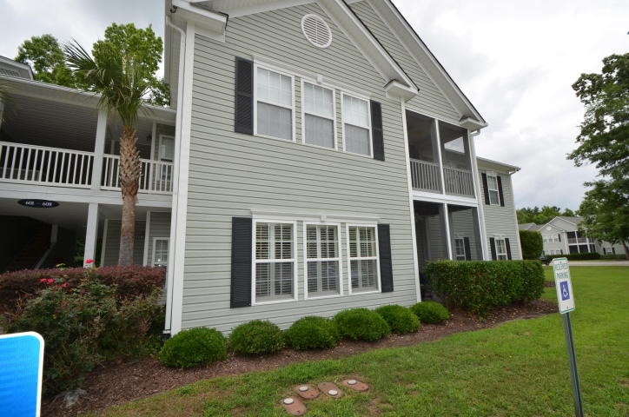
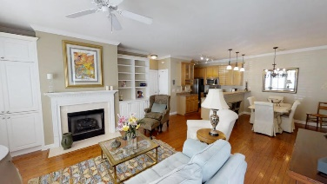
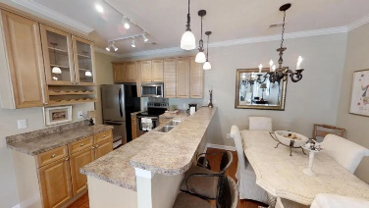
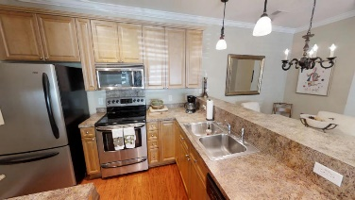
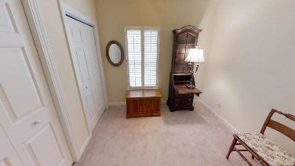
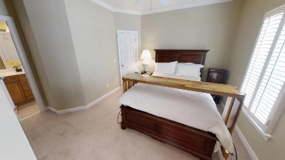
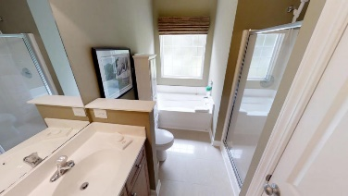
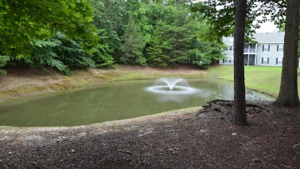
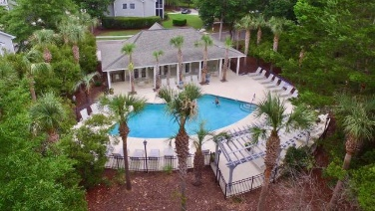



602 S Elgin Court Grand Oaks Plantation Charleston, SC 29414 MLS# 18014550 $205,000
Just Listed
+
Open House
Saturday, March 24th 11-1
Open House Sat June 9 12-2pm
Well cared for and updated ground floor condominium unit.
Open floor plan with gleaming hardwood floors, custom paint and moldings.
2 Room Master Bedroom En-suite with walk in closet and full bathroom.
Check out the virtual tour https://my.matterport.com/show/?m=TTEPFs2mXxp
Andrew Sorrentino
(843) 371-6218
andrew.sorrentino@agentowned.com
Kelly Rozier
(843) 209-3129
kelly.rozier@agentownedrealty.com
The AgentOwned Realty Co | 902 Savannah Hwy | Charleston, SC 29407
Real Estate • Mortgage • Insurance
www.AgentOwned.com

