Slide 1
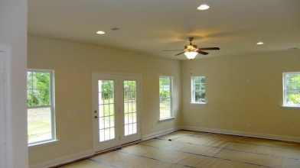
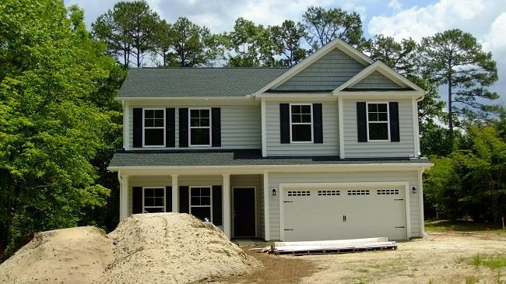
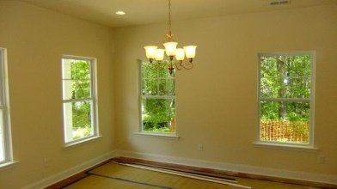
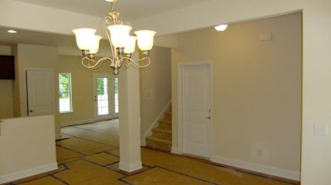
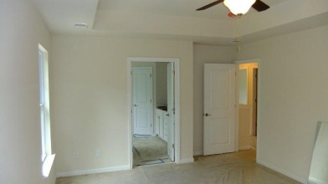
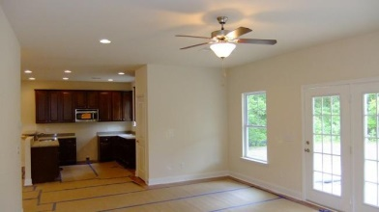
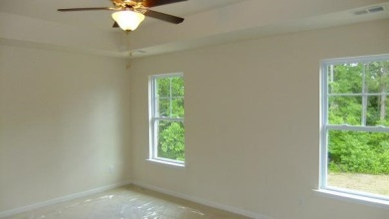

Large Lot ~ 0.9 Acres 602 Sleepy Hollow Court ~ Hidden Hills ~ Summerville MLS# 14027955 ~ $269,900
Home will be ready late Spring/early Summer! Hidden Hills is the best kept secret in Summerville! If you're looking for a large homesite--you've found it! This beautifully crafted home by Lowcountry Residential Builders offers an open concept first floor with all bedrooms being located on the second level. Hardwood and tile flooring, recessed lighting, stainless steel appliances, gorgeous granite kitchen countertops, 42'' maple cabinets with decorative hardware and crown molding make this house a home. Why not make it yours? This neighborhood offers a serene country setting and is merely minutes from shopping, schools, Historic Downtown Summerville.
Carolina One Real Estate
4024 Salt Pointe Parkway
New Homes Division
N Charleston, SC 29405
Ali Bring
843-226-1043
ali.bring@carolinaone.com

