Slide 1
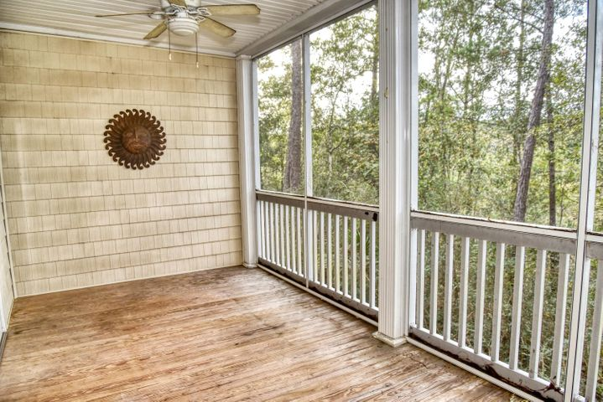
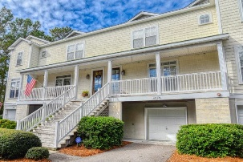
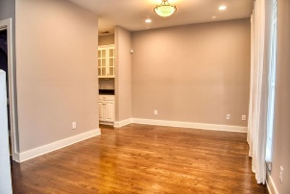
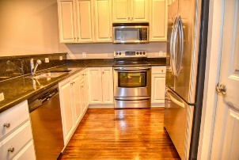
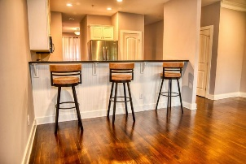
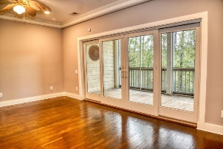
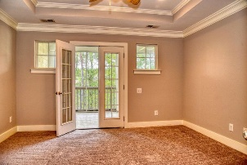
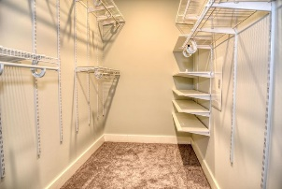
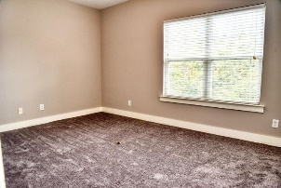
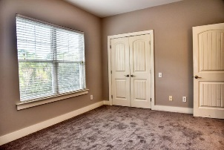
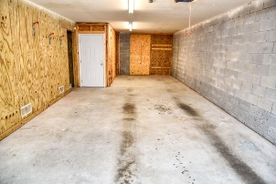


602 Merrifield Court
Charleston National
Mount Pleasant, SC 29466
MLS# 20031582 ~ $332,900
Open House Lunch ~ Friday, Oct 3 from 11 - 1
Handyman Special… Bring your hard hats!
The Retreat At Charleston National
$5000 Price Reduction
Move in ready. Freshly painted with new carpet on the second floor. The first thing that will strike you as you enter is the hardwood flooring, yes, hardwood, not laminate or vinyl. The floor plan is open and features a dining room, butlers pantry and a kitchen with granite counters and stainless appliances. You will find a large screened deck off the great room that overlooks the marsh. Upstairs, is the master bedroom with a large walk in closet and the master bath with a garden tub and separate shower. This master bedroom also features it own large screened deck also overlooking the marsh. The generous sized second bedroom with it's own bath and large closet and the laundry area finish out the second floor. The ground floor provides garage parking for two cars as well as lots of storage.
There is also provisions existing to add an elevator to service from the garage to the second floor. Seller is a licensed Real Estate Agent.
Steven Ginsberg, ABR, EPRO
(843) 860-7782
sginsberg1@gmail.com | www.steveginsberg.com
Realty ONE Group Coastal | 654 Coleman Bvld Suite 100 | Mt. Pleasant, SC 29464

