Slide 1
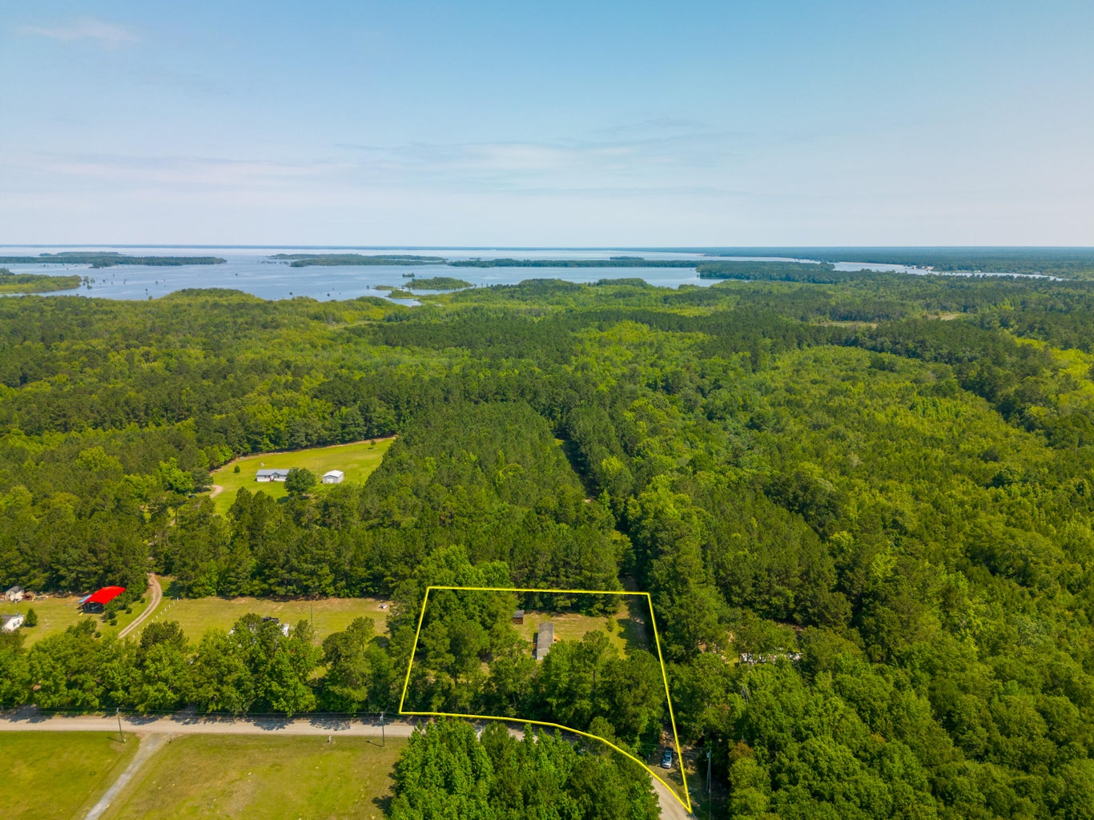
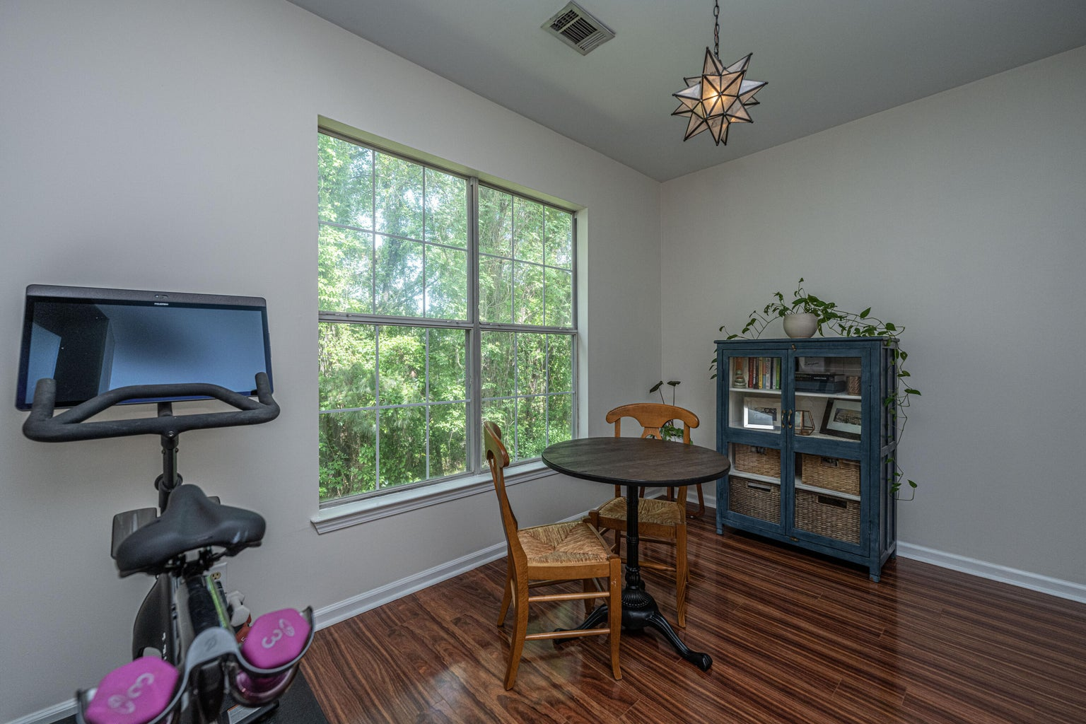
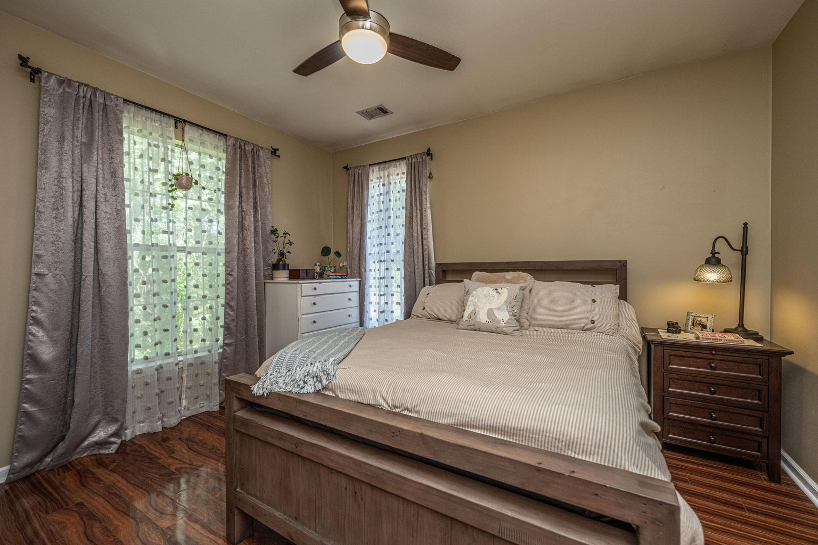



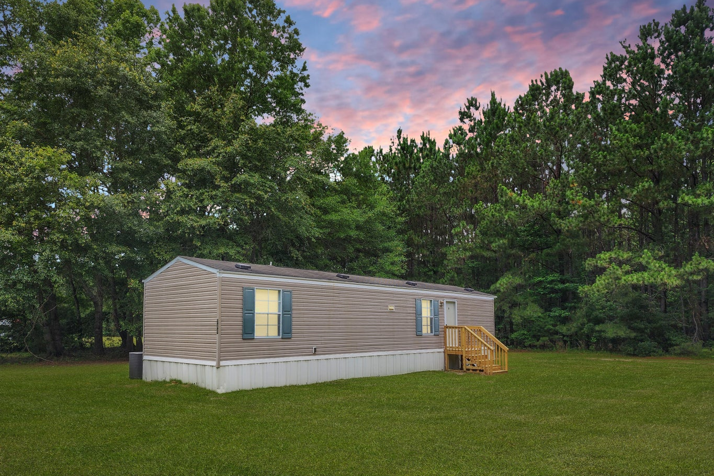
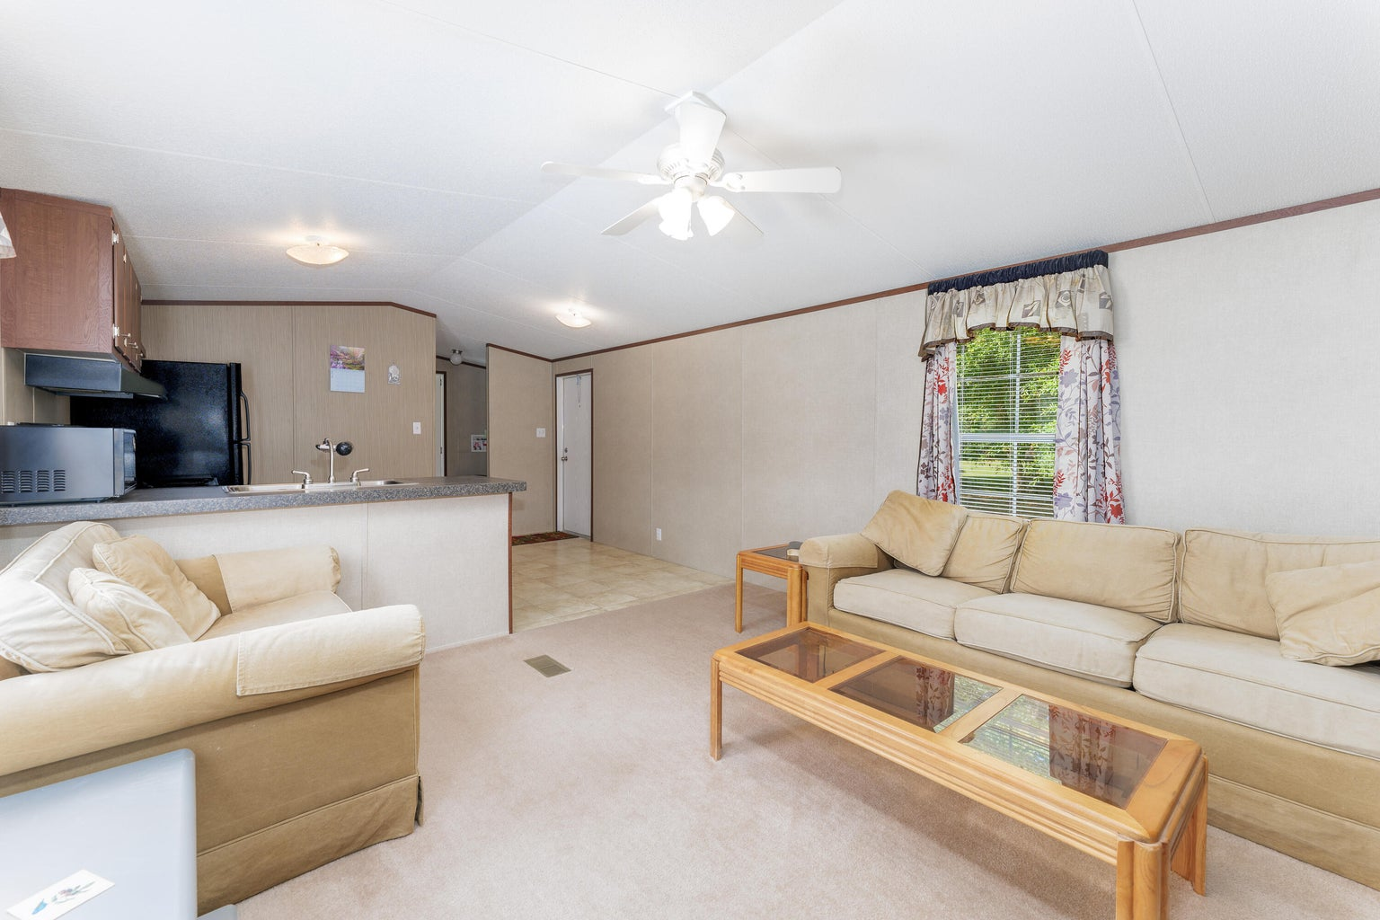
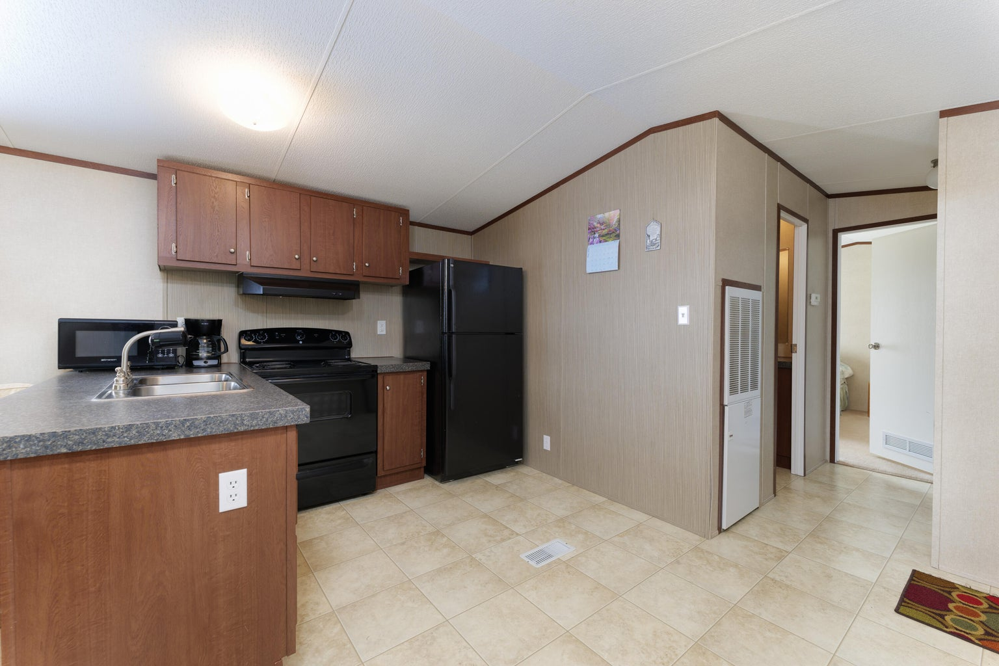
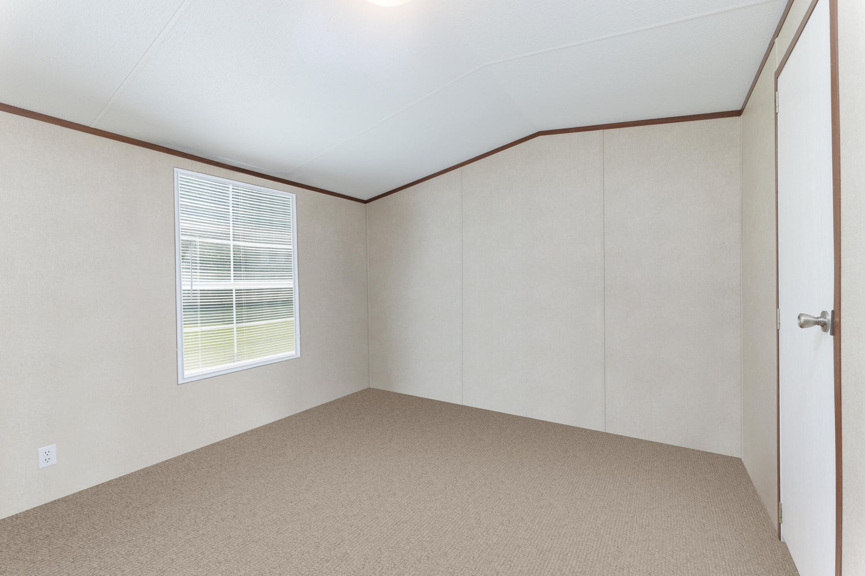


Minutes To Lake Moultrie And Lake Marion!
602 Murphy Bay Drive
Cross, SC 29436 | MLS# 23012890 | $169,900
Custom 5br, 4.5ba 4700 Sqft Of Flex Space
10’ Smooth Ceiling
Heart Pine Flooring
Master Bedroom Suite On First Level
Second Master On Upper Level
Two Dens With Gas Fireplaces
Formal Dining Room
Gourmet Kitchen With Second Den/Warming Room And Breakfast Room
Walk-in Pantry
Large Bonus/Game Room Above Oversized Two Car Garage
Screen Porch & Outdoor Firepit
Large Pond Lot With Mature Trees And Irrigation System
3 Separate AC Units
Gas Hot Water Heater
New 35-year Roof
Private Gated Community With Community Pool, Clubhouse, Boat Launch And Dock
4
3
1,844
Are you looking for a property that shares the passion for outdoors, for fins, feathers, fur or gathering under the stars with family and friends? A perfect weekend getaway, vacation rental or primary home to enjoy. This exceptional home is minutes to either Lake Moultrie and Lake Marion with 170,000 acres of pristine waterways.
Video Tour: https://youtu.be/rrwEyTTLDHE
Telecia Bilton
843-412-3586
tmbilton@rogcoastal.com
Realty ONE Group Coastal
1510 Trolley Rd
Summerville, SC 29485

