Slide 1
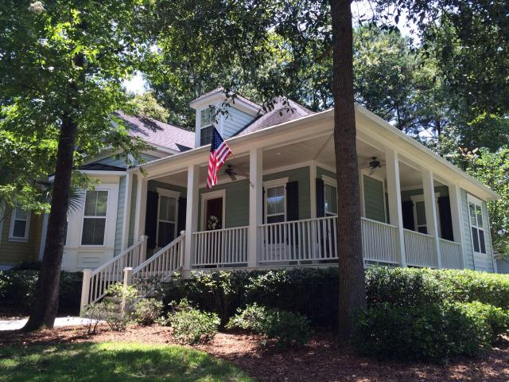
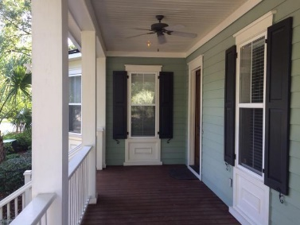
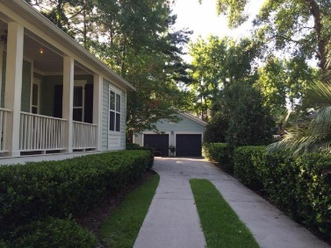
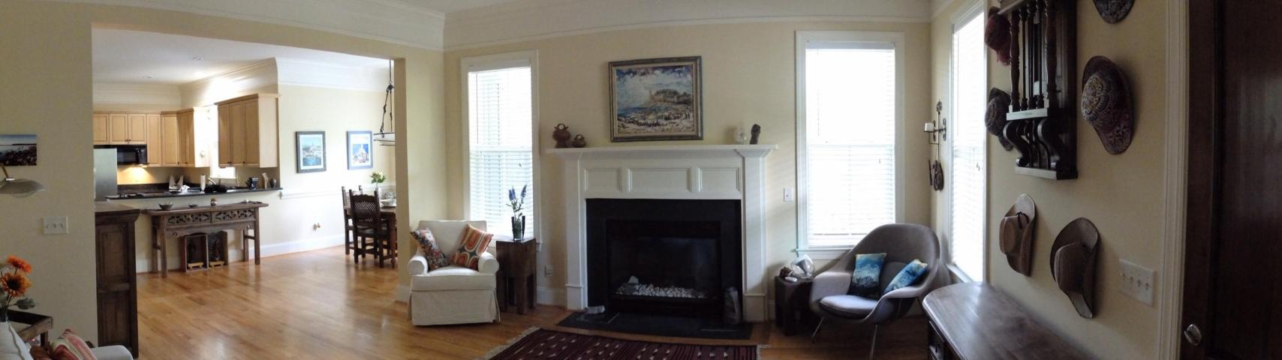
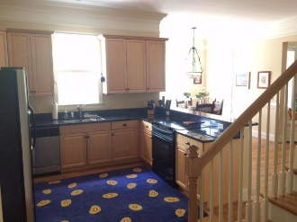
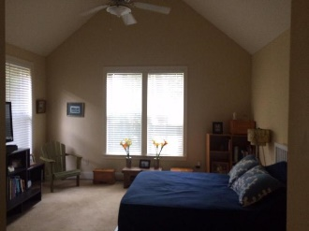
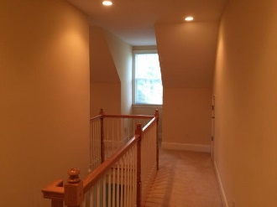
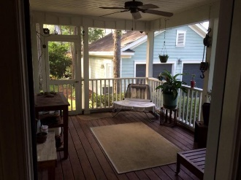


6031 Grand Council St Center Park/Daniel Island MLS# 15018576 $539,500
Semi-Custom Home on Daniel Island
****$2,000 Bonus Offered through October****
This JD Smith, semi-custom, home sits in a beautiful neighborhood on Daniel Island, Center Park. You will enjoy this gorgeous private lot, with large Pine Trees and mature landscaping. This cottage style home boasts 4 bedrooms, 3 full bathrooms, loft area, large screen porch, first floor master suite, separate laundry room, large kitchen with granite counter tops, and an open floor plan. A private bedroom and full bathroom upstairs makes it an ideal retreat for your guests. Having a detached garage provides you with the option to build a FROG (Carriage House) above the garage to provide rental income or extra space. Relax and catch island breezes on the wrap around front porch! Buyer pays a one time neighborhood enhancement fee of .5% x sales price to Daniel Island Community Fund.
Owner agrees to pay a $2,000 bonus to be any agent that brings a buyer to this property, and obtains a successful closing. Offer good through the month of October, and expires November 1, 2015
Daniel Mykols
(843) 566-5169 | mykols@homesc.com
Infinity Realty | 1250 Fairmont Ave | Mt. Pleasant, SC 29464

