Slide 1
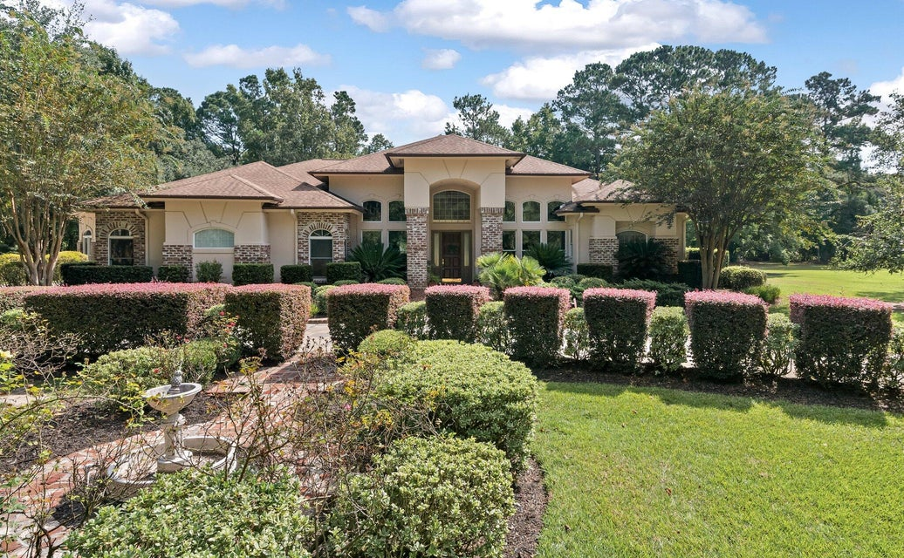
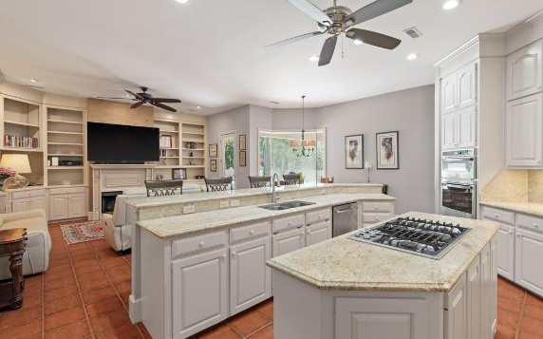
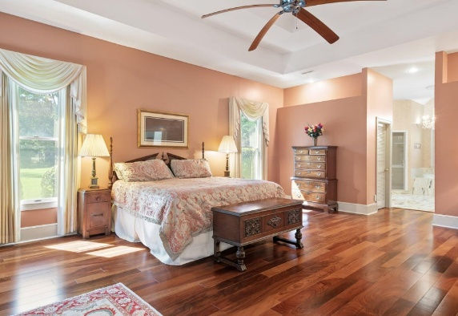
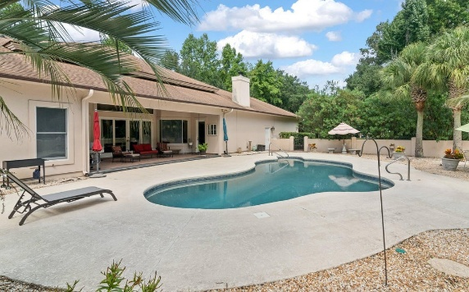

Open House March 9th from 12:00 to 2:00
6036 Postell Drive
Ravenel, SC 29470
MLS# 24022999 | $895,000
Magnificent Mediterranean style home on a spacious 2+ acre lot. Great location for those seeking to be close to everything but far enough away from it all. The exterior features Old English Brick including walkways. A Circular drive surrounded by lush landscaping leads to the main entrance . Enter into a formal foyer with open space created by high ceilings and marble floors. Enjoy your own private oasis as you overlook the lanai and salt water pool. The kitchen is equipped with JennAir appliances with plenty of cabinets and oversized pantry. Spacious primary bedroom with gorgeous African Teak Hardwood floors accented by a double trey ceiling. Seller is a licensed Real Estate Agent.
Steven Olson
843-412-9848
solson1071@aol.com
Nanette Piccirillo
843-345-8942
nanette@thomasmasi.com
AgentOwned Charleston Group | 902 Savannah Hwy | Charleston, SC 29407-7802

