Slide 1
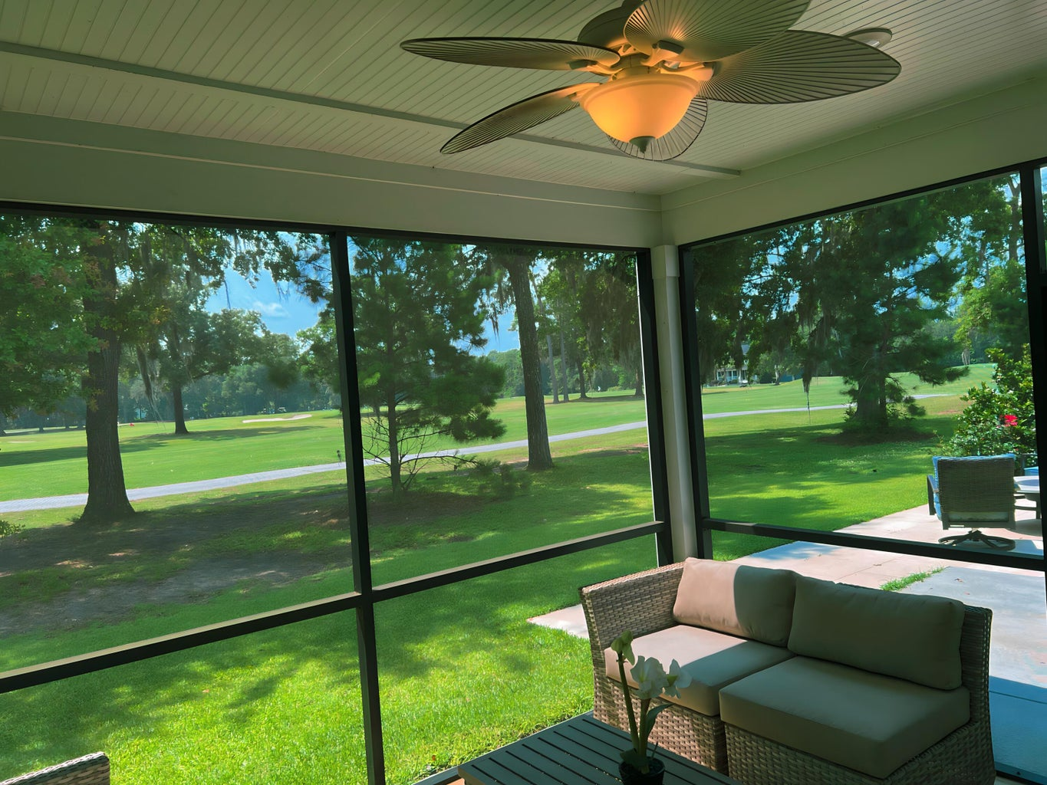
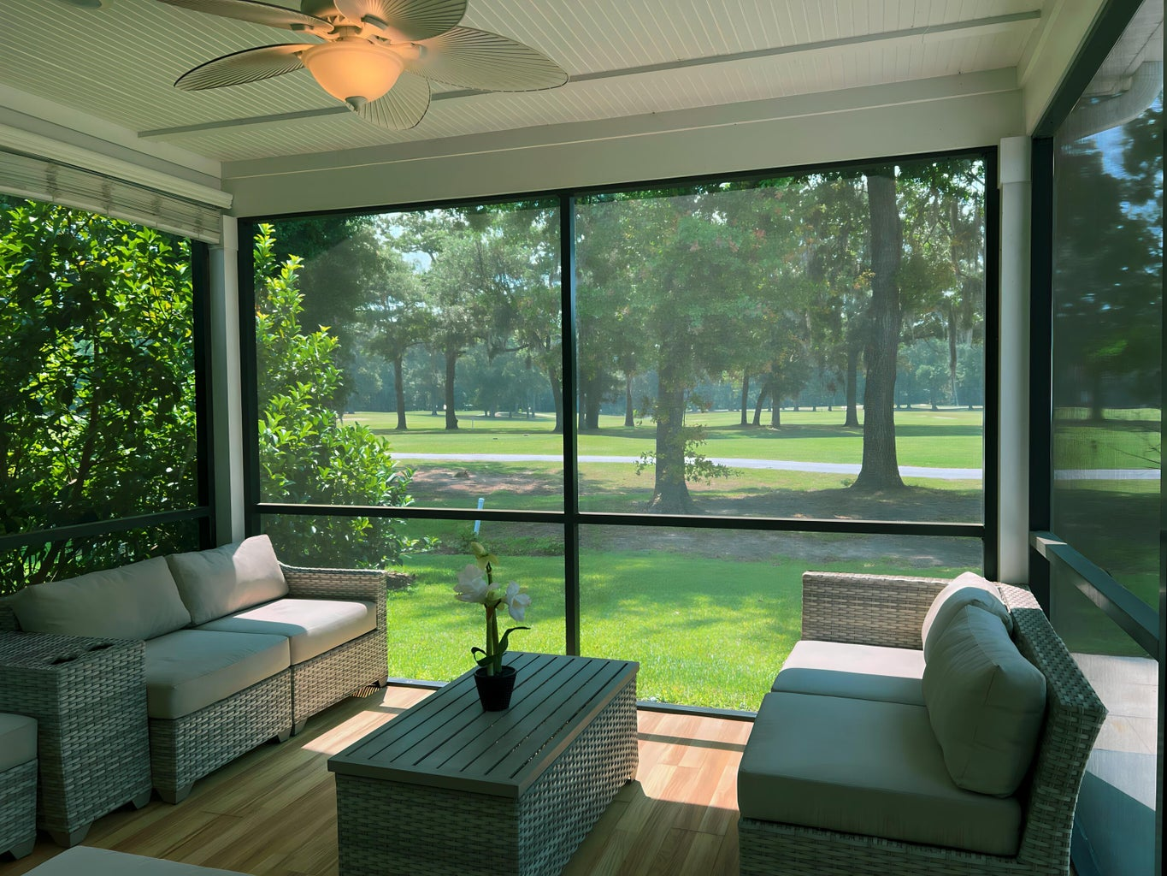
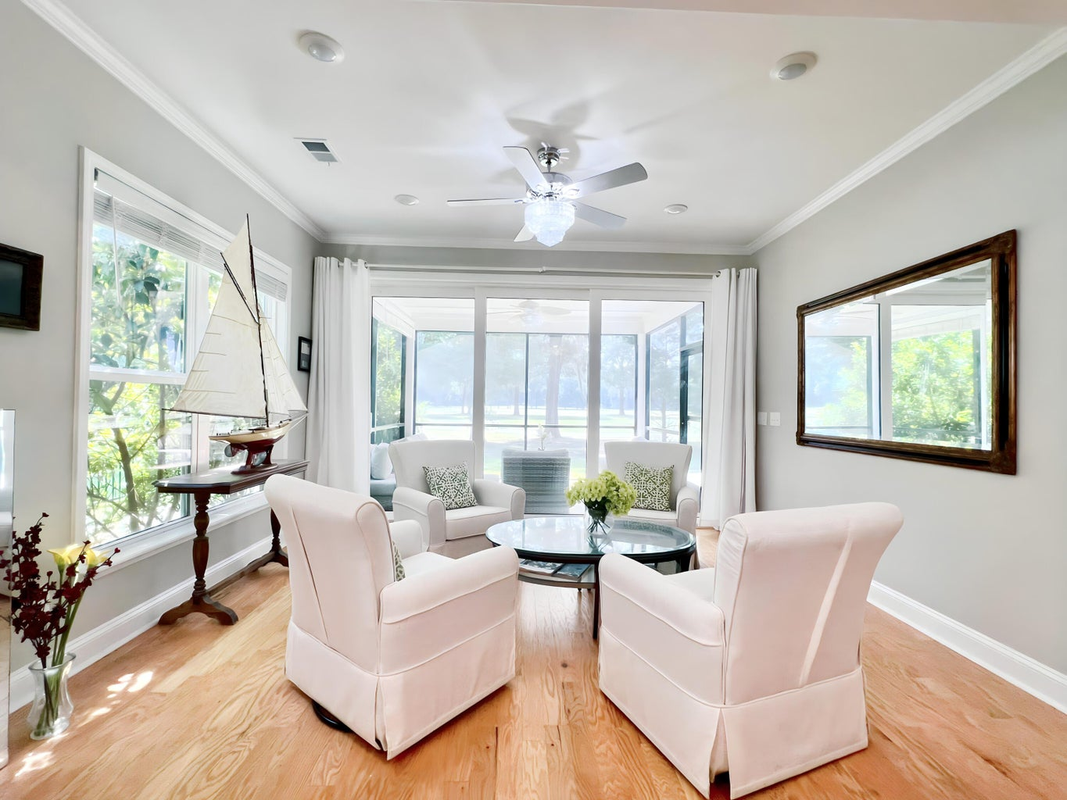

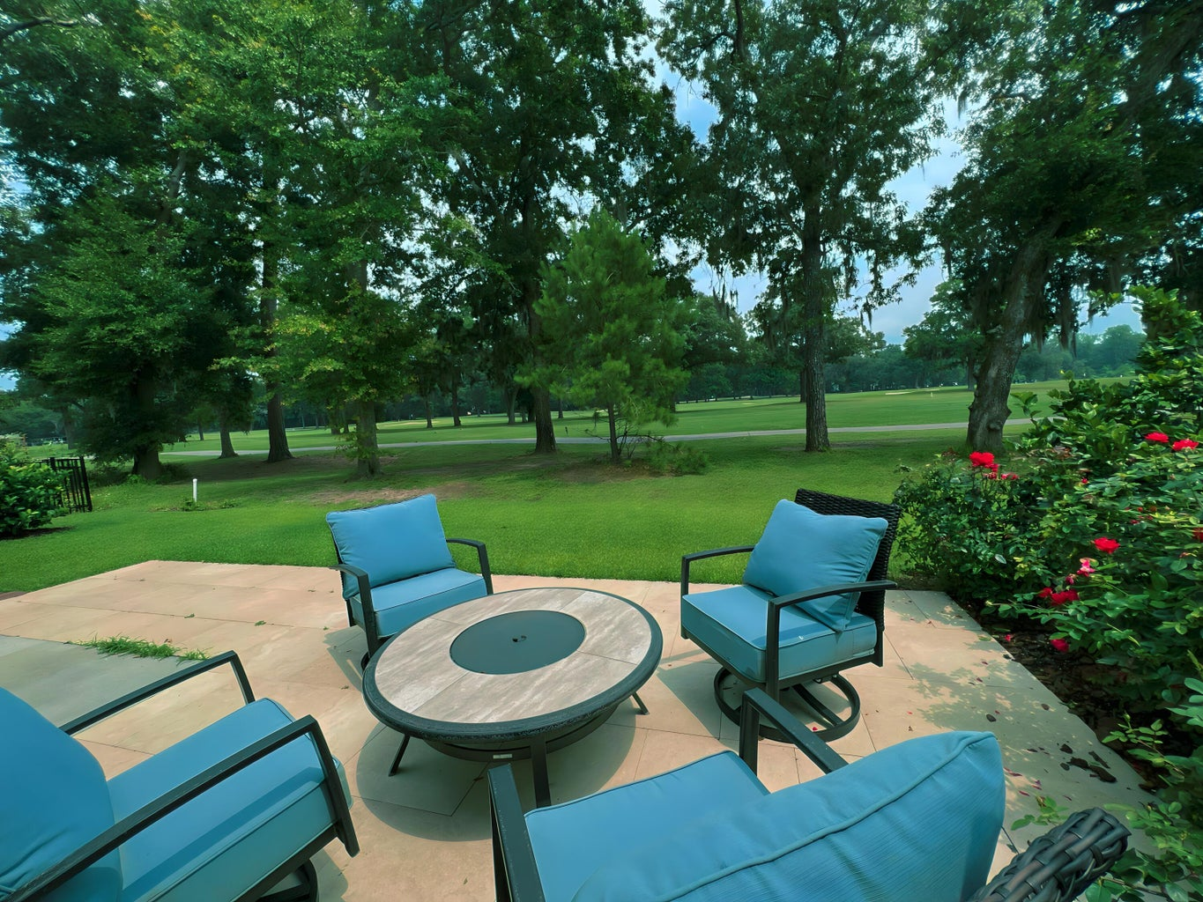
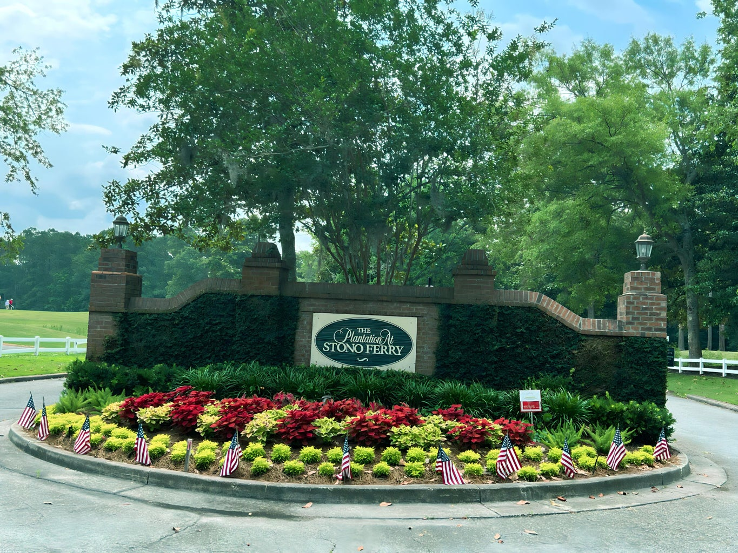

6041 Wilkes Pond Drive
MLS# 23013035
$788,000
Open House on Month, Day
From Start Time to End Time
Broker Open House
Premier Golf Course Living
Tina Millette
854-222-4532 | ting.millette@gmail.com
Brand Name Real Estate | 4 Carriage Lane Suite 106 | Charleston, SC 29407

