Slide 1

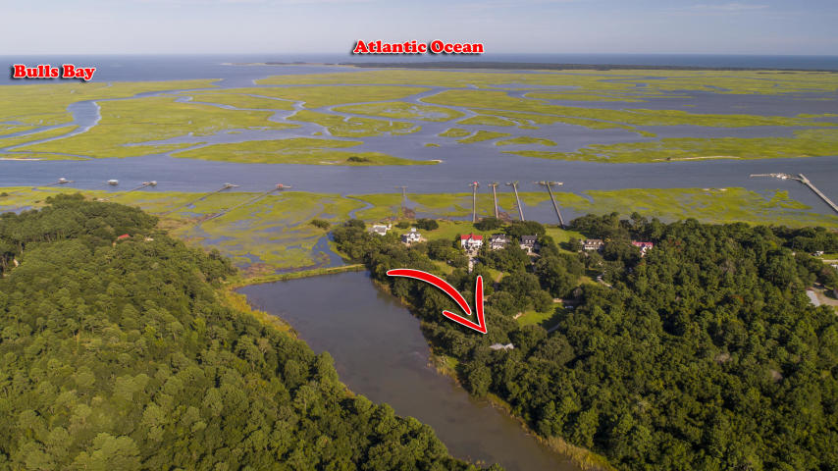
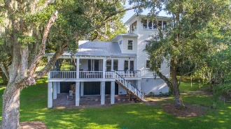
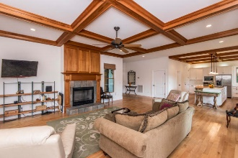
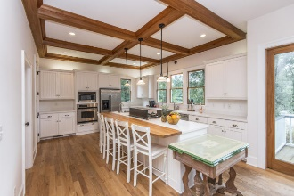
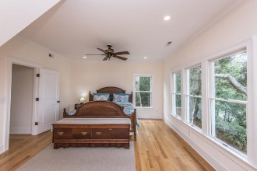
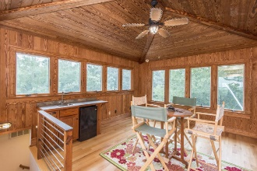
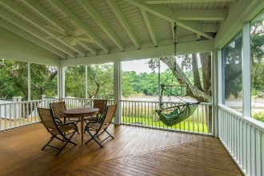
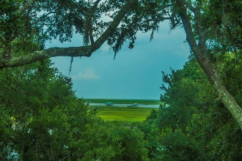
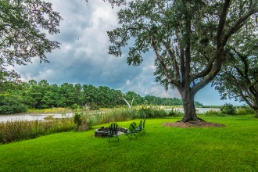
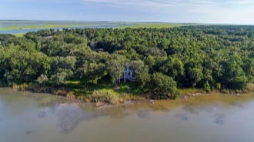
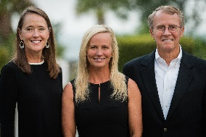

6046 Mossey Grove Lane
Grove Plantation | Awendaw
MLS# 18023913 | $700,000
Major Price Drop!
Motivated Sellers!
Breathtaking marsh/river views, Spanish moss-draped Live Oak trees and a coastal farmhouse inspired home welcome you to this little piece of paradise. Down a tree-lined driveway and nestled against a tidal creek, the home is situated to take advantage of the stunning views while still maintaining the ultra private feel you expect in a location like this. The home itself is pure Lowcountry charm, with custom millwork, hardwood floors and an abundance of windows to capture the gorgeous views.
This setting is ideal for anyone looking for a private, away from it all feel while still being just minutes to the conveniences of Mount Pleasant and Charleston. Grove Plantation is surrounded by Bull's Bay, Cape Romain Wildlife Refuge and the Francis Marion National Forest but only 12 minutes to Oakland Shopping Center, the new Lowe's and Roper Mount Pleasant Hospital and just a few minutes to the world class shopping and dining of historic Downtown Charleston.
Asking $1,200,000
MLS# 17023051
3,692 SqFt
4 Bed/3½ Baths
Short Drive to Historic Downtown Charleston & Beaches
Don Dawson
843-514-0452
ddawson@carolinaone.com
Carolina One Real Estate • 2713 Highway 17 North • Mount Pleasant, SC 29466
www.TeamDawsonSC.com

