Slide 1
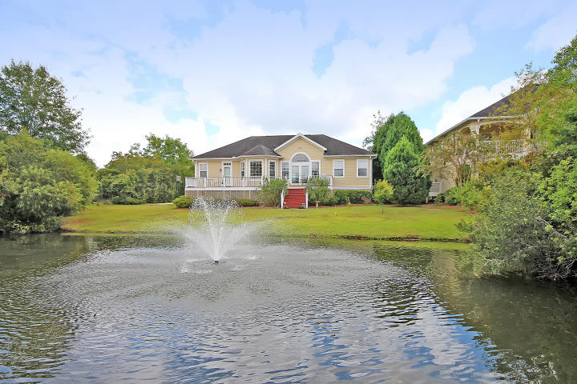
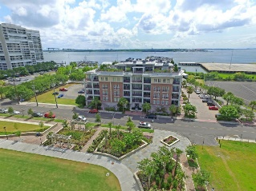
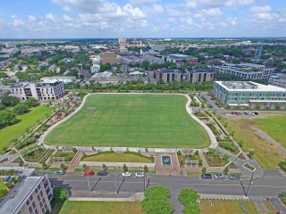
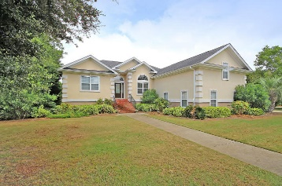
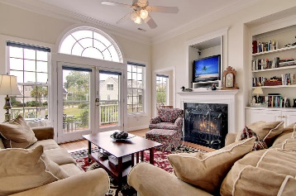
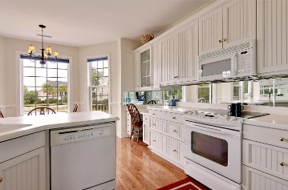
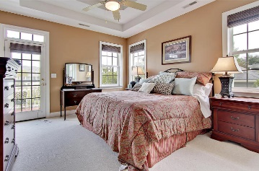
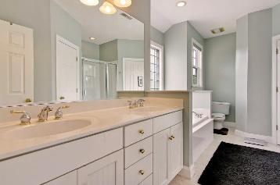
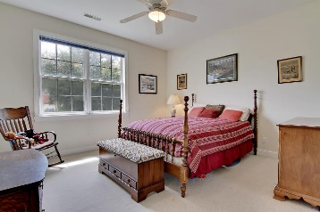
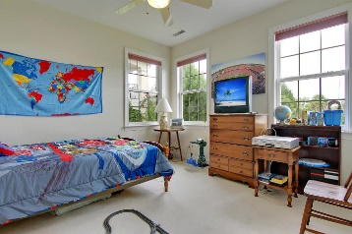
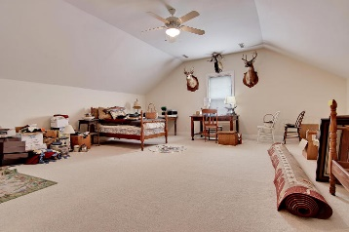
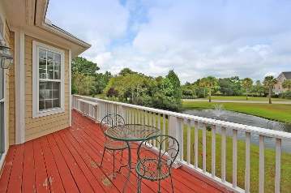
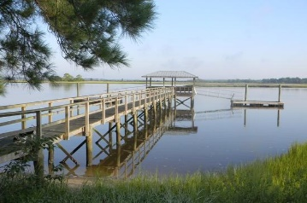

Price Reduced!
Price Reduced in Grimball Gates!
604 King Haven Lane
Johns Island, SC 29455 ~ MLS# 16022505 ~ $445,000
This incredible home in Grimball Gates is perfect for you and your family. Enjoy pond views from this 3 bedroom, 2.5 bathroom home. This home features gorgeous hardwood floors, an upgraded kitchen, a great room with built-ins, and a roomy deck. The gated community of Grimball Gates includes a community dock on the Stono River and a 90 acre nature preserve with walking trails and golf cart path. Book your showing today!
Sue Campbell suecampbell@mattoneillteam.com 843-864-3471

