Slide 1
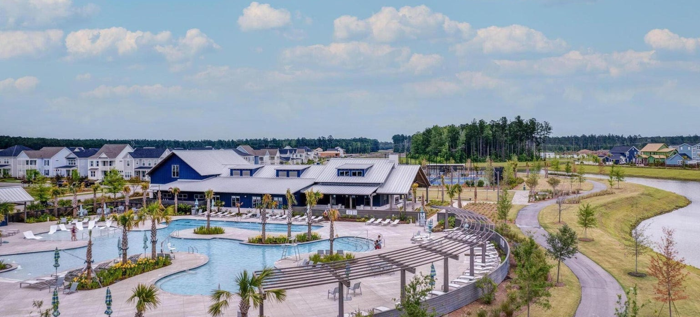

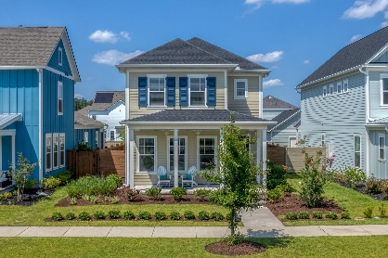
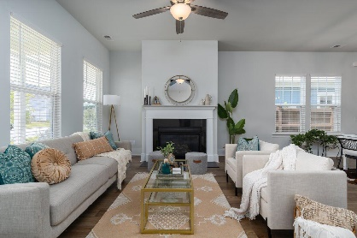
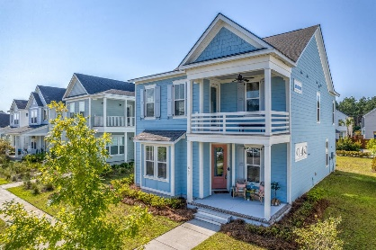
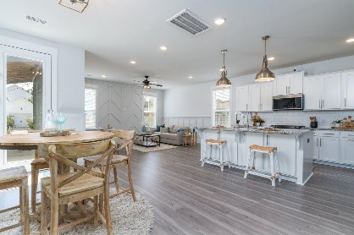
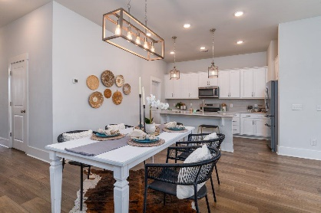
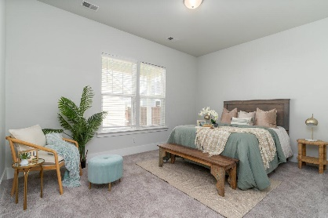
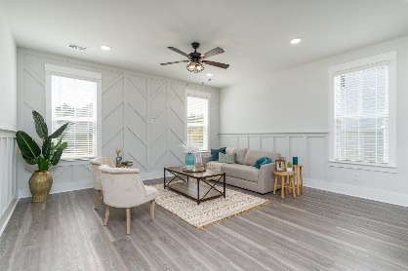
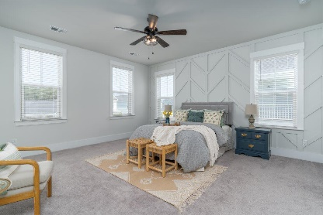
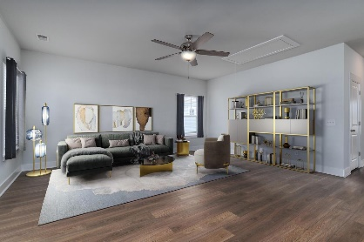
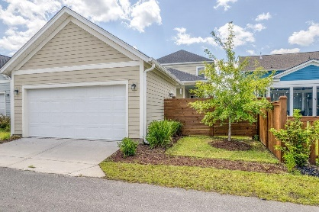
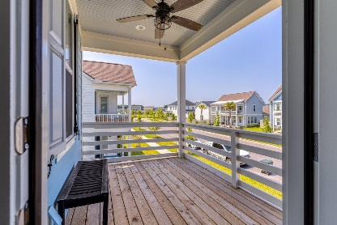
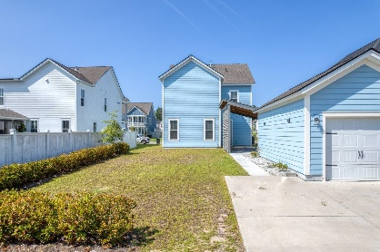
604 Blueway Avenue
MLS# 23019910 | $485,000
Video Walkthrough
Darrell Creek Elevated Home With Elevator & Salt Pool
2 New Listings, 2 Open Houses in Nexton
Friday 9/1 from 3-5PM & Saturday 9/2 from 11AM-1PM
Co-sponsored by
Come kick off your holiday Weekend with a Happy Hour and Door Prizes
at these 2 New Nexton Listings
Offering $3000
Lender Credit
647 Blueway Avenue
MLS# 23019625 | $500,000
Video Walkthrough
Lauren Parker
843-607-0971 | lauren.parker@agentownedrealty.com
Elissa Campbell
843-853-1433 | elissa.campbell@agentownedrealty.com
AgentOwned Realty Preferred Group | 824 Johnnie Dodds Blvd | Mt Pleasant, SC 29464

