Slide 1
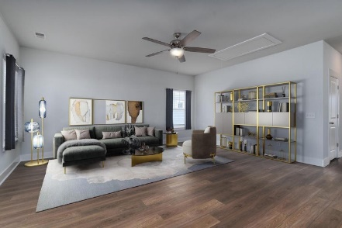
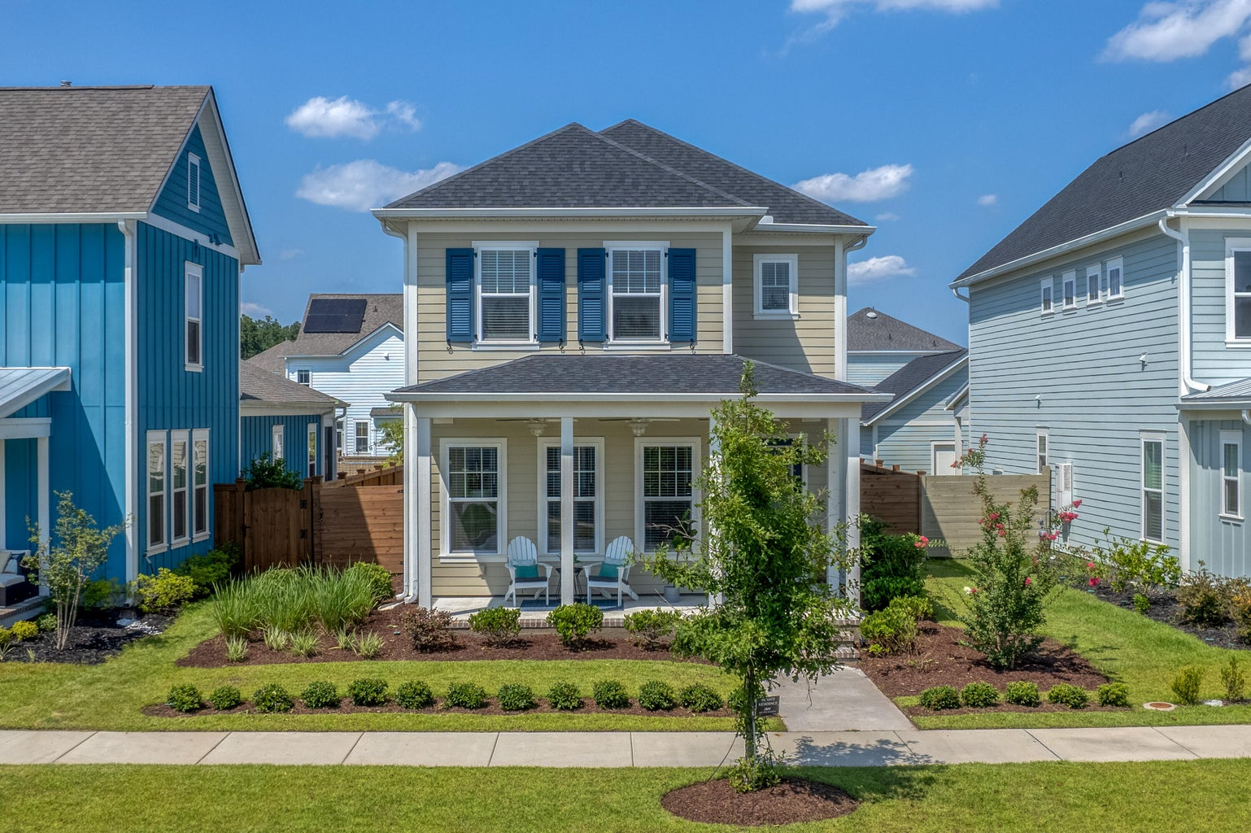
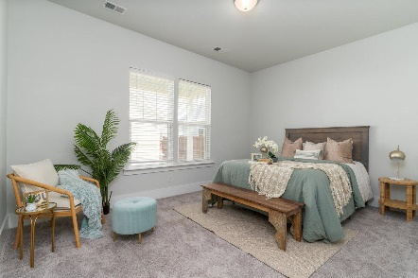
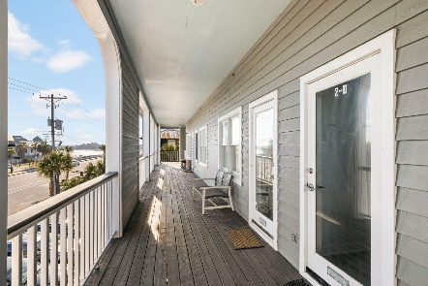
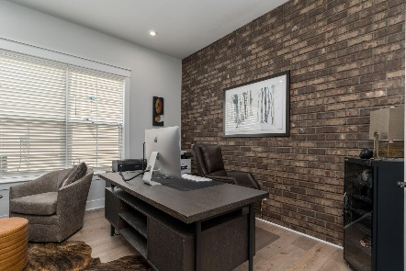
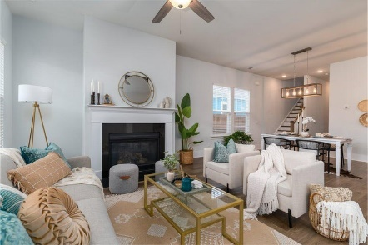
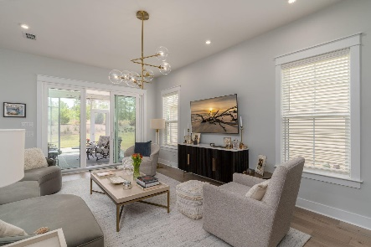
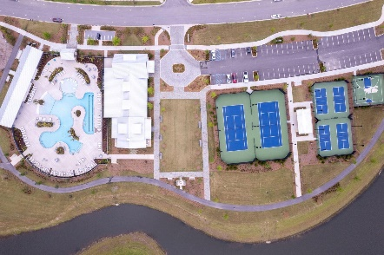

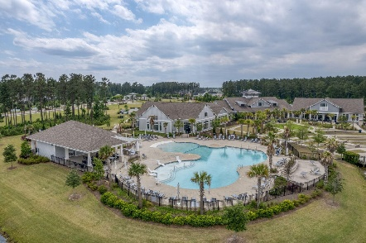
604 Blueway Avenue
Midtown @ Nexton | Summerville, SC 29486
MLS# 23019910 | $465,000
Darrell Creek Elevated Home With Elevator & Salt Pool
$1,500 Agent Bonus PLUS $10,000 in Closing Costs in Nexton
(with acceptable offer through this weekend)
Open House Sunday 10/15 11-2 with Pie Takeaways for Everyone!
Co-sponsored by
Offering $3000
Lender Credit
JUST REDUCED AND $10,000 IN CLOSING COSTS OR RATE BUYDOWN NOW AVAILBLE WITH ACCEPTABLE OFFER!
Welcome Home to 604 Blueway Ave. in Nexton's Midtown Neighborhood, where front-porch sitting is a way of life! This is a RARE Opportunity to own the Doty Floorplan from Ashton Woods...and UNDER $500K IN MIDTOWN! This home is a beautifully appointed 3- Bed, 2.5- Bath with a HUGE LOFT! The Front Porch is adorned with 3 custom ceiling fans to catch the breeze while sipping your morning coffee! As you enter the Foyer you are greeted by a Sun-Drenched Open Floorplan! This is the perfect space for entertaining! Cozy up to the gas log fireplace in the Family Room. Entertain in the Dining Area and Gourmet Kitchen, upgraded with quartz counters, 42-inch cabinets,, and custom outfitted pantry.
The Spacious Master Suite is also located on the Main Level. It boasts a large walk-in closet with Master Bath with double bowl vanity and a tiled walk-in shower with seat.
Travel upstairs and be blown away by the Capacious Loft, which can be used as a Second Living Area, Game Room, Playroom, or Office...the possibilities are endless! There is also a well-appointed Laundry Room with washer and dryer that convey. Down the hall are 2 more good-sized Bedrooms and Full Bath.
The Backyard is a perfect oasis for entertaining and BBQ'ing, with ANOTHER Covered Porch upgraded with custom ceiling fans and extended patio. The yard is also already fully fenced, has a built-in irrigation system, and a full 2-car garage. With all these upgrades and only 2 -years-old, this is a true Charleston Charmer!
The other wonderful aspect about this home is the proximity to the Midtown Club in Nexton. The Midtown Club is home to Summerville's best-known Resort-Style Pool...you'll instantly feel like you're on vacation! In addition, the Club boasts a state-of-the-art gym and yoga studio, media room, and the largest and most beautiful work-from-home space, the Living Room. In addition, Midtown offers Pickleball, Tennis, and Basketball Courts, as well as miles of walking/jogging trails. Midtown Residents also can use Brighton Park's Pool, Pavilion, and Dog Parks at no extra charge! And if that isn't enough, hop on your golf cart or bike to Nexton Square. Get your shopping on and then unwind at Taco Boy or Halls Chophouse or any of the many Nexton Square Restaurants. This beautiful home will truly not last, book your showing today!
House Tour | Amenity Tour
Elissa Campbell
843-853-1433 | elissa.campbell@agentownedrealty.com
AgentOwned Realty Preferred Group | 824 Johnnie Dodds Blvd | Mt Pleasant, SC 29464

