Slide 1
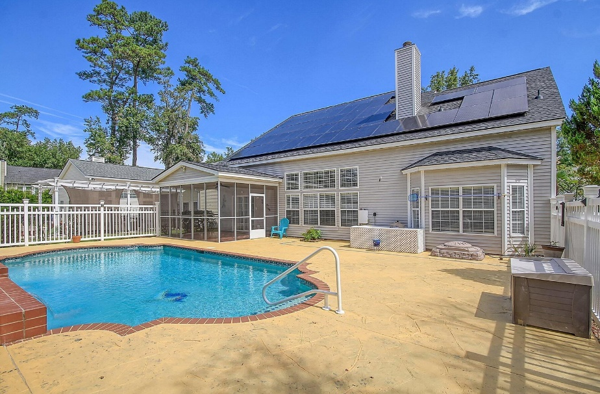
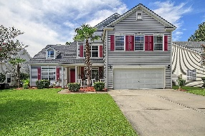
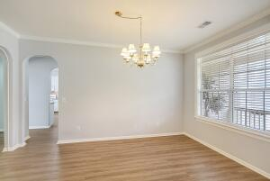
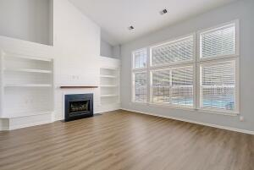
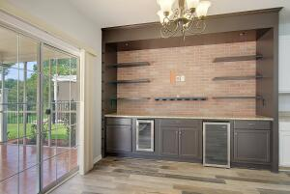
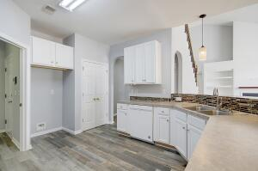
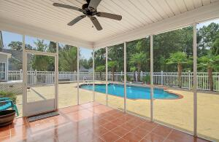
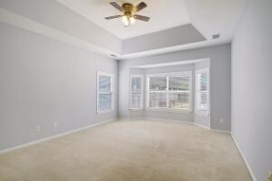
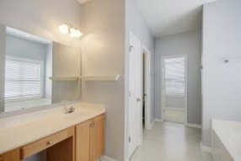
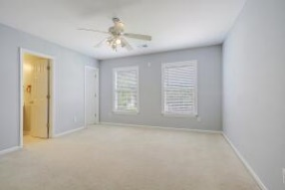

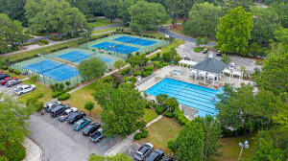
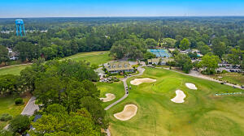


On Golf Course ~ In-ground Pool! Move in Ready!!
604 Pointe Of Oaks Road
Legend Oaks Plantation
Summerville, SC 29485
MLS# 23021135
$499,900
4 Bedrooms | 3½ Baths | 2,538 sf
This move in ready home is the one you've been waiting for! Located in the lovely golf course community of Legend Oaks, this gem of a house has golf course views as well as a built in pool! Upon entering, the dining with arched doorways will be to your right. This room is a great size for entertaining. Off of the dining room is the kitchen which offers a pantry, plenty of cabinet space, a gas stove, breakfast bar and eat in kitchen area. The laundry room as well as access to the garage is also off of the kitchen. In the eat in kitchen area is a built in bar area which offers more storage, a wine cooler, a beverage cooler and shelving. You can hang your TV here as well! The kitchen overlooks the family room which has a wall of windows overlooking the pool as well as a wall with built in shelving, a gas fireplace and wainscoting. Completing the first floor is the main bedroom. This room is large and also offers pool and golf course views. The main bathroom has dual vanities, a tub and separate shower and a large walk in closet. Head upstairs to see the rest of the bedrooms. Three more large bedrooms with great closet space make up the upstairs. One bedroom has its own full bath, making it a great guest suite, plus there is another full bath in the hall. So much space!! Now, head back downstairs and out in to your own private paradise! The backyard is completely fenced in, but don't worry, you can still see the golf course! But you'll be too busy relaxing in the in ground pool! The perfect spot to beat the heat. There is a large patio area surrounding the pool as well as a screened in porch. This home also offers solar panels! These panels will be paid for in full at closing by the seller, so you get to enjoy the benefits of a huge savings on your electricity bill! What more could you ask for!? This home has been well maintained and cared for. The neighborhood club offers different levels of membership, so if you're a tennis or golf lover, this is the place for you! This home is located in highly sought after Dorchester District two school system and is within a half hour or so from the airport, Bosch, Boeing and downtown Charleston. Don't miss your chance to view this home today!
Larry & Kathy Mazalatis
Larry Cell 843-693-0529
Kathy Cell 843-693-0159
mazteamrealty@gmail.com
AGENTOWNED PREMIERE GROUP | 1800 TROLLEY RD | SUMMERVILLE, SC 29485

