Slide 1

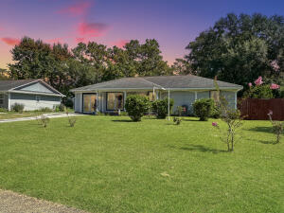
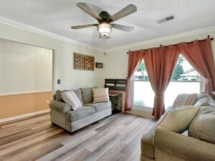
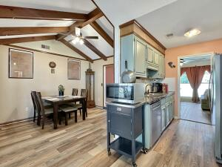
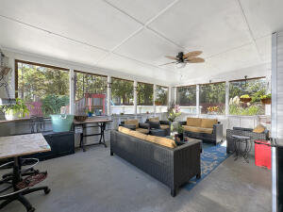
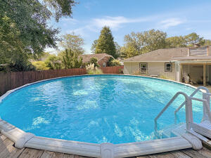


Open House Thursday 11a-2p Check Out This Beautiful New Home And Enjoy A Light Lunch
Price Adjustment
605 Beauregard Road
Sangaree | Summerville, SC 29486 | MLS# 23022476 | $289,999
3 Bedrooms | 2 Baths | 1,195 sf
Step inside this cozy ranch style home that has been charmingly refreshed and updated. Gorgeous LVP flooring, fresh paint and brand new thermal windows and doors (with lifetime warranty!) are just several of the improvements made by the sellers. Cozy kitchen has brand new SS appliances. Cabinets have been painted a cheery coastal blue and new countertops were installed, as well. All new light fixtures and fans throughout the house. Main bathroom has new sinks and faucets; guest bath also has new fixtures including a new tub and surround. The kitchen leads to the spacious screened porch and landscaped yard where you can enjoy summer fun in your new 24 foot saltwater pool.
Backyard is private with lovely landscaping and plenty of room for entertaining and for the kids to play. The shed outside has new siding and electrical, the perfect workshop or man cave. Sellers added a water softener which conveys. New HVAC and attic insulation make this home energy efficient and ready to move in.
Lisa Burdick
413-348-9841
lisaburdickrealtor@gmail.com
Home Solution Real Estate Services
PO Box 80966
Charleston, SC 29416

