Slide 1
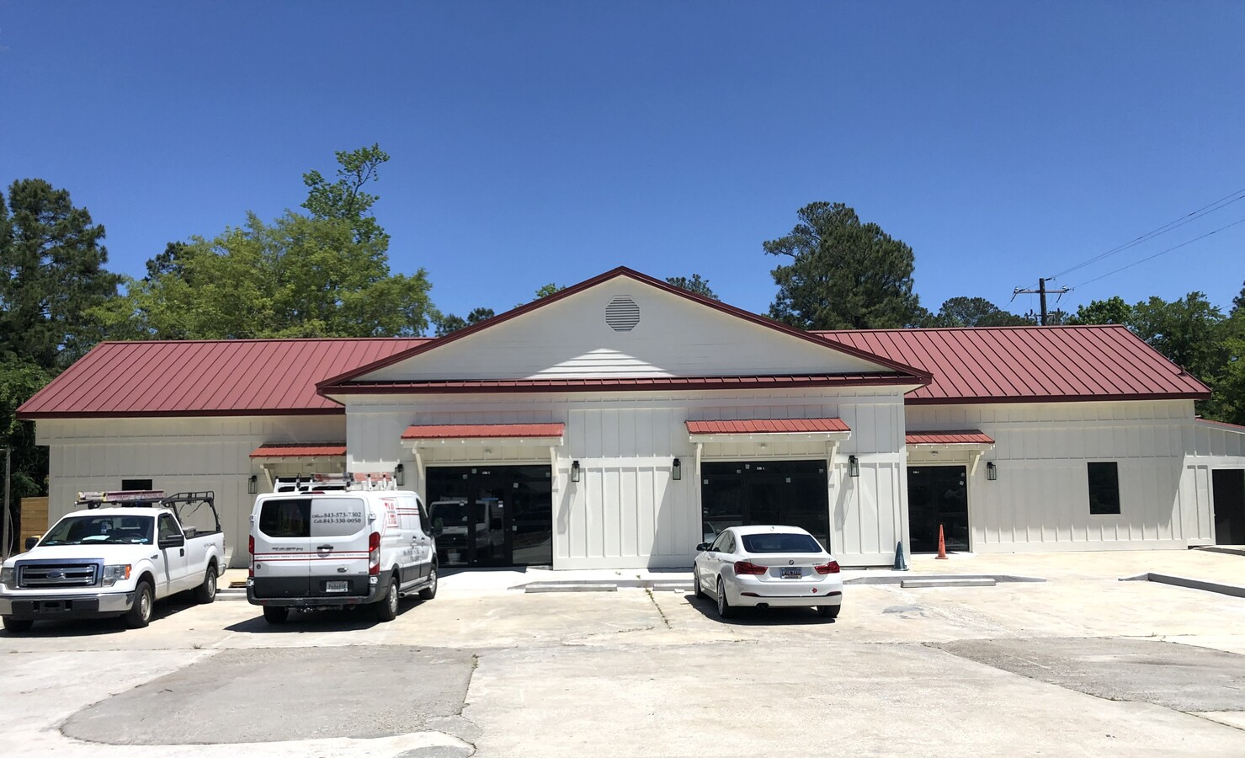


NEW 5,000SF OFFICE/RETAIL
LEASE $25/SF
605 OLD TROLLEY RD
SUMMERVILLE, SC 29485
Complete Renovation! Excellent Location!
All 5,000 Sf Or 2 Units Available. Vanilla Shell
3 Phase Power For The Heavy Medical User And X-ray
Perfect For Nuclear Medicine And Imaging
Gas And Storage Room Set Up And Ready
Construction Completion Date February 2021
Vanilla Shell Construction. .
5,000 Sf Free-standing Building. Ideal For A Single Tenant Or Multi-tenant. Plenty Of Parking.
1 Or 2 Units Available.
Entire Bldg Available 5,000 Sf
Unit A – 2,200 Sf
Unit B – 2,800 Sf
Retail, Professional Office Or Medical Office
Located Approximately 2 Miles To Summerville Medical Center / Hospital.
High Traffic Area With Great Visibility Next To A Traffic Light.
This Would Be Ideal For Medical Or Professional Office. B-3 Zoning Allows For Retail And Restaurant As Well.
All New Mechanical And Plumbing. 3 Phase Hvac.
Chris Garcia
Office (843) 557-7100
Mobile (843) 557-7100
cmcdaid1@yahoo.com
RE/MAX Pro Realty
9209 University Blvd.
N Charleston, SC 29406

