Slide 1
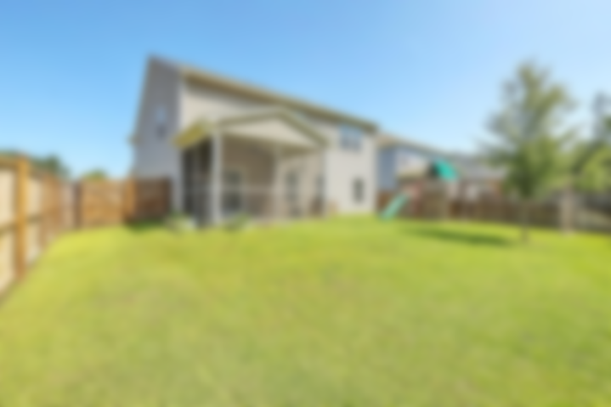
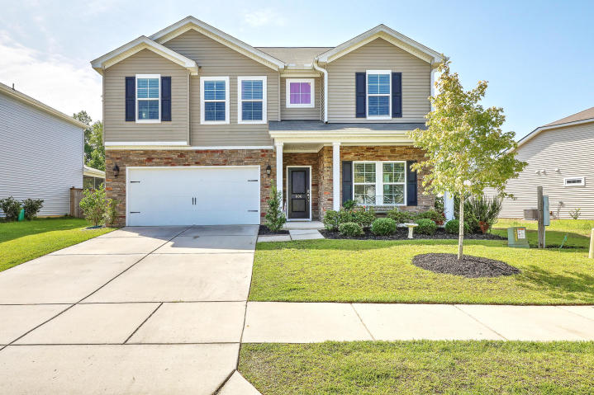

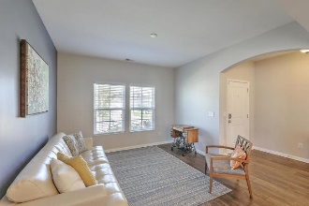
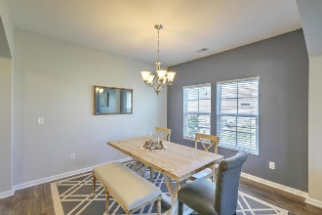
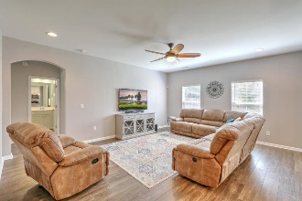
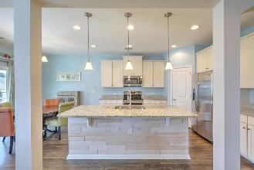
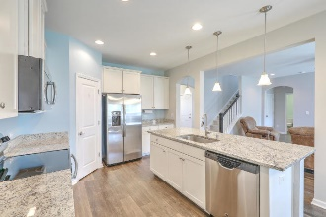
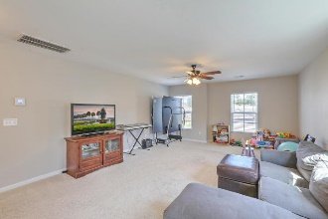
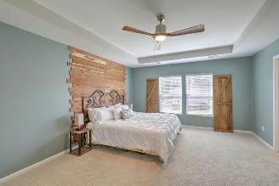
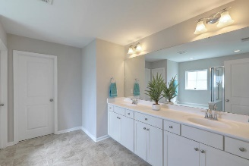
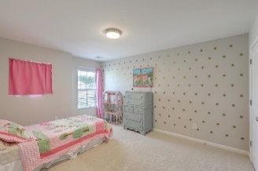
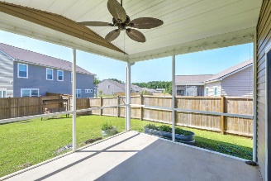


Just Listed!! Gorgeous Home In Reminisce Open House Sat 12-2
606 Calabash Court
Reminisce | Summerville, SC 29483 | MLS# 19018847 | $289,975
Welcome home to this gorgeous stone front home w/inviting front porch. Upon entering, you will be immediately drawn to the open layout & gleaming high quality laminate flooring. Entertaining will be a breeze with this floor plan - open living/dining area, spacious family room, leading to a cook's dream kitchen! Features include**Large kitchen w/s/s appliances, plentiful 42'' cabinets w/crown molding & roll out trays, granite counters & large island w/ample seating**Powder room off the office/den & has a large storage closet that could be easily converted into a shower. You will find four nicely sized bedrooms plus HUGE Loft upstairs. You will love your new Master en suite w/tray ceiling, dual sinks, separate shower/soaking tub & large walk-in closet! And, nicely sized laundry room is also located upstairs. We can't forget the screened in porch overlooking the fenced yard, complete with large playset - you will enjoy many gatherings for years to come! Reminisce is a welcoming neighborhood with many events throughout the year - you will love living here!
Desiree Maurer Office - (843) 416-2000
Mobile - (843) 327-9010 desiree.maurer1@gmail.com
www.yourcharlestonhousesearch.com
Keller Williams Realty 496 Bramson Ct Ste 200 Mt. Pleasant, SC 29464

