Slide 1
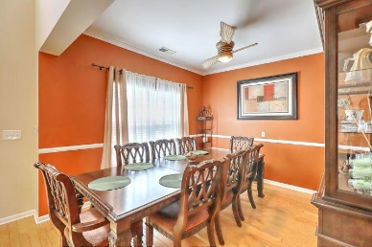
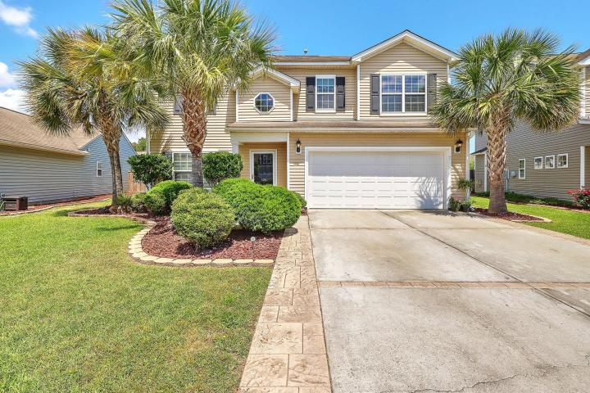
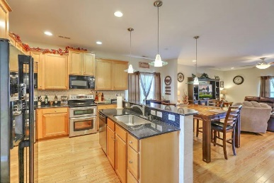
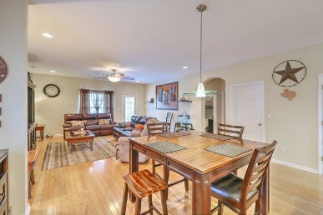
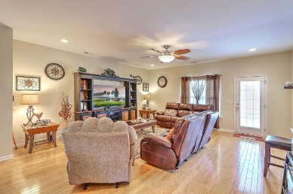
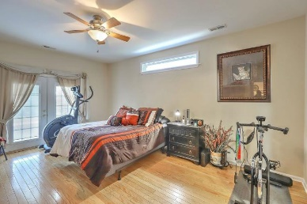
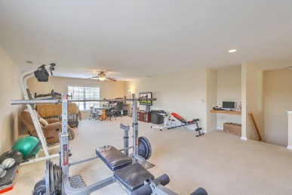
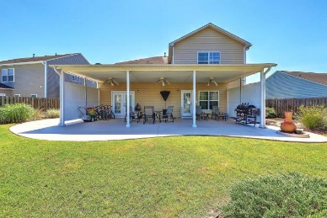
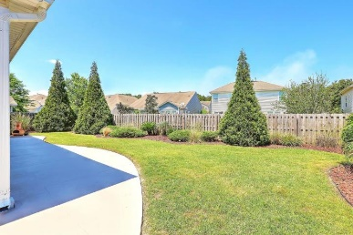
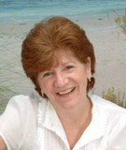

606 Parkwood Drive Brickhope Plantation ~ Goose Creek MLS# 19012502 ~ $295,900
Master Bedroom On 1st Floor
Limited Time Only - $1,000 Buyer's Agent Bonus
(with BIC approval and paid at transfer of deed)
Don't wait or you will miss out on the opportunity to own this beautiful 4 bdrm home with an open floorplan. Located close to the Naval Weapons Station, SPA War, Boeing, Trident hospital, USAF/CHS int airport etc. You are greeted by the 2 storied foyer as you enter. The formal dining room is to your left. Just down the hallway is the kitchen with plenty of cabinets, granite countertops, counter seating and an eat-in area all open to the family room.
LARGE MASTER SUITE ON 1ST FLOOR! The 3 spacious secondary bdrms are located upstairs along with a HUGE LOFT that could be a media room, playroom etc. or even a 5th bedroom There is plenty of space to entertain family & friends both inside & out. Extra large covered patio and upgraded landscaping. Walk to the amenity center just steps away.
Maggie Curtis
REALTOR, EPRO, LMC, ABR
(843) 693-8207
maggiecurtis@comcast.net
Bob Curtis
(843) 425-1965
thebobcurtis@comcast.net
Coldwell Banker Residential Brokerage | 1127 Queensborough Blvd. 103 | Mt Pleasant, SC 29464

