Slide 1
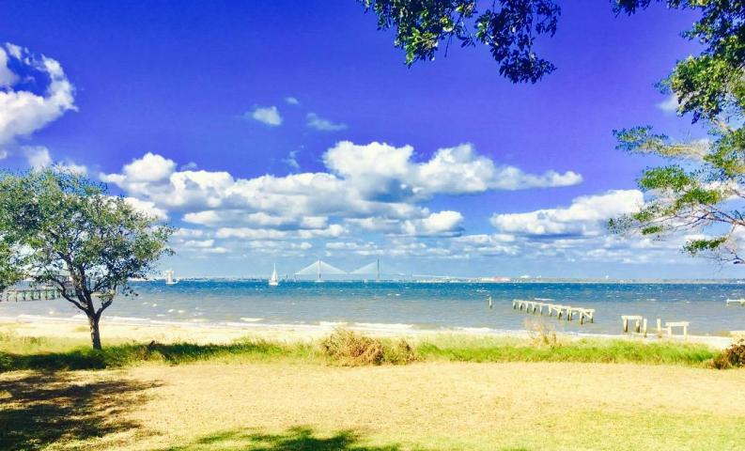
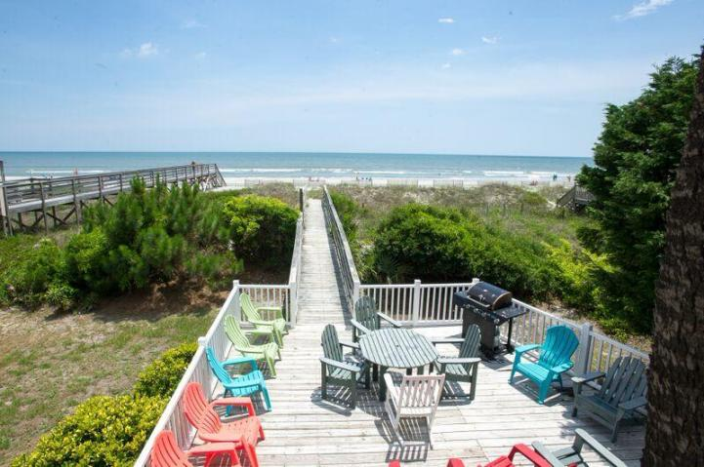
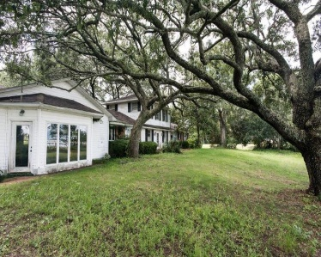
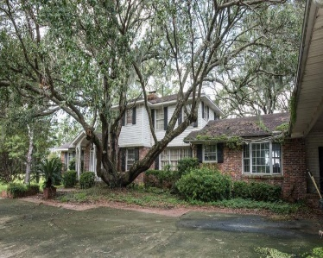
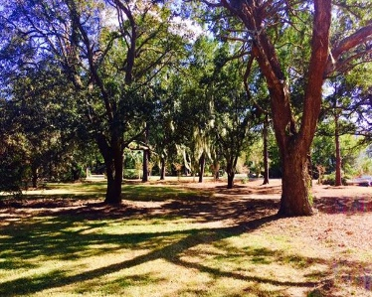
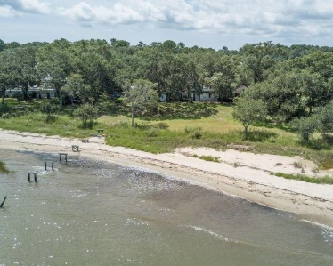


Renovate or Build The Home Of Your Dreams
606 Wampler Drive
Eastwood · Charleston, SC 29412
MLS# 17022732 · $3,750,000
Stunning view like no other on the market. 2.25 acres of Direct deep-water access on Charleston Harbor (nothing else compares lot wise on the harbor) with full views of South Battery, the beautiful church steeples of Charleston, Charleston Harbor, The City of Charleston, Mt. Pleasant and the Ravenel Bridge. Three lots are listed with the property under one TMS number. Perfect opportunity to build a luxury home of your dreams or renovate home currently on the property. Location is filled with a beautiful beach, amazing ocean and harbor breezes, nearly adjacent to the James Island Yacht Club and all of the best of the waterways in the area. Be offshore from your own dock in a matter of ten minutes. First time this property has been on the market in nearly half a century. Unbelievable locale.
Bryan Thompson
Office - (843) 769-5100
Mobile - (843) 452-1686
bryan.thompson@agentownedrealty.com
www.bryanthompsonrealestate.com
AgentOwned Charleston Group | 902 Savannah Hwy | Charleston, SC 29407-7802

