Slide 1
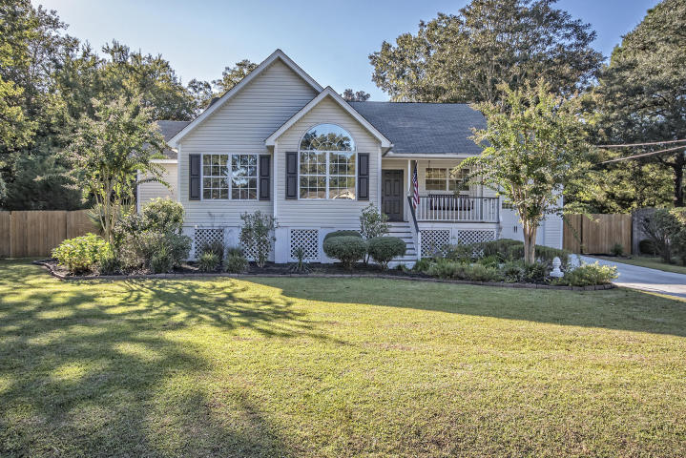
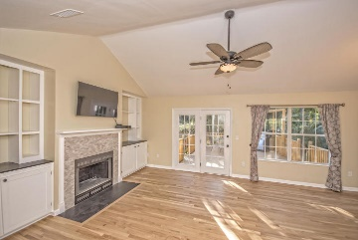
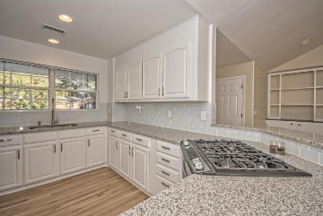
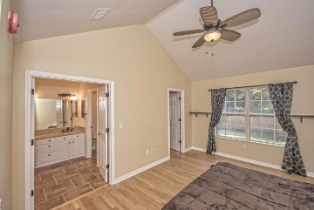
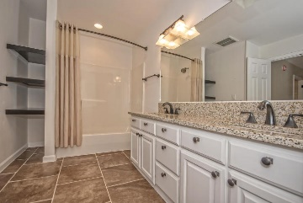
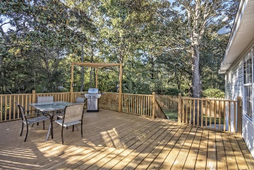
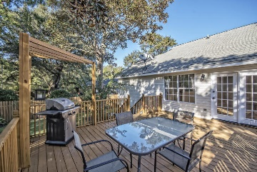
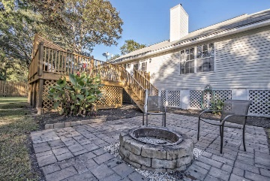
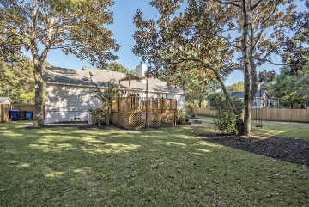


607 Constant Drive ~ Stono Shores Professional Renovation 3BR/2BA Home on James Island!
Immaculate professional renovation just completed, and ready for an owner to call it home. The open floor plan boasts stunning refinished oak floors, fresh paint, and a chef's kitchen invite you home. The granite countertops, glass subway tiling, and white poplar cabinets give a warm yet modern feel to the kitchen. Master BR with on-suite has vaulted ceilings, appointed with dual vanities on Curava counters and Moen faucets. Two large guest rooms (plus a FROG), and the full bath were also completely renovated down to the illuminated light switches and the magnetic door stops. The back yard has also been professionally landscaped and offers a fire pit, paver patio, and an enormous 20x15 deck with privacy galore. This is a MUST see at this price point with such custom home finishes.
MLS# 15027109
$329,900
Haynes Johnson
Mobile - (843) 864-8159
haynes.charlestonproperties@gmail.com
The Boulevard Company, LLC | 35 Broad Street | Charleston, SC 29401 | haynes.charlestonrealestate.properties

