Slide 1
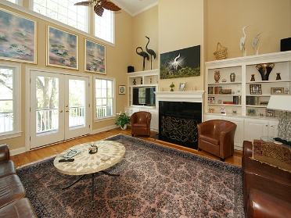
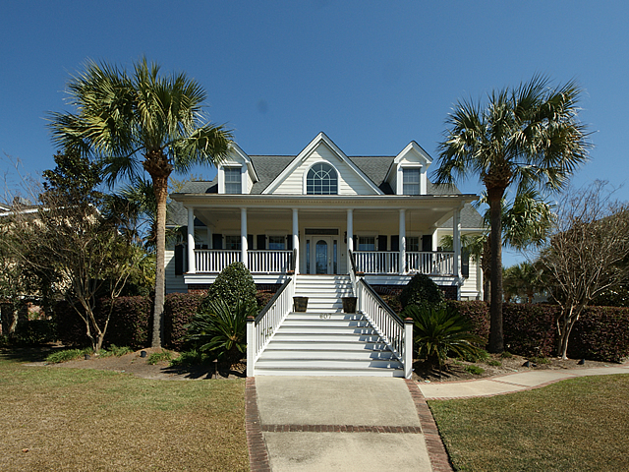
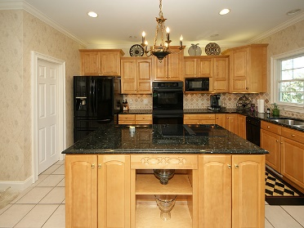
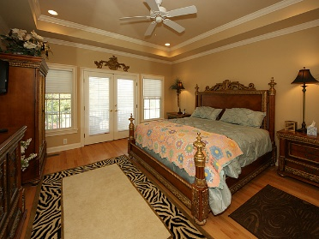
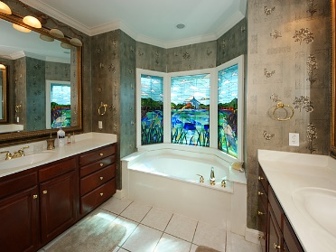
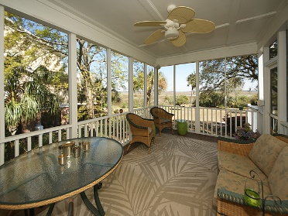
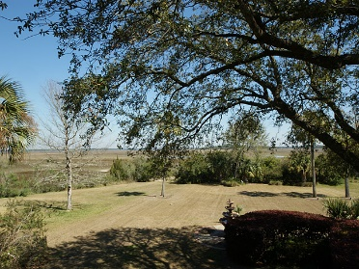
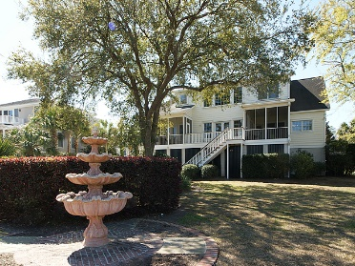


Marshfront Executive Home ~ Motivated Seller
607 Island Walk E
MLS# 17007795
$950,000
$450,000
Welcome to one of the best locations in Mt. Pleasant at The Islands. Minutes to downtown, this home sits on a beautiful lot overlooking the marsh and views of the water. The full front porch is the perfect place to greet friends. Upon entering home there is a separate dining room & office. From the great room you are struck by the beautiful views and all the natural light. The kitchen is a chef's dream with granite counters, island, wine bar with lots of storage. Back of the house has porches and decks overlooking the fountain and yard with special lighting. Upstairs 3 bedrooms & amazing storage. There is a 3 car garage, hurricane shutters for all windows. This elegant home has it all beautiful lot, open floor plan with lowcounty views throughout. Welcome! Recent appraisal in hand.
Peggy Reese
E-PRO, GRI
phreese@bellsouth.net
Mobile (843) 693-2050
Real Estate ● Mortgage ● Insurance ● Business Brokerage

