Slide 1
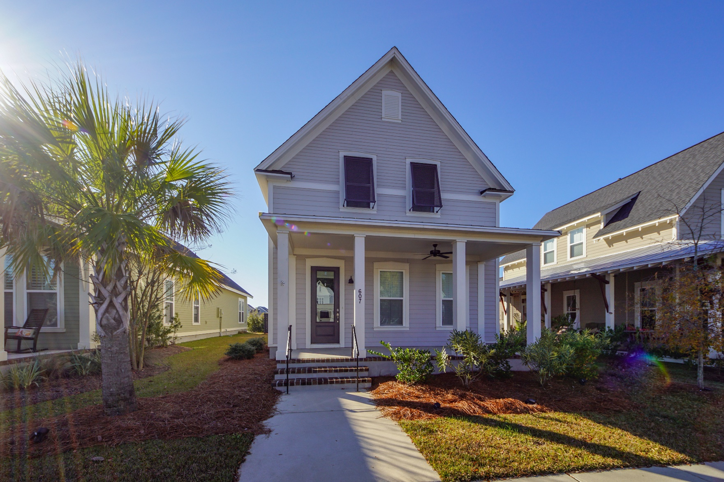
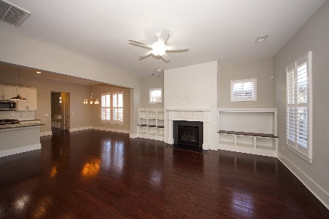
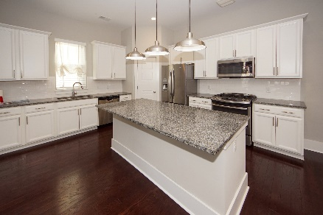
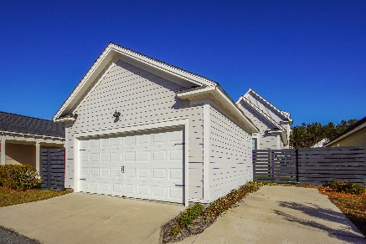


607 Long Meadow Street Nexton :: Summerville, SC 29486 MLS# 19032265 :: $2,250 3 Bed / 2½ Bath
Rental for $2,250/month
New Price!!
Gorgeous home offers an open floorplan, large family room with fireplace & custom shiplap book case, a gourmet kitchen with large center island, granite counter-tops, up-graded cabinetry, a double pantry and gas range! The Spacious Master Suite is located downstairs and features a large walk in closet and is accompanied by a master bath complete with double shower and water closet. The downstairs also features a large separate laundry and an alcove that is perfect for an office area. The upstairs features a spacious loft, full bath and two large bedrooms. Other features include; hardwood floors throughout main living areas, upgraded carpet in bedrooms and ceramic tile in baths. Home is situated on a premium lot across from hammock park / green space. Neighborhood Pool & More!
Connie White, Broker
843-532-3356
connie@chrepros.com · conniewhiterealestate.com
Charleston Homes · 597 Old Mt. Holly Road · Suite 301 · Goose Creek, SC 29445

