Slide 1

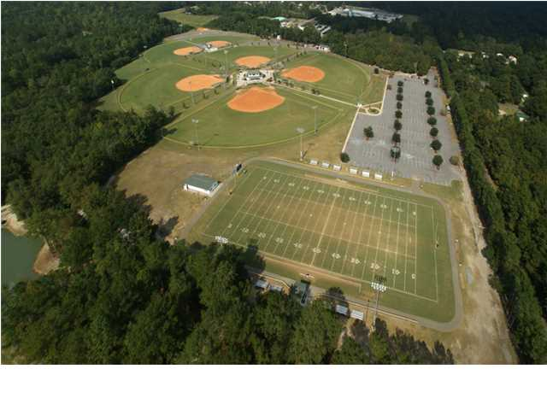
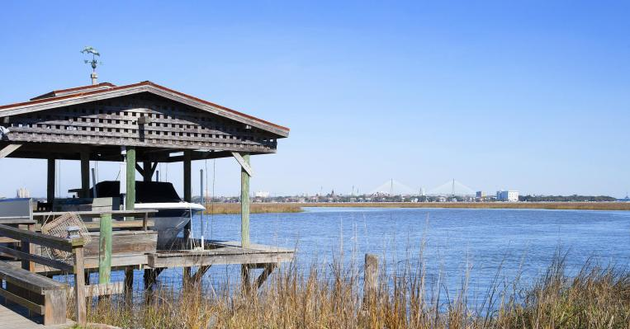
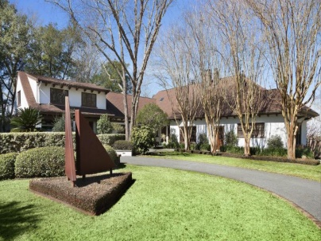
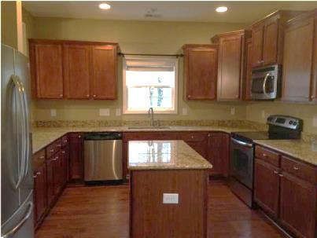
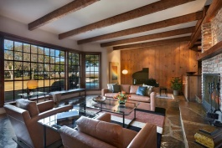
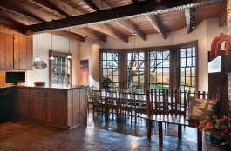
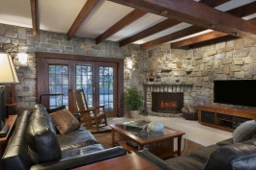
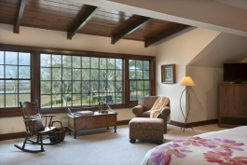
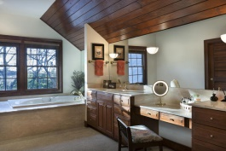
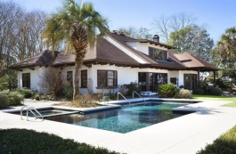

Pam Bass, Realtor
M 843-259-4926 | O 843-871-2121
www.pambassproperties.com
pbass@century21properties.com
607 N Shore Dr | Lawton Bluff | Charleston | MLS# 15005649 | $4,395,000
Prepare yourself for one of the MOST EXPANSIVE WATERFRONT VIEWS in Charleston from this spectacular one of a kind DEEP-WATER ESTATE nestled among mature moss-covered live oaks on a secluded 2 acre lot, located 10 minutes from Historic Charleston. One of Charleston’s Top Architects, Frank Lucas recreated 4300 square feet of luxury beginning in 1995 when he purchased this home for his personal residence, including major renovations and adding an additional 1800 square feet, including a 2nd floor master bedroom with en-suite and an abundance of storage space. This house offers both an upstairs and downstairs luxurious master suites, both with breathtaking views of the Charleston Harbor. The upstairs bathroom has a jetted soaking tub with separate tiled shower and dual sinks and an enormous walk-in closet with built in drawers. There are two additional bedrooms and two full baths on the first floor. The kitchen features double ovens, a gas range with 6 burners, a wood burning fireplace and large eat in dining area. There is a separate formal dining room with beautiful heart of pine flooring that opens into a large living room with Tennessee Crab Orchard Flagstone flooring. The family room has built in bookshelves along with a stone fireplace with French doors opening onto an outdoor terrace. The exposed beams, several post and the pine flooring in the home were all recovered from an old 17th Century Church demolished in downtown Charleston. The house has 4 working fireplaces and an antique bread warmer oven. There is also a large game room with built-ins upstairs. Outside there is an abundance of outdoor living space with a patio with built in grill, in-ground heated swimming pool with attached hot tub, and a separate building used for cookouts which was a bunker during the Civil War. There is an additional outbuilding with approximately 600 square feet that was at one time used as a guest cottage, but now used as a storage/workshop space with a bath house. This pristine grounds has a long causeway that leads to the Deepwater dock with floater, 10,000 lb. boat lift, dry slip and even a fish cleaning station to clean your fresh catch â€“ has power and water. Enjoy boating, fishing, kayaking and paddle boarding right in your backyard. You even have your own boat ramp to launch a small boat. With over 180 degree views overlooking the Charleston Harbor to Historic Downtown Charleston, breathtaking sunsets, a private dock and outdoor living spaces, this home represents LOWCOUNTRY WATERFRONT LIVING AT ITS BEST ~ A MUST-SEE!!

