Slide 1
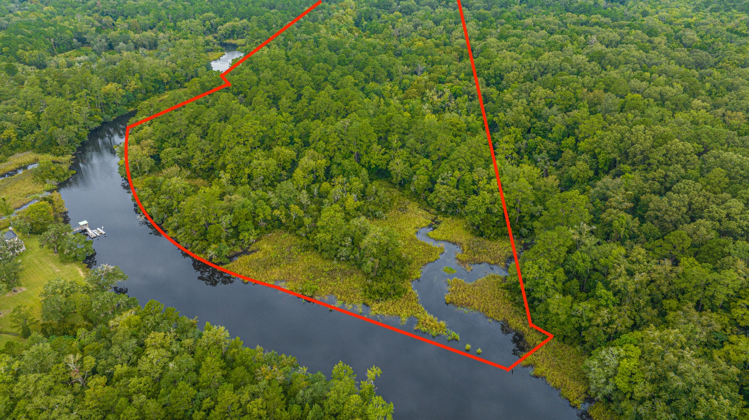
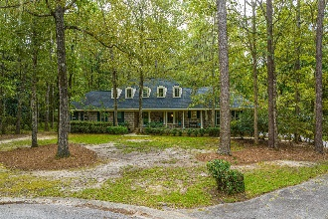
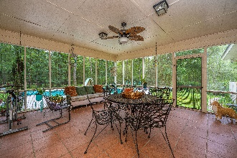
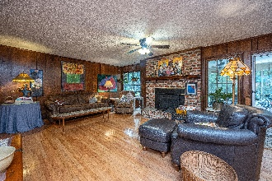
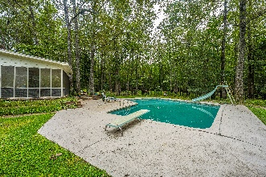
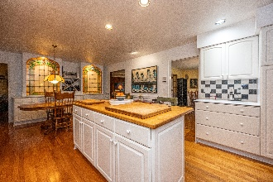
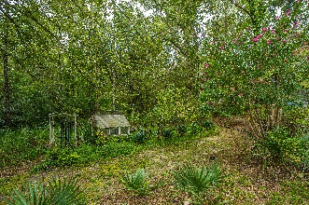

607 Mayfield Street Ashborough ~ Summerville, SC 29485 ~ MLS# 23021479 ~ $1,000,000
The Only Deep Water Home On Daniel Island
Agent Open House
Tuesday October 10th 11:30 to 1:30
Hall's Gift Card Drawing
607 Mayfield Street in Ashborough is now for sale! The listing comprises 2 TMS #'s 's 161-11-01-003 and # 161-00-00-031, a total of 25.91 acres. This unique property is located at the end of Mayfield Street, a cul-de-sac location, and the land sits between the Colonial Dorchester State National Park and the Ashley River! This all-brick home features 3 bedrooms and 2 full baths downstairs with 2 additional bedrooms and a full bath upstairs. Upon entering the home, you are welcomed in a proper foyer with the large eat-in kitchen to the right and the bedrooms to the left. The family and dining room are at the back of the home. The oversized kitchen features 2 beautiful built-in stained-glass pieces, tons of cabinetry, built-in island, solid surface counter tops, stainless steel appliances, a bay window and ample room for dinette/breakfast tables. The large family and dining room both overlook the wooded and VERY private 25-acre property. Step out onto the tiled 17ftX20ft screened-in porch and enjoy all your evenings and morning coffee out here. You can exit the screened porch either onto the 636sqft wood deck OR onto the pool patio. After you enjoy a swim, you can use the outdoor shower! The acreage on the property is just beautiful. You will find where a garden and greenhouse were used to the right of the home. This is one of the areas that the current owners had made trails to walk down to the Ashley River. It has been a while since these trails have been used thus are now overgrown in areas. All of this happens to be in the Ashborough Subdivision which offers many amenities including the Ashborough Lake, a neighborhood pool, tennis courts, volleyball court, basketball court and a play park. Ashborough Residents have access to the 3.9 miles of Nature trails that have been established throughout the approximate 96 acres that is owned by the Ashborough Association along the Ashley River as well. Home to be sold in as-is condition!
Nickole Samios
(843) 330-4136
nickole@carolinaone.com
Carolina One Real Estate
900 N Main St
Summerville, SC 29483
www.summervillesouthcarolinahomes.com

