Slide 1
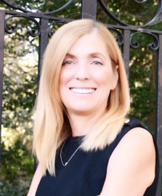
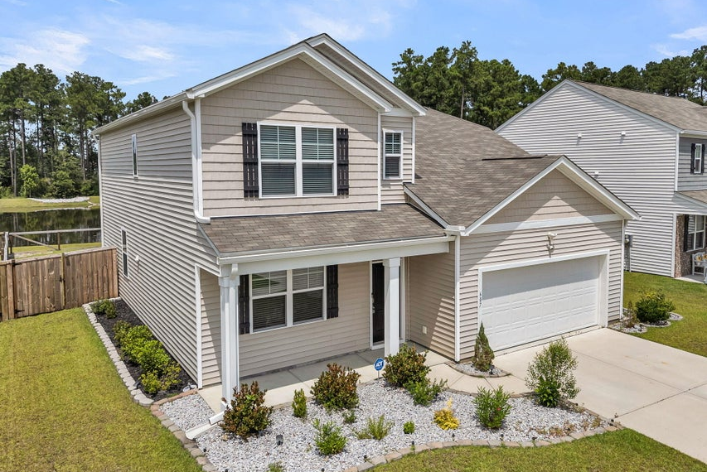
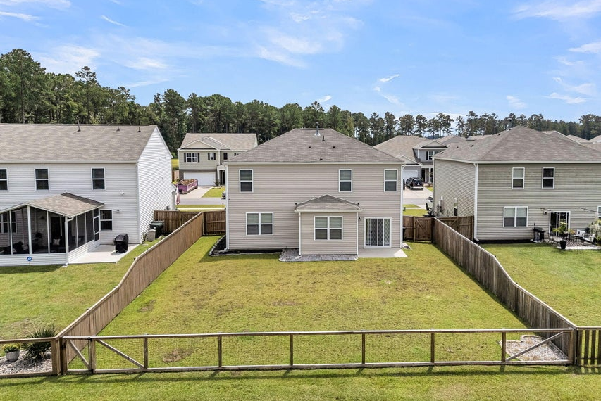
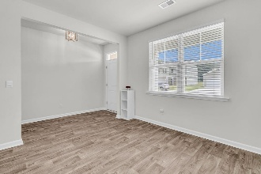
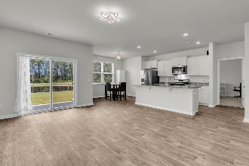
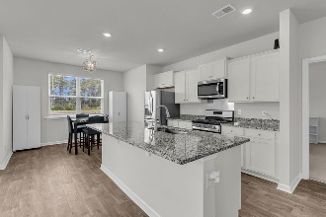
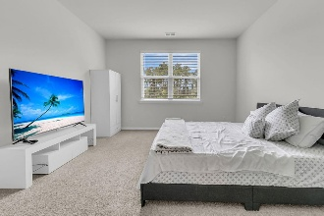
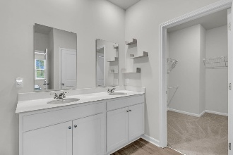

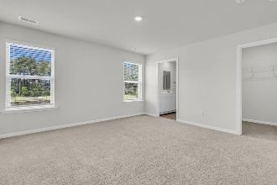
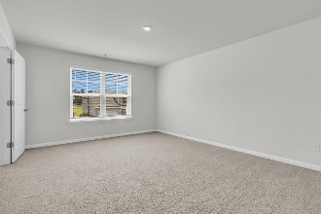
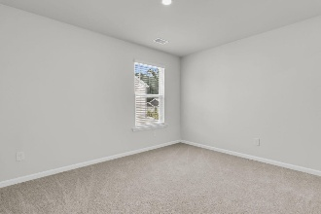
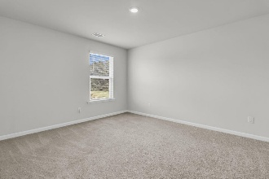
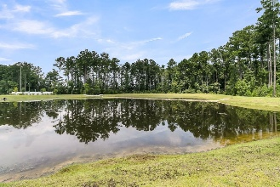
Better Than New!
$5K Buyer Incentive
Debbie Cromer
ABR, RSPS, REALTOR, CRS
(843) 437-6342
debbie@debbiecromer.com
www.debbiecromer.com
607 Silver Spruce Street
Cane Bay Plantation | Summerville, SC 29486 | MLS# 25023135 | $429,990
Great new price on this Boetter Than New - Move-In Ready w/ Dual Owner's Suites! Offering $5,000 flex money, this stunning home is better than new & ready now—why wait on new construction? Featuring two primary bedrooms—each w/ ensuite baths—this flexible floor plan is perfect for multigenerational living or those who love extra space & privacy. The main level includes a formal dining room, laundry room, & an open-concept layout where the spacious kitchen flows seamlessly into the living room, casual dining area, back patio, & fully fenced backyard. The first-floor owner's suite offers multiple closets & a spa-like bath w/ dual vanities. Upstairs you'll find three additional bedrooms—all w/ walk-in closets—plus a second expansive owner's suite complete w/ two walk-in closets & a large private bath.
Located in Cane Bay's popular Pine Hills community, you'll enjoy miles of scenic walking & jogging trails along w/ a brand-new, state-of-the-art amenity center featuring a sparkling pool & play park just down the street. This one checks every boxspace, style, convenience, & unbeatable amenities. Don't miss your chance to call it home!
TAKE A VIRTUAL TOUR | PROPERTY WEBSITE
Century 21 Properties Plus | 1090 Park West Blvd; Ste 103 | Mount Pleasant, SC 29466

