Slide 1
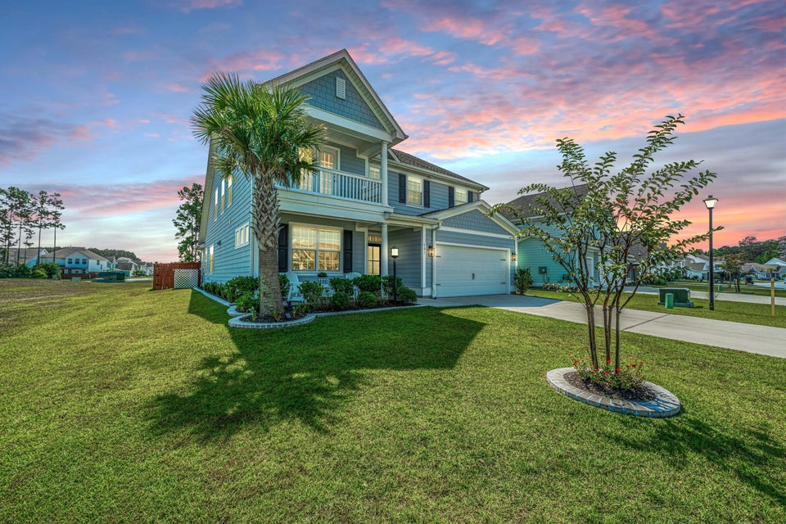
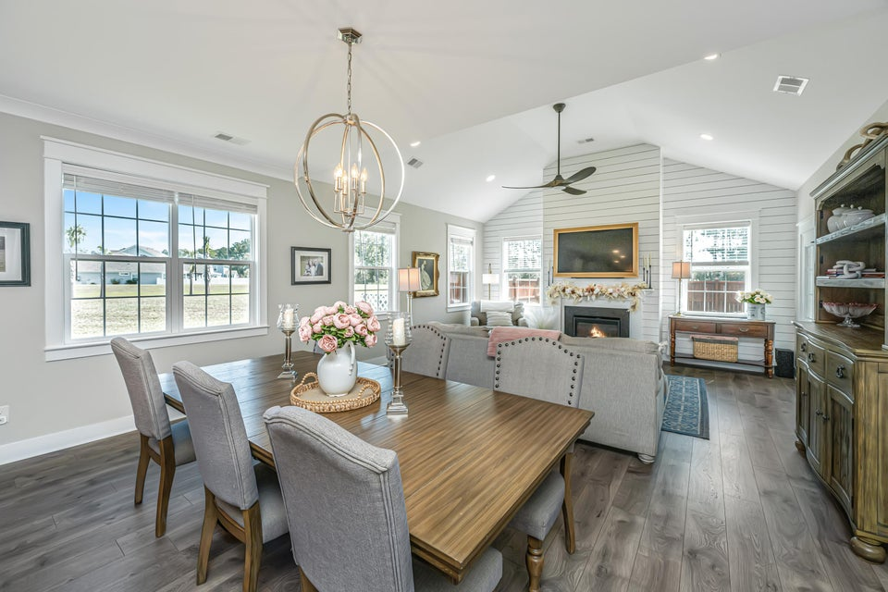
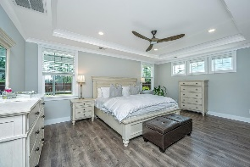
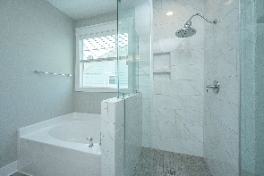
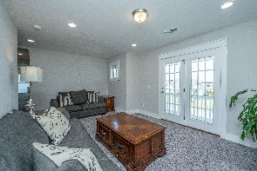
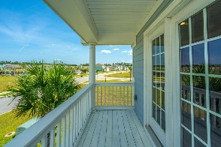
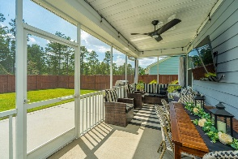
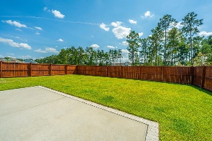


$10,000 Realtor Bonus + 2.5% Broker Comp
607 Yellow Leaf Lane
Cane Bay Plantation | Summerville, SC 29486 | MLS# 24024960 | $594,000
MOVE - IN READY IN THE HAMMOCKS
Situated on a **premium corner lot** offering extra space and privacy. This beautiful 5-bedroom, 3½-bath home is bathed in natural light, with upgraded lighting and thoughtful storage throughout. The Chef's Kitchen is a true centerpiece, featuring a gas cooktop, wall oven, and a large island wrapped in shiplap, perfect for entertaining. Modern cabinetry with pull-out drawers and a Butler's pantry add convenience and style. The Great Room impresses with its vaulted ceiling, shiplap accents, and a cozy gas fireplace, creating an inviting space to relax. The 1st-floor Owner's Suite provides a peaceful retreat with a tray ceiling, spa-like bath, and custom his and her closets.
Also on the 1st floor, a walk-in laundry room with upgraded cabinetry and marble counter is sure to please. Upstairs, you'll find 4 additional bedrooms, 2 full baths, and a spacious loft/media room that opens to a 2nd-floor balcony, ideal for relaxing and enjoying the view. Outdoor living shines with a fenced backyard that backs up to serene wooded greenspace, offering privacy and plenty of room for activities. A screened-in porch is perfect for morning coffee or unwinding after a long day. For added convenience, a gas line is already installed for your gas grill. Located just a short walk from the community pool and the scenic Cane Bay Trail System, this home also provides easy access to local schools, dining, shopping, and the new YMCA. It's the perfect blend of comfort, convenience, and charm. Don't miss the chance to make it yours! $10K Realtor Bonus that it is with a ratified contract by 11/15
Take a 3D Virtual Tour
Debbie Rogers (843) 990-2915
deborah.rogers@carolinaone.com
www.DebbieRogersSellsCharleston.com
Carolina One Real Estate | 2713 Highway 17 North | Mt. Pleasant, SC 29466

