Slide 1
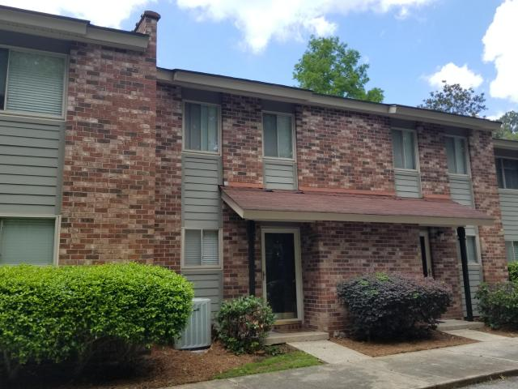
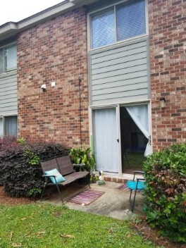
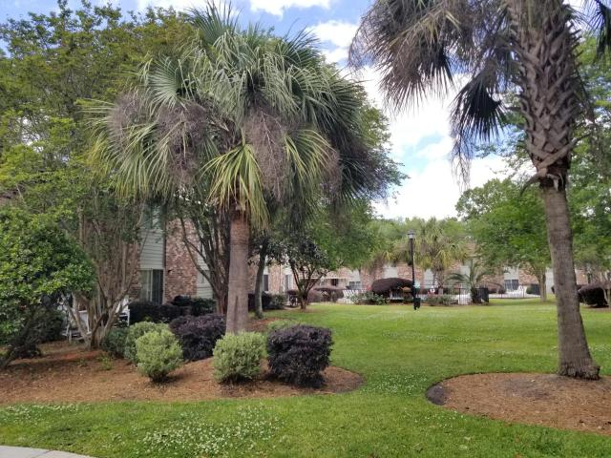
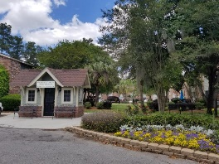

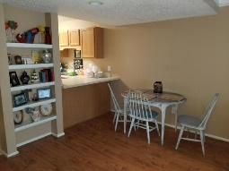
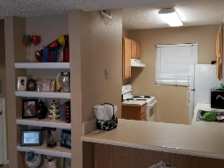
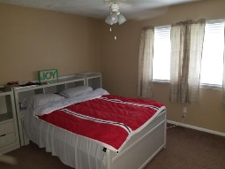
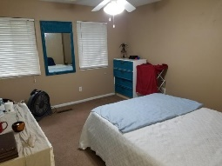
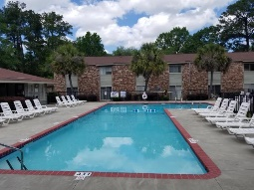


Don't let this one slip away!
Great Investment Opportunity!
608 Andrea Lane Otranto Station | Hanahan, SC 29410 | MLS# 18011422 | $95,000
One year Home Warranty INCLUDED and seller to pay $500 towards closing costs with acceptable offer! Tenant occupied through 9/30, receiving $900/month in rent.
This 2 bedroom, 1 1/2 bath unit is tucked away in the back of a well-maintained neighborhood.
Close to I-26, Boeing, Mercedes-Benz Vans, SPAWAR, Volvo & Charleston Southern University.
Great amenities including a pool, playground area & clubhouse.
Monthly regime fee covers the termite bond, water/sewer, exterior insurance, lawn maintenance, pool, playground and trash pick-up.
Whitley Boyd
(843) 324-4761
w.boyd@agentowned.com
www.PropertiesofCHS.com
AgentOwned Preferred Group | 824 Johnnie Dodds Blvd | Mt Pleasant, SC 29464

