Slide 1
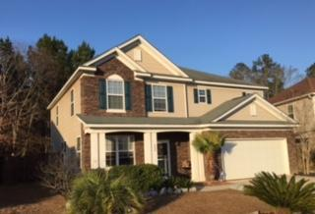
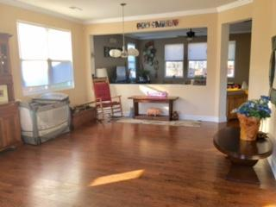
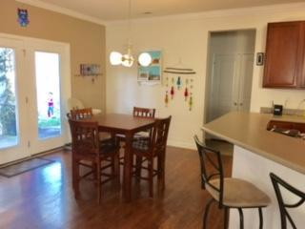
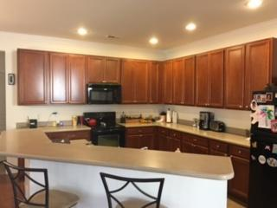
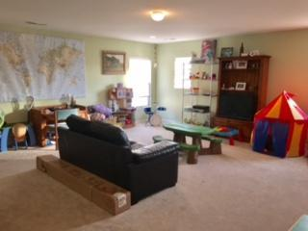
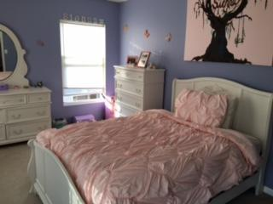
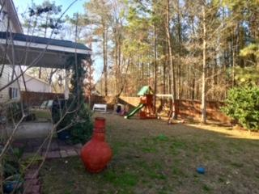
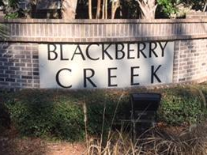
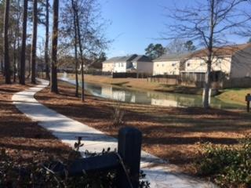
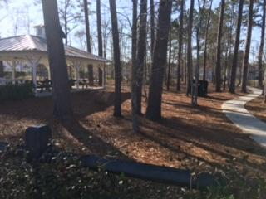

608 Grassy Hill Road
Blackberry Creek
Summerville, SC 29483
MLS# 17001274
$269,000
3 Bedrooms | 2½ Baths | 2,791 sf
Guess Who's Coming to Town? No, Not Santa… It's Volvo!
I loved this townhouse so much
I bought one myself!
Yes, that is correct! This is the hometown of the new $500 million Volvo Car USA plant, and if you have clients moving here to work at Volvo, please check this home out. The original owners are selling this 2700+ square foot home in Blackberry Creek, Summerville, SC. This beautiful section offers a quiet and quaint community, which is tucked away in the woods of Summerville. Convenient access to I-26 gives the commuter an easy commute to most of the larger employers in the Tri-County area; including Boeing, Volvo and other companies moving to the area. This lovely two-story Dearborn floor plan home features; 3 large bedrooms, a spacious loft area, which could be a forth bedroom if closed off, a large living room and dining room area. The eat-in kitchen with 42-inch maple kitchen cabinets, Corian counter tops with a huge pantry makes preparing any meal a delight. The large master bedroom has recessed lighting, a spacious closet, and a combination jetted tub with shower. Downstairs there's a half bathroom, separate laundry room off the kitchen and a spacious two car garage. Nine foot ceilings make the rooms feel larger and brighter than they already are! The backyard is fenced-in for your dog or the kids! Energy Star Certified!
Susan & Greg Day
843-900-0477 | 732-757-2904
charlestonbyday@gmail.com
www.charlestonbyday.com
AgentOwned Realty Co. Premier Group, Inc. | 824 Johnnie Dodds Blvd | Mt Pleasant, SC 29464

