Slide 1
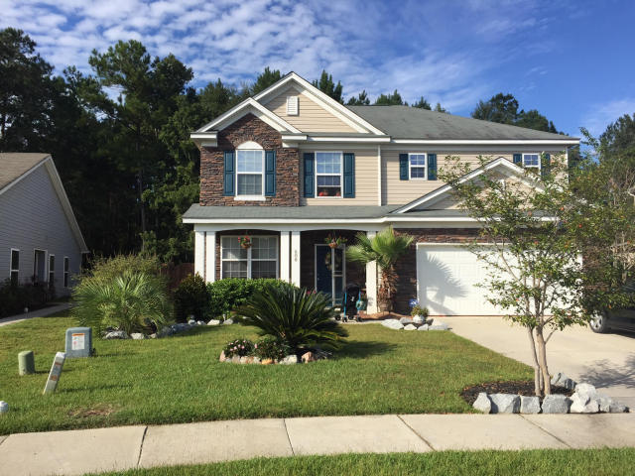
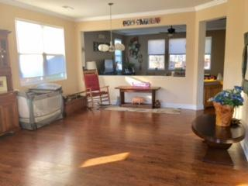
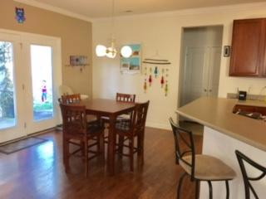
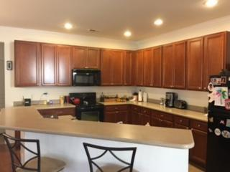
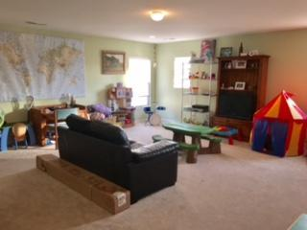
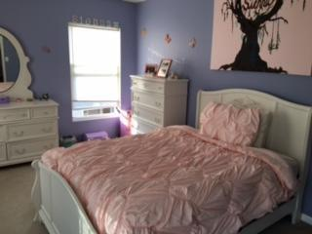
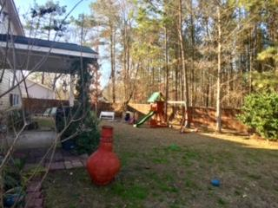
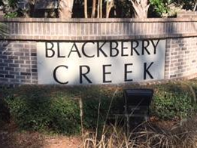
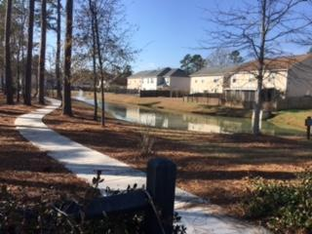
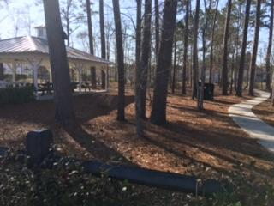

608 Grassy Hill Road
Blackberry Creek
Summerville, SC 29483
MLS# 17001274
$259,000
3 Bedrooms | 2½ Baths | 2,791 sf
Guess Who's Coming to Town? No, Not Santa… It's Volvo!
Recently Reduced ~ Sellers Offering $1,000 Agent Bonus
The owners are offering for sale this 2700+ square foot home in the Blackberry Creek Section of Summerville, SC. This beautiful home lies in a heavily wooded secluded development that offers quiet, secure living situated in the award winning Dorchester II School District, all neatly tucked away into the woods of Summerville. This lovely two-story Dearborn floor plan features: 9 foot ceilings throughout, multiple recessed lights, a large open living room adjacent to the equally large family room / eat-in-area with the connecting spacious kitchen providing enough cabinet and counter space for the most demanding of family needs. The laundry area and half bath are situated in the back hallway providing quick access to the two car garage. Upstairs there are three large bedrooms with plenty of closet storage. The spacious loft area can be easily walled off to provide a fourth bedroom. The large master bedroom has recessed lighting, a spacious closet, connecting master bath has separate shower and jetted tub. There is an additional full bath serving the other bedrooms. The large backyard is completely fenced-in with plenty of privacy provided by a backdrop of dense woods. Quiet neighborhood, quality schools, ease of commuting access are cornerstones to a quality life you can experience by living in this lovely home.
Susan & Greg Day
843-900-0477 | 732-757-2904
charlestonbyday@gmail.com
www.charlestonbyday.com
AgentOwned Realty Co. Premier Group, Inc. | 824 Johnnie Dodds Blvd | Mt Pleasant, SC 29464

