Slide 1
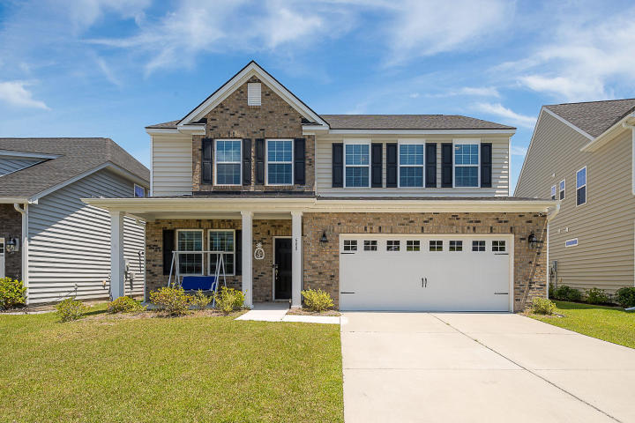
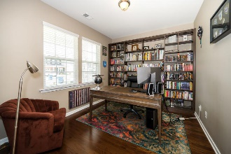
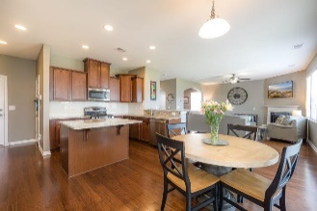
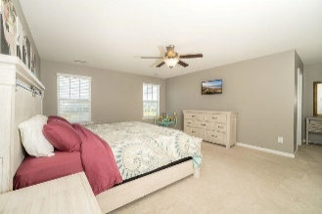
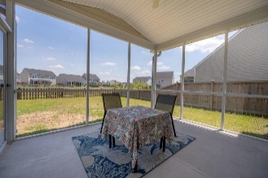
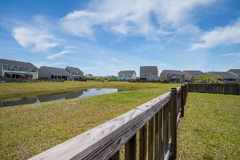


MUST SELL THIS WEEK! Bring all offers!
$15,000 Agent Bonus
with ratified contract by 4/15/18
608 Redbud Lane
Cane Bay Plantation
Summerville, SC 29486
MLS# 20012356
$309,899
$12,100 Under
Recent Appraised Value
Perfect Cane Bay home with a beautiful fenced in pond lot! This 4 bedroom 2.5 bath home features stunning hardwoods that welcome you upon entry. The spacious first floor offers a dining room with charming wainscoting and an office space with unique custom shelving. As you move to the back of the home you are greeted by a large living area that features a gas fireplace and large windows that overlooks the backyard and pond. The gorgeous kitchen overflows with entertaining potential with its size and style, all of which features a large walk in pantry. Upstairs you immediately step into a very functional bonus space which hosts 4 bedrooms and 2 full bathrooms. The large master bedroom boasts relaxation with two windows overlooking the pond and a master bathroom fitted with a large soaking tub and glass shower. Inside the large walk in closets, you'll find custom built in shelving with soft close drawers. This home also features the gutters, pre wired cable throughout, ceiling fans, tankless water heater located inside the garage, lawn irrigation system, and window treatments throughout. Lindera Perserve features a pool with splash pad, dog park, and playground.
Age, Sqft, schools, taxes & HOA fees are approximate. Buyer should verify all information deemed necessary.
Brad McCullough
843-345-0450
brad@theeverettgroup.net
RE/MAX Pro Realty, 9209 University Blvd, Charleston, SC 29406

