Slide 1
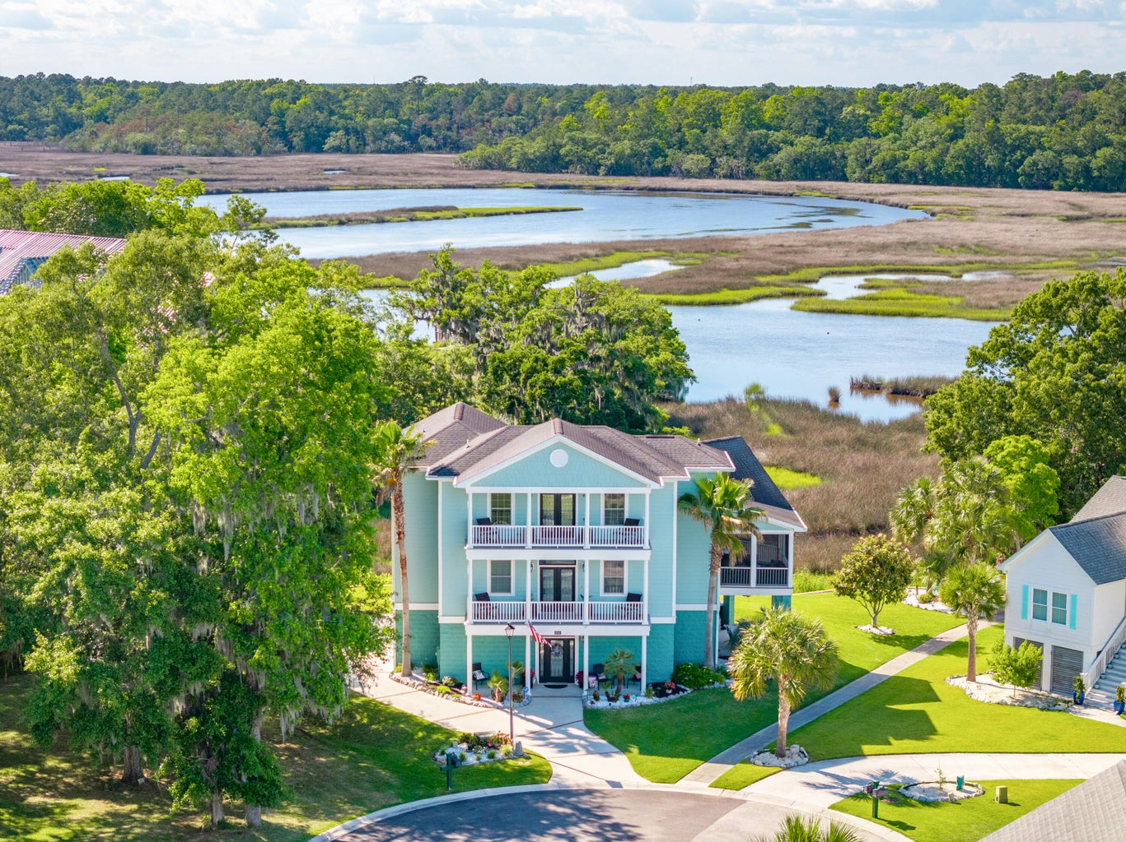
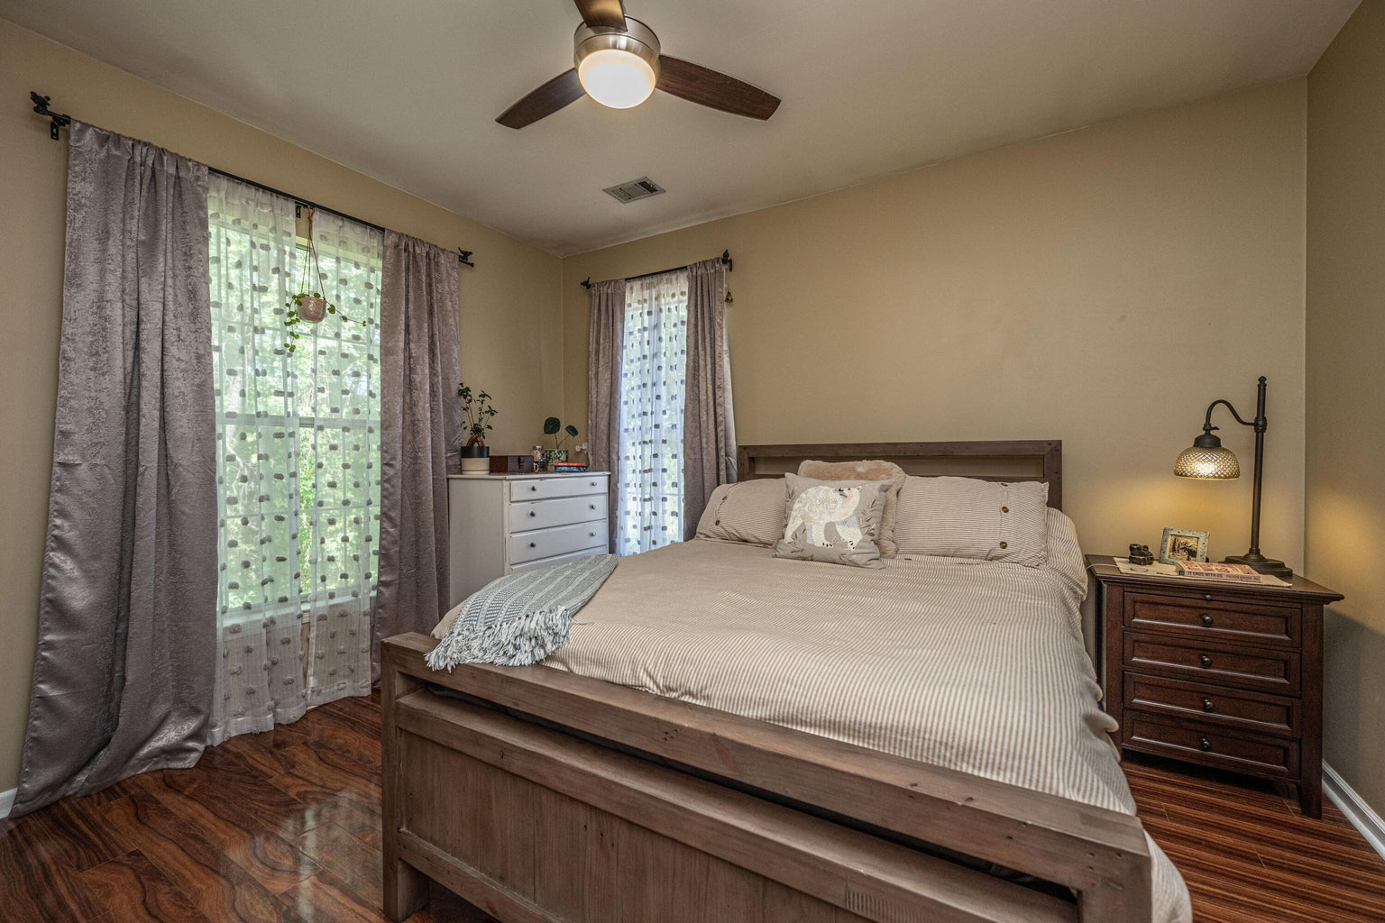
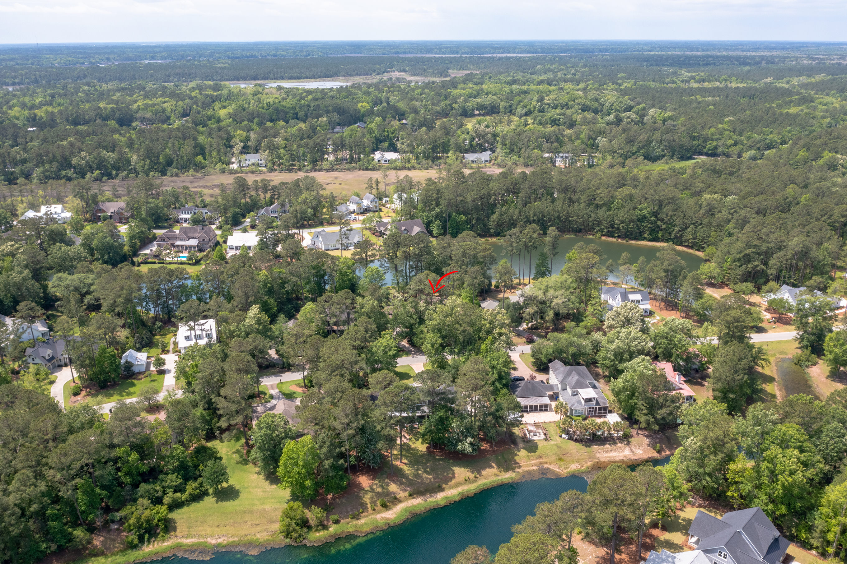
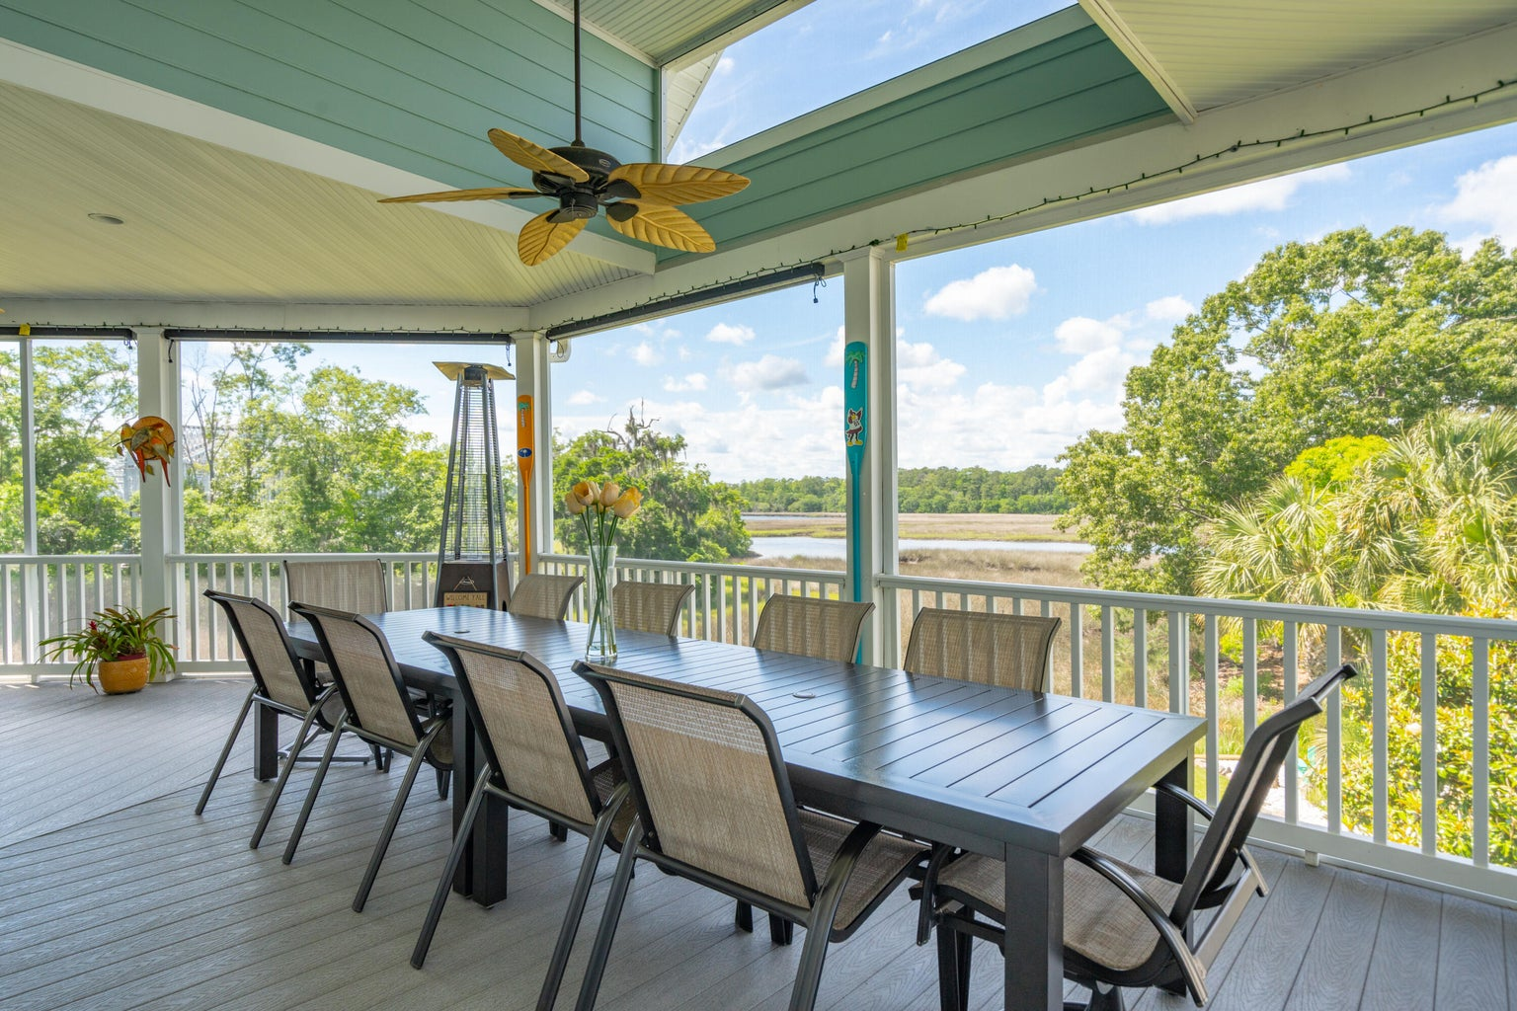
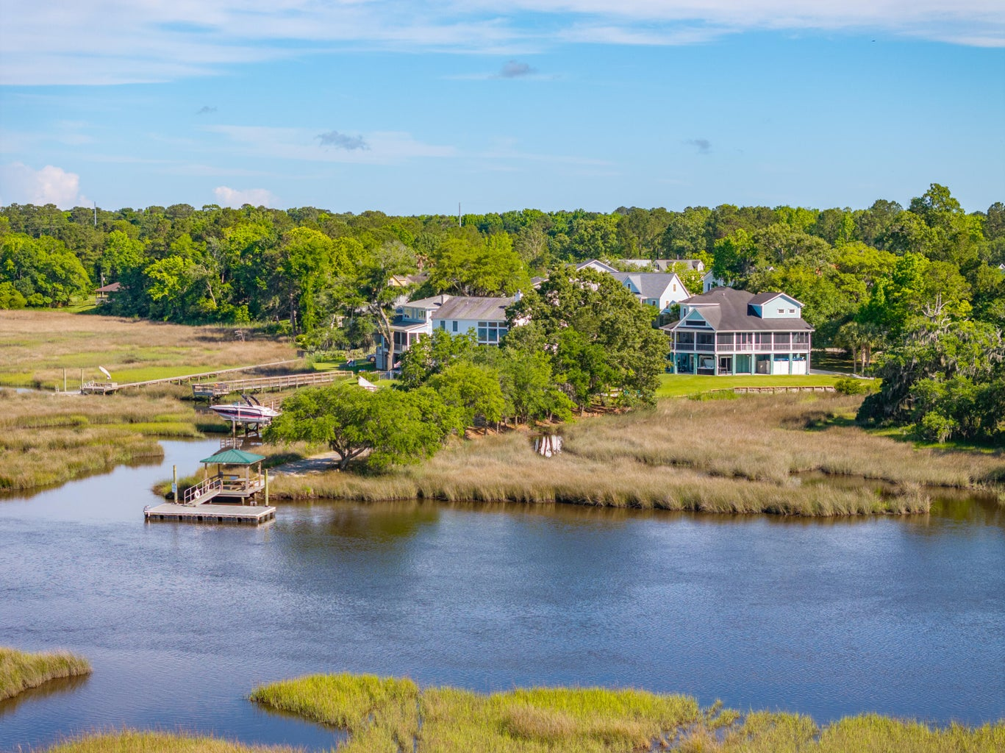
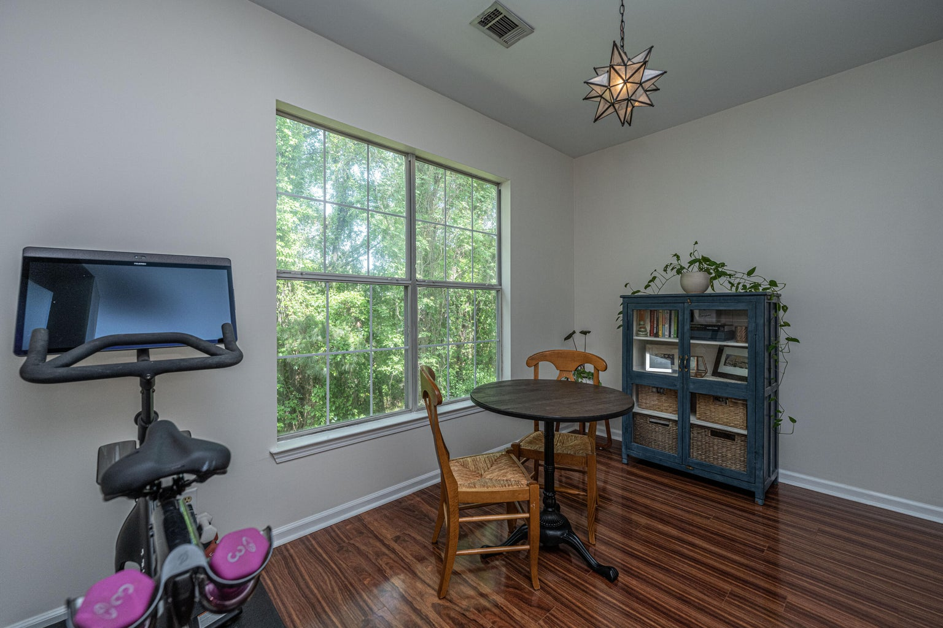



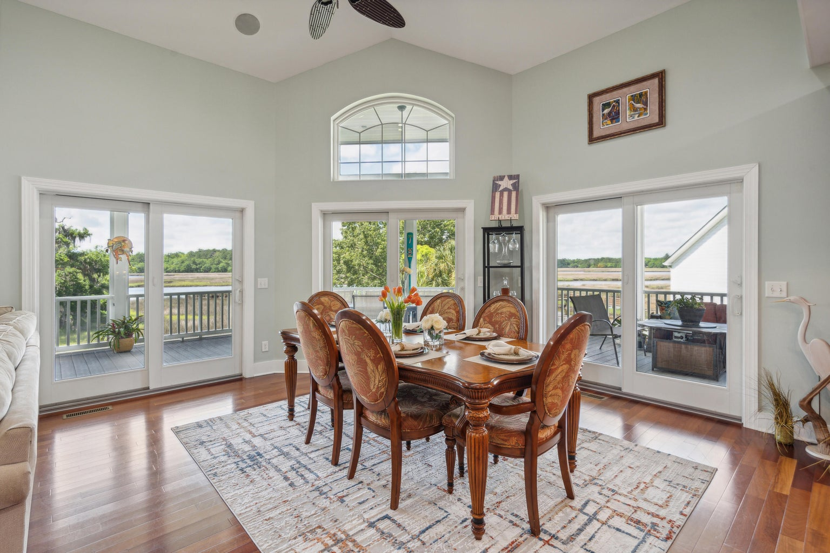
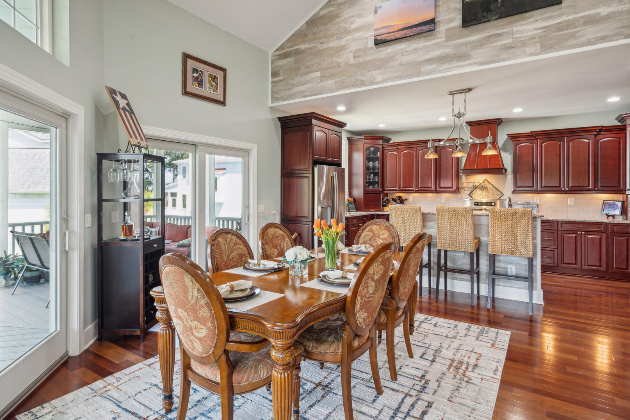
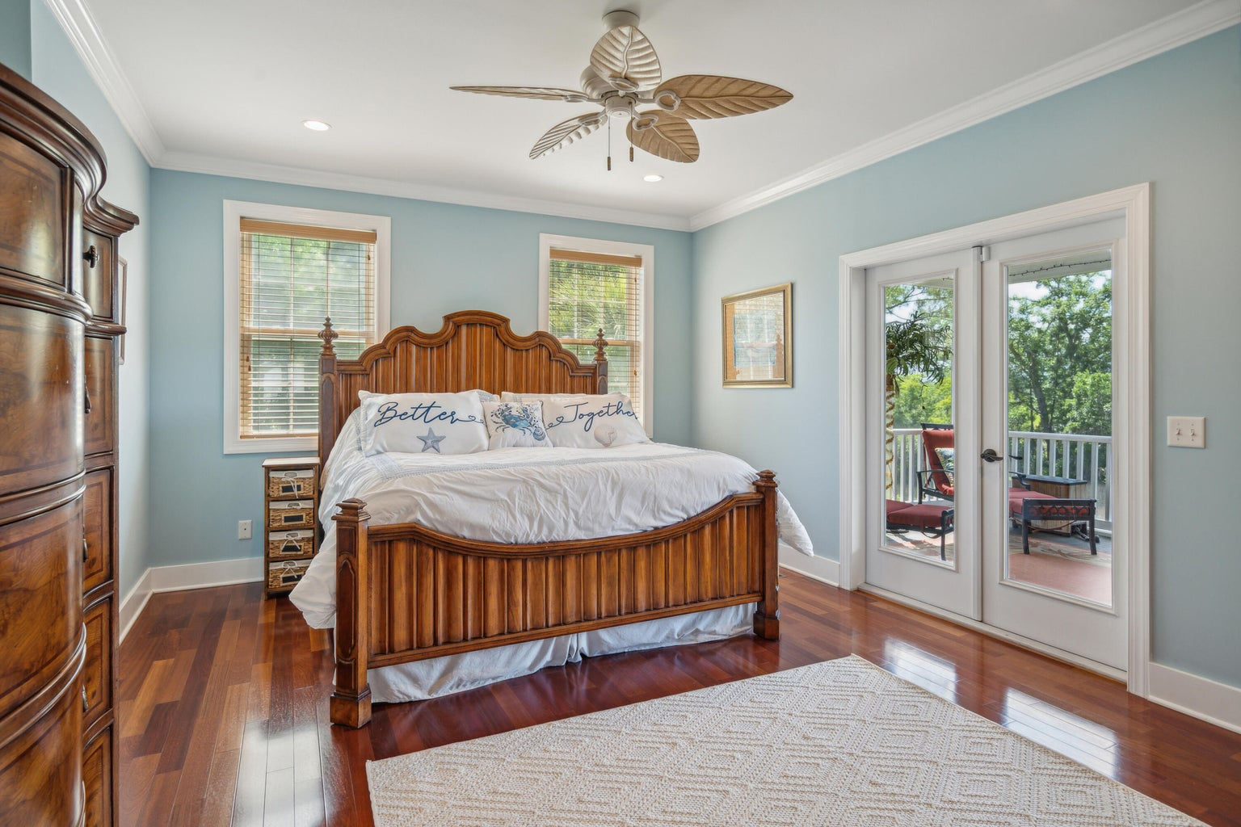
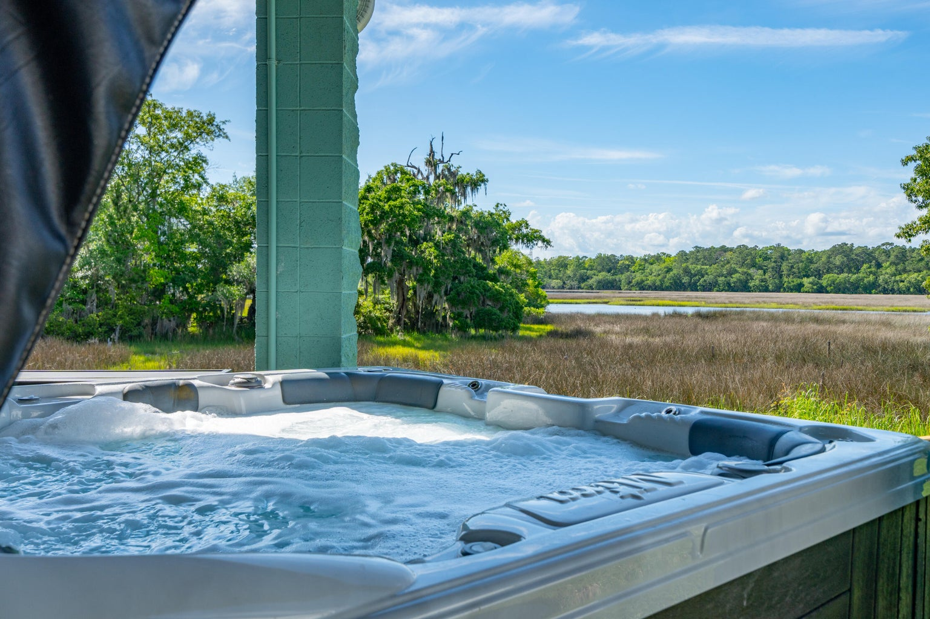



On the Water in Jacob’s Point
6099 Jacob’s Point Boulevard
Just Past West Ashley
Ravenel, SC 29470
MLS# 24011691 | $1,200,000
Enjoy Lowcountry waterfront living in this gorgeous home on Wallace Creek. The shared dock is steps away from the back door and this custom buildout includes an abundance of features in its well-thought design. With 4 bedrooms, 3.5 baths and 3426 square feet there is plenty of space for a large family or many guests. The primary bedroom is on the main floor with the open kitchen, living room, and dining room which all open out to a huge screened porch offering some of the most beautiful views including jaw-dropping sunsets. The ground floor offers a bonus space that could be an additional suite or an entertaining space with a bar and direct access to the covered back porch and hot tub. The top floor has two bedrooms, a bath, and a loft space. All of this is brought together with an elevator that gives access to all three floors.
VIDEO TOUR | VIRTUAL TOUR
Waterfront Views
Dock Access Out the Back Door
Elevator Accessing All Levels
Massive Screened Porch
Spa-Like Primary Suite
Potential Second Suite or MILS
4
3
1,844
Seth Stisher
843-270-2902
seth@stishgroup.com
www.stishgroup.com

