Slide 1
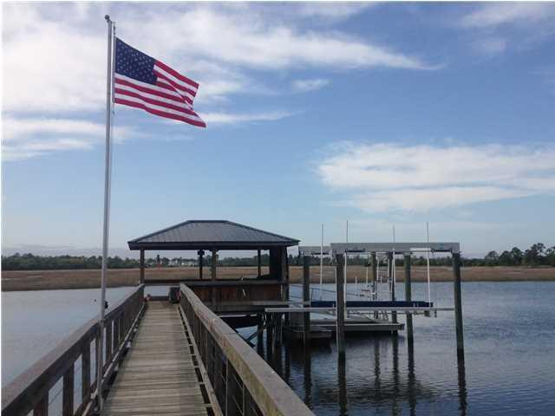
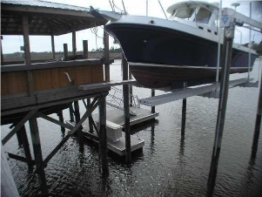

True deep water. Approximately 9' at low tide. Beresford Creek provides easy access to Charleston Harbor and the Atlantic Ocean. Custom dock with covered pier head, floater dock, fresh water and electric service already established. Dock includes ice maker, water heater, sink, shore power etc. 16,000 lb boat lift. Dock is built to provide access via standard sized gold cart. Stainless steel cable picket railings.
Deep Water Lot with Dock
on Beresford Creek
609 Barbados Drive
Beresford Hall
Charleston, SC 29492
MLS# 16000229
$899,000
Kent Jordan
(843) 375-2222
kenteastshore@yahoo.com

