Slide 1
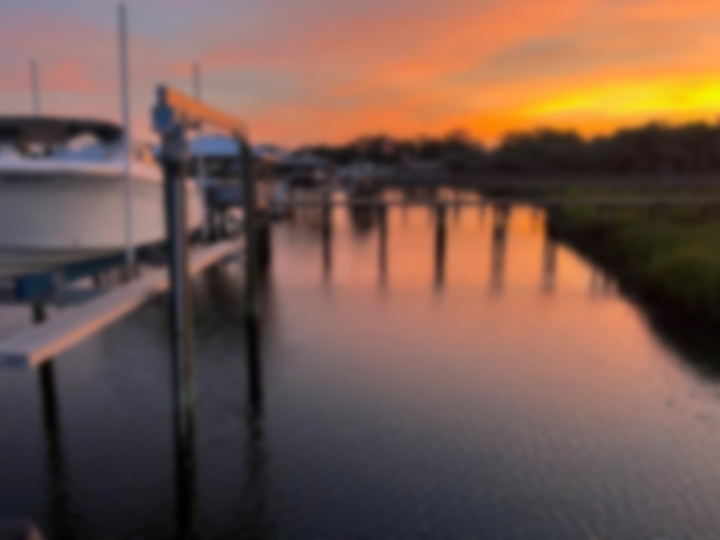
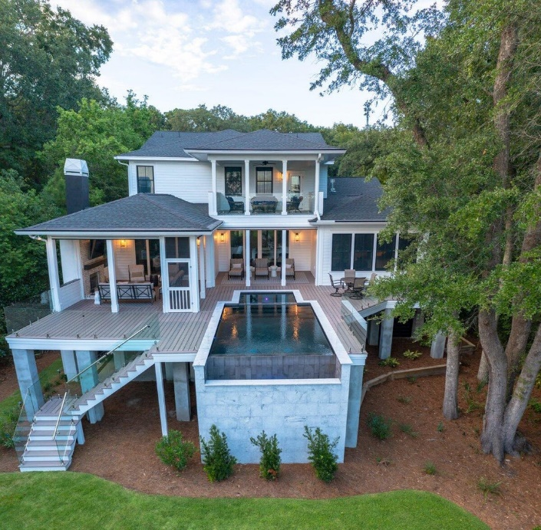
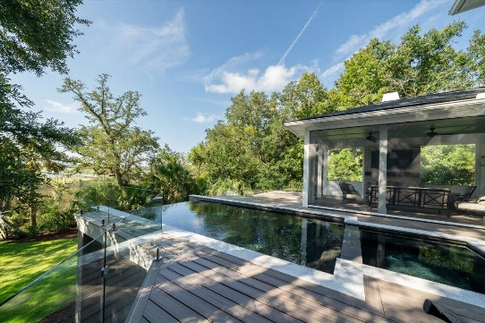
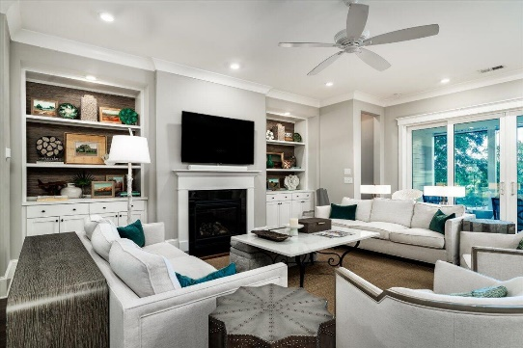
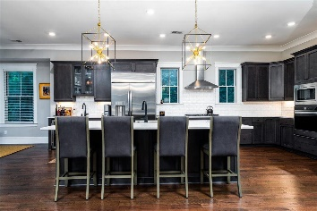
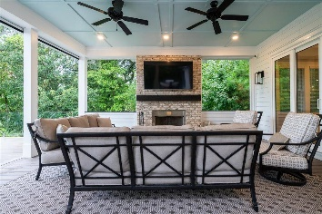
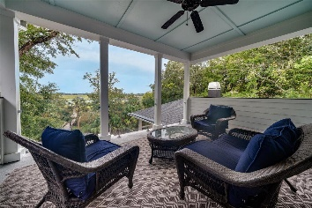
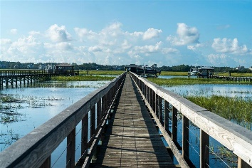
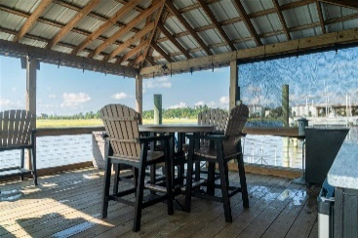


DEEP WATER OASIS | ASSUMABLE LOAN 2.49%!
609 Barbados Drive
Beresford Hall
Charleston, SC 29492
MLS# 23021388 | $3,999,999
Welcome to this exquisite coastal retreat in well sought out Beresford Hall near Daniel Island. Its a luxury private haven that epitomizes high-end living and offers the lifestyle you have been dreaming about. Built in 2020, this deep water, riverfront home is sure to impress with over 4,400 square feet, 4 bedrooms, 4.5 baths, and an infinity pool and spa (built in 2023) on 0.62 wooded acres. As you step onto the covered porch and enter the foyer, a sense of elegance and tranquility envelops you. The entryway is flanked by an impressive formal dining room boasting trey ceilings and a chandelier fixture, and a home office with an attached half bath. The bright and inviting great room offers expansive views of Nowell Creek, built-in bookshelves, a gorgeous gas fireplace, recessed lighting, and outdoor access.
The kitchen is a chef's dream, adorned with quartz countertops, a wall oven and microwave, a gas range with a vent hood, a subway tile backsplash, a wine fridge, and a large kitchen island. Enjoy entertaining at its finest- through the breakfast area is an expansive BRAND NEW Trex deck system with remote-controlled retractable screens and an outdoor fireplace. Also built in 2023 is a custom elevated infinity pool with an electric heater, chiller, and a gas-heat spa! The palatial primary suite is a true sanctuary, offering multiple windows to take in the breathtaking water views! The primary bathroom showcases a wall-length vanity, a water closet, and a tiled walk-in shower. The HUGE walk-in closet with custom shelving and a laundry closet for a stackable washer and dryer complete the primary suite. A stylish guest bath finishes the main floor. Upstairs, you will find 3 additional bedrooms, each with an ensuite bath, and a HUGE bonus room featuring a wet bar and mini fridge with access to the covered balcony with ceiling fans and water views! Plus a utility room, complete with storage. Outside awaits a picturesque oasis of manicured lawns and palms surrounded by woods. This lot is across from protected historical land and flanked by 35 ft nature curtains on each side, ensuring continued privacy and serenity. Built on a true deep water lot with direct frontage on Nowell Creek, you have the privilege of a private dock with a 16,000 lb boat lift, water, electric and shore power, and an EZ floating dock. Prepare a cool drink on the dock gazebo featuring a wet bar with granite countertops, a minifridge, and an ice maker. Enjoy unfettered access to explore the surrounding marinas, restaurants, and islands by paddleboard, kayak, or boat. Additional features of this remarkable property include an interior elevator, 400 series Anderson windows, a spacious 4+ car garage with plenty of room for storage or a golf cart and 2 Tesla charging stations, with an additional 220 electric car outlet. The garage is also above elevation and buildable. You can add a mother in law suite, gym, etc....Sellers have already had plans approved through HOA.
Located in sought-after Beresford Hall, a luxury gated community with noteworthy amenities, including a community pool, clubhouse, dock facilities, icehouse, and multiple parks and playgrounds. This award-winning community is located on over 700 acres of full-time residences and is 30 min from downtown Charleston, 6 miles from Daniel Island, and 15 minutes to Charleston International Airport. Taking the boat? You are 15 minutes to Kingstide restaurant on Daniel Island and 25 minutes to Shem Creek dining! With its thoughtfully designed spaces, high-end finishes, and desirable amenities, this property represents the epitome of coastal living and provides an idyllic sanctuary for the discerning homeowner. Make this beautiful property your home today!
ENJOY THIS VIDEO TOUR
Kristen Whitehead
Mobile - 843-670-1671
kwhitehead@kwchs.com
www.charlestonislandagents.com
Keller Williams Realty
Charleston Islands
1304 Palm Blvd
Isle Of Palms, SC 29451

