Slide 1

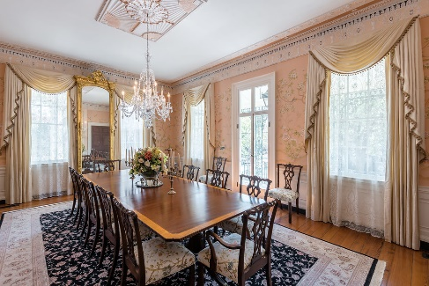
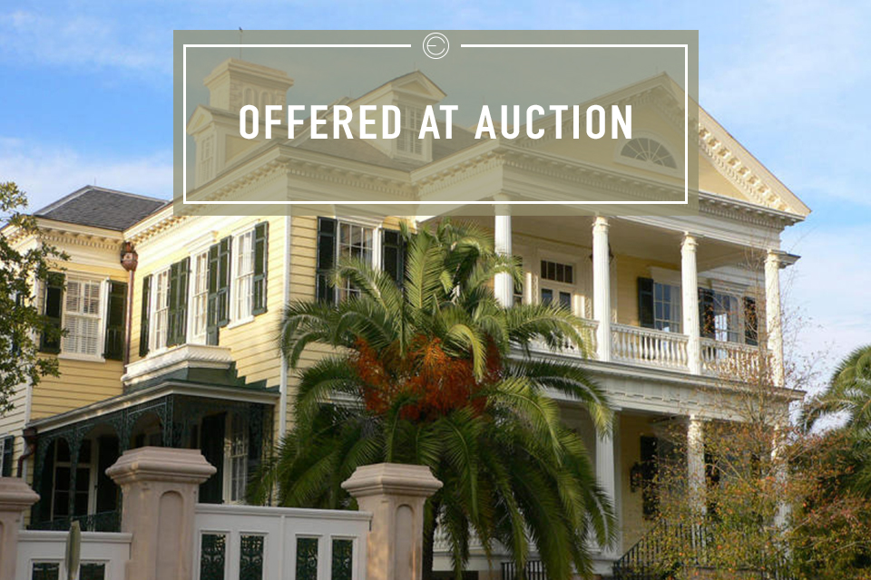
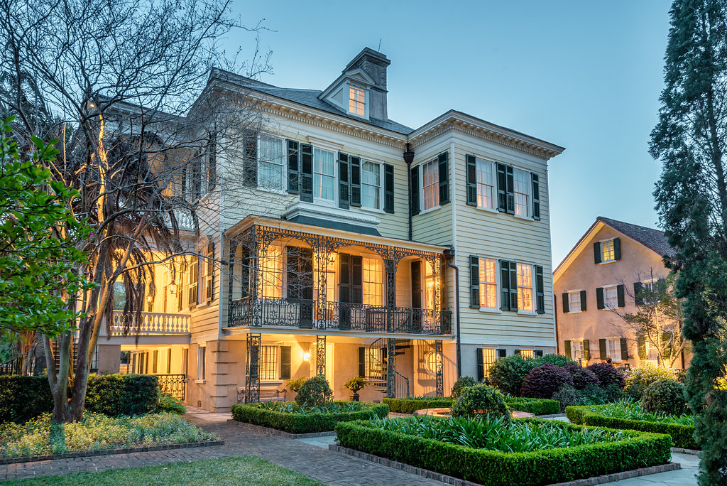
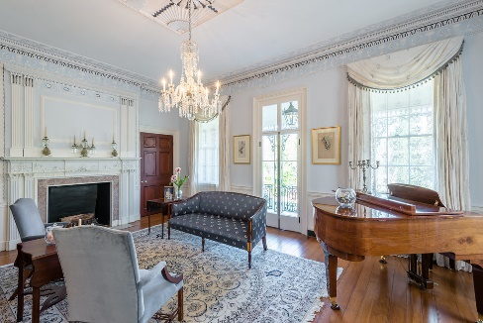
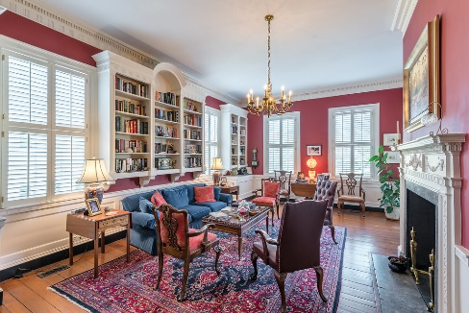
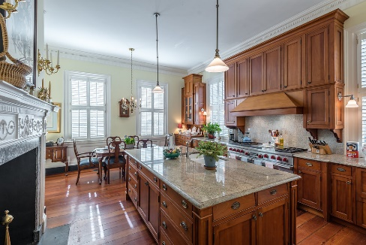
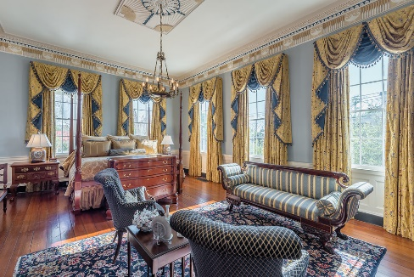
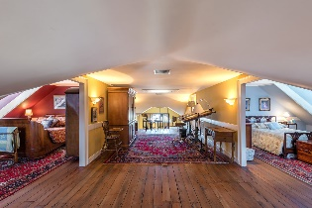
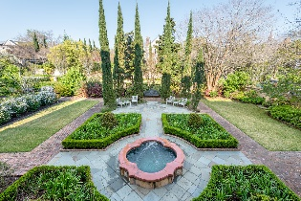
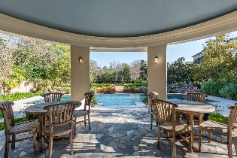
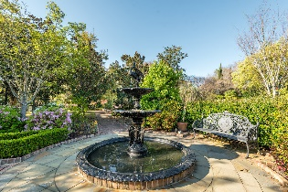

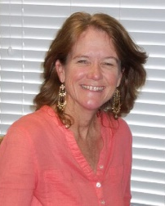
60 MONTAGU STREET CHARLESTON, SC 29401
New Price!
SATURDAY, MAY 5TH AT 11:00A
Welcome home to the Gaillard-Bennett House, Circa 1801.
This home has been meticulously restored in full to its original glory. ”You can’t find another property like this one in Charleston,” states Preservation Architect Glenn Keyes. The Federal-style main house consists of six well-proportioned bedrooms and five and one-half baths. Along with the main house are a restored former kitchen house and carriage house with additional guest quarters and a reconstructed tack house containing all the mechanicals for the property. The 1.25-acre property has expansive gardens, a newly built pool house, salt water gunite pool with infinity edge all beautifully maintained. Walk up the elegant stone double staircase where you are greeted by one of the most outstanding homes in Charleston.
Watch a video, see more photos, and get auction details here:
http://eliteauctions.com/portfolio/gaillard-bennett-house
Saturday, May 5th At 11:00a
SCOTT FOERST
Market Director | Partner
Elite Auctions
404-597-7786
scott@eliteauctions.com
www.eliteauctions.com
ANN EVANS
Realtor
Carolina One Real Estate
843-452-4605
aevans@carolinaone.com
www.charlestonluxuryrealestate.com
Carolina One Real Estate
195 W Coleman Blvd
Mt Pleasant, SC 29464-3495

