Slide 1
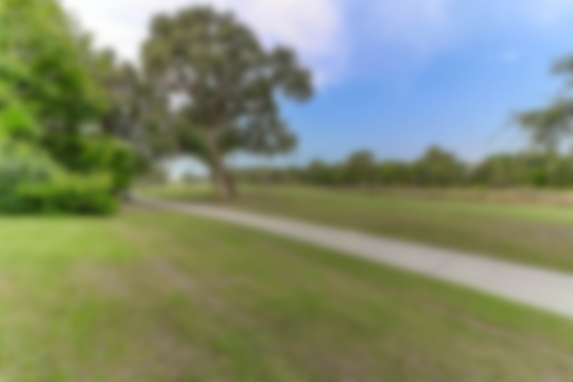
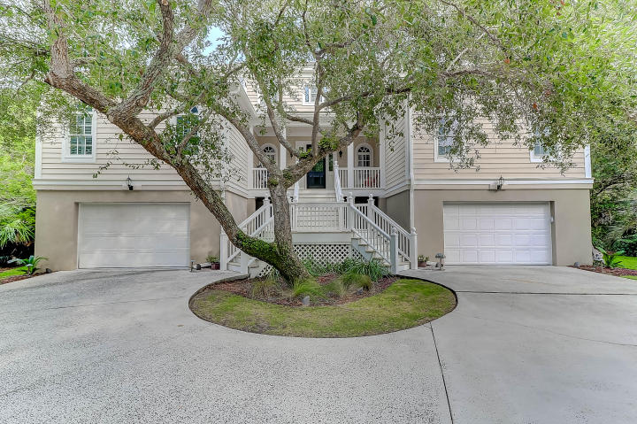
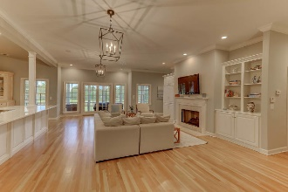
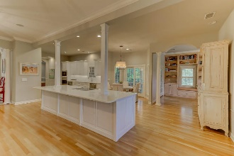
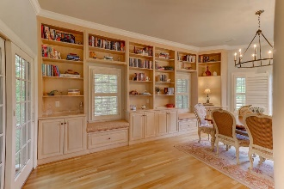
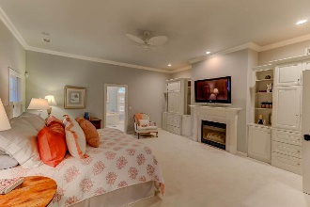
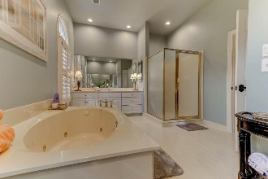
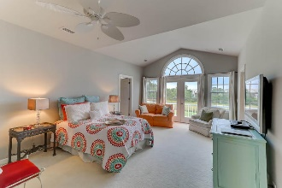
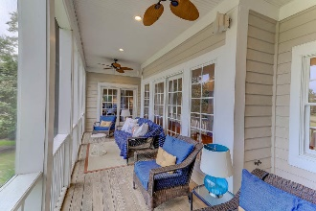
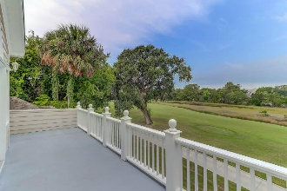


60 Seagrass Lane Isle of Palms, SC 29451 ~ MLS# 17023605 ~ $1,599,000
Wild Dunes Luxury
Enjoy the privacy of this FURNISHED Luxury, well appointed home nestled in a serene Lowcountry setting at the end of a private road which leads off of Seagrass Ln. You will be surrounded by wetlands, beautiful marsh and majestic trees, along with overlooking the 3rd Ladies Tee Box of the Wild Dunes Links golf course, giving you a sense of total seclusion. This house would make a great permanent, secondary or rental investment, as it is being sold furnished for the exception of some specific personal items, furnishings & accessories of the Sellers, please see Documents for Furniture and Furnishings Exclusions. Complimented by recent upfits and renovations, you will enter a grand Foyer with Travertine Tiles flooring, which meet hardwood floors installed throughout the newly renovated. Too many details to mention here. See the listing for complete info.
Wild Dunes offer access to two golf courses, tennis center, three pools, of which one is heated, three great restaurants, lovely hotel, miles and miles of beautiful beaches, two fitness centers, walking/biking trails, children's playground and a Property Owner's Beach House for entertaining, plus an easy walk to the beach.
Linda Laird REALTOR
M (843) 209-7571 | O (843) 886-8110
linda.laird@carolinaoneplus.com | www.lindalaird.com
Leading Real Estate Companies of the World
Carolina One Real Estate
1503 Palm Blvd
Isle of Palms, SC 29451-2280

