Slide 1
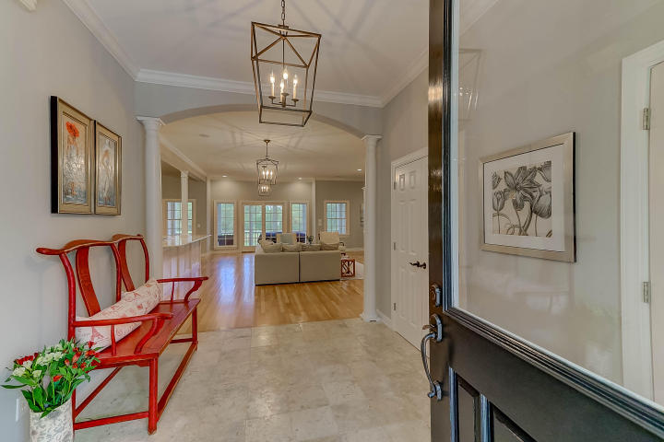
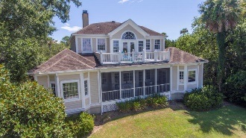
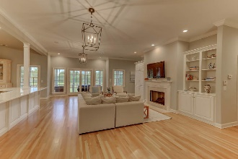
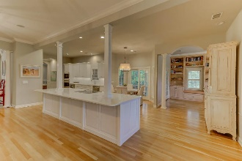
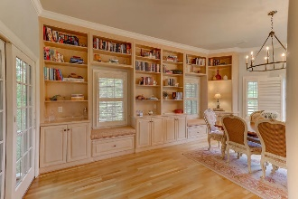
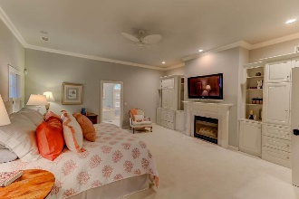
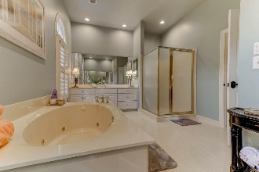
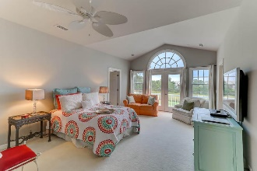
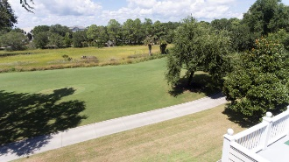

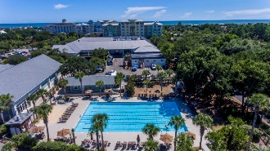

60 Seagrass Lane Isle of Palms, SC 29451 ~ MLS# 17023605 ~ $1,549,000
Adjusted New Purchase Price
Wild Dunes Swim & Social
Membership w/ Acceptable Offer
Enjoy the privacy of this Luxury, well appointed home nestled in a serene Lowcountry setting situate at the end of Seagrass Ln. You will be surrounded by wetlands, beautiful marsh and majestic trees, along with overlooking the 3rd Ladies Tee Box of the Wild Dunes Links Golf Course, giving you a sense of total seclusion.
The heart of the home is the large Great Room with fireplace, custom built-in bookcases on either side. Featuring an exquisite open floor plan, this space allows for fabulous entertaining and family gatherings. The gourmet kitchen has Quartz countertops, custom cabinets, high-end Wolf appliances, wine cooler, hands free Delta faucets and built-in power strips installed in the magnificent kitchen island, along with a neat prep sink...this kitchen is every Chef's dream. A cozy screened porch located just outside the breakfast eating area, is a great place to share an early morning cup of coffee and enjoy the great outdoors. Adjacent to the kitchen you will find a neatly organized utility room, consisting of a Half Bath, Elevator access/egress, large laundry sink, washer/dryer and an oversized pantry.
Across the rear of the home is a second screened porch with exquisite views of the golf course.
Wild Dunes offers access to two golf courses, tennis center, three pools, one is heated, three great restaurants, lovely hotel, miles and miles of beautiful beaches, fitness center, walking/biking trails, children's playground and a Property Owner's Beach House.
This home was built by Phillip Smith, General Contractor, a leading custom home builder throughout Charleston, SC.
Wild Dunes Comm. Assn. Fee - $ 824.00 annually | Beach Assessment Fee - 1,263.00 Paid by Sellers | Wild Dunes Membership Club - Optional
Linda Laird REALTOR
M (843) 209-7571 | O (843) 886-8110
linda.laird@carolinaoneplus.com | www.lindalaird.com
Leading Real Estate Companies of the World
Carolina One Real Estate
1503 Palm Blvd
Isle of Palms, SC 29451-2280

