Slide 1
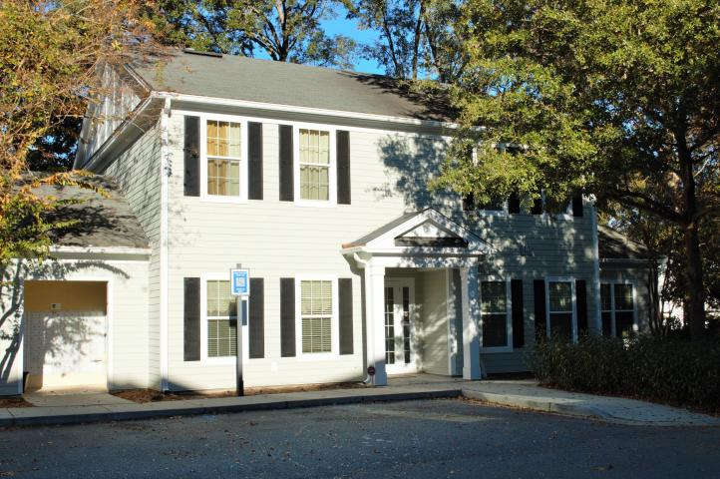
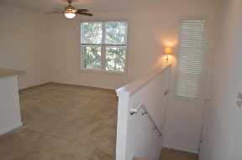
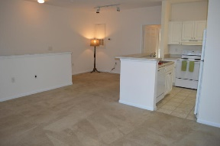
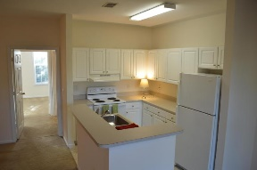
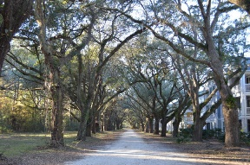
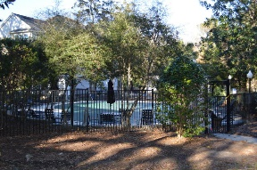
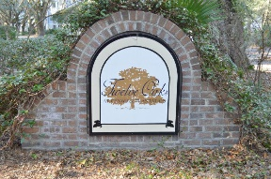


Most Private Condo in Twelve Oaks
60 Fenwick Hall Allee #1021 Twelve Oaks | Johns Island, SC 29455 | MLS# 16031054 | $128,950
This one will go FAST!
Live in the most private building in the entire Twelve Oaks community. Plus, seller is offering a $1200 flooring credit at closing. Located minutes from downtown Charleston. Enjoy the exclusivity of this unit and the many community amenities that it offers.
From the private entry, follow the stairs to an open living space that is situated on the second floor of the building. Large kitchen with an island for extra prep space. Great for entertaining. Large garden tub in bathroom. Master bedroom w/spacious walk-in closet. Utility closet with room for a full w/d. 9' ceilings throughout. Wired for surround sound & a security system.
Enjoy the community pool, jacuzzi, exercise facility, Club House, grilling areas and walking trails. This unique unit is a must-see.
Whitley Boyd
(843) 324-4761
w.boyd@agentowned.com
www.PropertiesofCHS.com
AgentOwned Preferred Group | 824 Johnnie Dodds Blvd | Mt Pleasant, SC 29464

