Slide 1

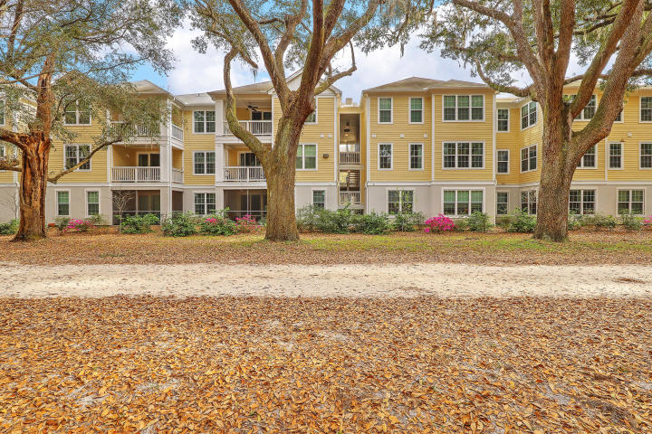
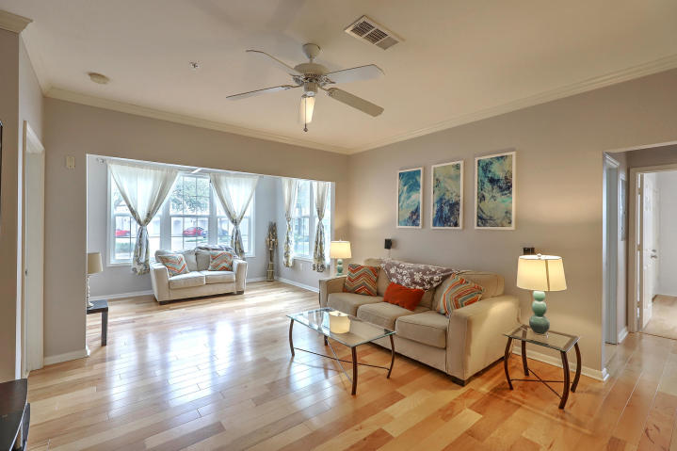
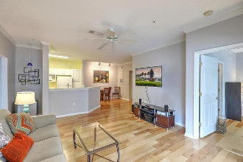
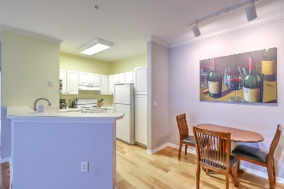
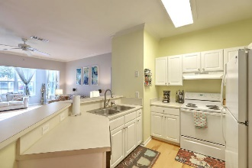
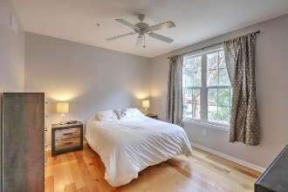
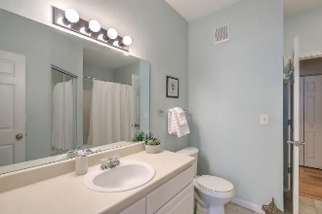
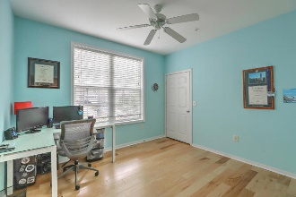
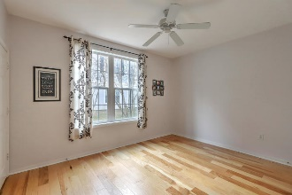
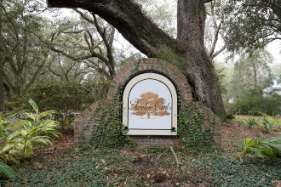
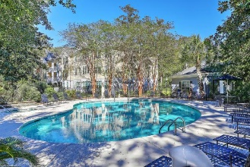



JUST LISTED!! Charming 1st Floor Condo w/GARAGE
Open House Saturday 11-1
60 Fenwick Hall Allee 218
Twelve Oaks | Johns Island, SC 29455 | MLS# 19008186 | $197,000
As soon as you see the majestic canopy of Grand Oaks as you enter Twelve Oaks, you will feel like you found paradise with this 3BR/2B ground floor condo w/1-CAR GARAGE, tucked away in a lush, tranquil setting. This well maintained, spacious unit, just across the Maybank Bridge in Johns Island, is just what your buyers are looking for! Features include**BRAND NEW FLOORING in all bedrooms**Open kitchen to dining, living and sunroom, great for entertaining guests while cooking**Dual Masters on opposite ends of living area both w/lrg walk-in closets as well as 3rd bedroom w/walk-in closet**Wonderful amenities including Clubhouse, BBQ, Gym and Pool, Walking Trails**And you can't beat its centralized location as historic Downtown Charleston, beautiful beaches and shopping are easily accessible!
Some additional, recent upgrades include:
New dishwasher motor
New washing machine motor
New energy efficient windows and siding
New insulation on front facing walls
New USB outlets in bedroom and living room
Make this home yours today!
Desiree Maurer
Office - (843) 416-2000
Mobile - (843) 327-9010
desiree.maurer1@gmail.com
www.yourcharlestonhousesearch.com
Keller Williams Realty
496 Bramson Ct Ste 200
Mt. Pleasant, SC 29464

